Slide 1
Last Two Decades: A Glance
1

Slide 2
Sixth Chair – Larry Davis
Term 1999- 2012
Longest tenure as a chair
Brought about many changes

Slide 3
Faculty Count and Majors

Slide 4
Computer Science Instruction Center
Opened in Fall 2002
Well Equipped classrooms
Large Lecture Hall
Some Office space

Slide 5
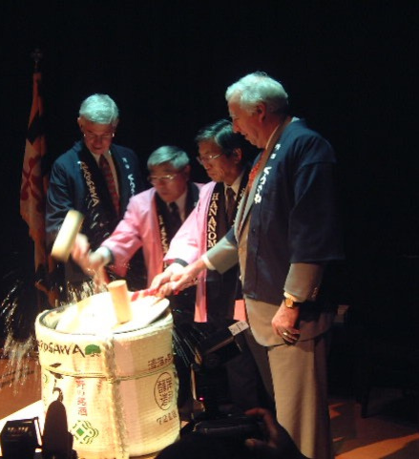
FUJITSU RESEARCH LAB AND THE MIND LAB
In 2001, Fujitsu established its east coast research lab in College Park and established a close collaboration with the MIND Lab, started by Ashok Agrawala and Jim Hendler.

Slide 6
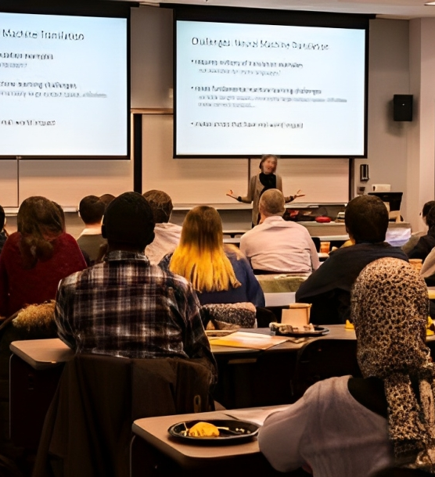
SIGNIFICANT CHANGES TO GRADUATE COURSES
In 2004, graduate coursework rules were revised. Students had to take seven 600-800 level courses spanning at least 5 areas, with a maximum of 2 from one area. They needed a minimum of 5 A's with the remainder being B's. Eligible courses were faculty-certified, primarily lecture-based with exams, and excluded seminars.

Slide 7
Augmentarium
The Augmentarium is a revolutionary virtual and augmented reality (VR and AR) facility that brings together a unique assembly of projection displays, augmented reality visors, GPU clusters, human vision and human-computer interaction technologies, to study and facilitate visual augmentation of human intelligence and amplify situational awareness

Slide 8
MAXWell LAB
The only WiMax Forum Application Lab in the Western Hemisphere. The Lab was founded as a partnership between the University of Maryland Institute for Advanced Computer Studies and the Laboratory for Telecommunications Science. The theme for the lab was research into WiMAX technology, applications and location–based services.

Slide 9
Seventh Chair Samir Khuller
Term – 2013 – 2018
40th Anniversary Celebration
Iribe Center

Slide 10
Challenge
Rapid Increase in Majors
Faculty Counts ??

Slide 11
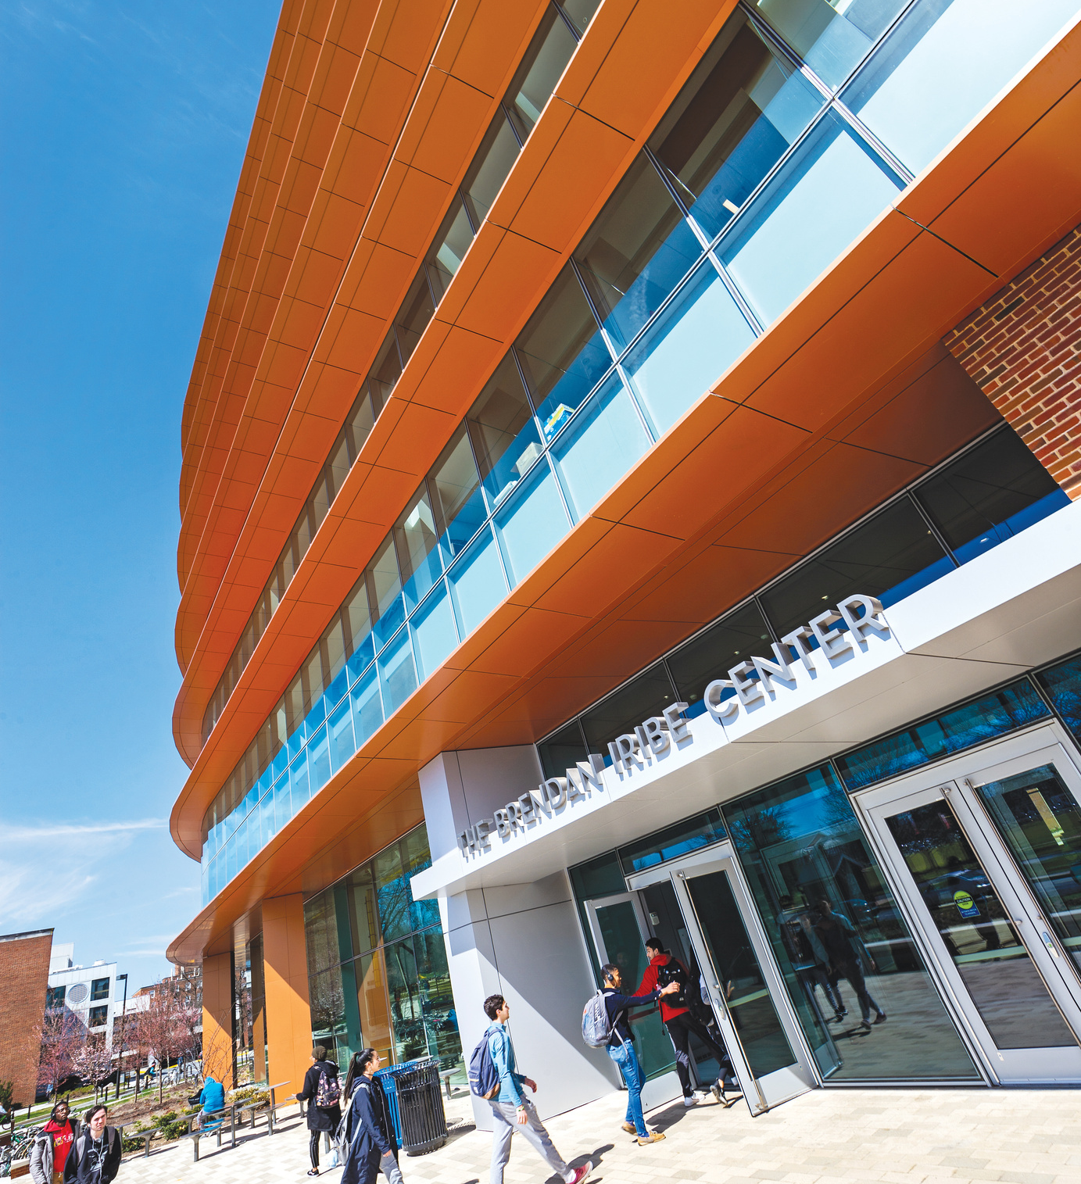
THE BRENDAN IRIBE CENTER
Opened in April 2019, the Brendan Iribe Center is a 215,000-square-foot facility costing $152 million, built over three years. It was funded by Brendan Iribe and other contributors and includes classrooms, offices, specialized labs, a makerspace, cafe, outdoor area, and a 298-seat auditorium.

Slide 12
Eighth Chair Ming Lin
Term – Jan 2018 – July 2020
Large Undergraduate Program
Raised funding for multiple chairs and labs
Top TEN in CS ranking
Moved from AVW to Iribe Center

Slide 13
Majors vs. Faculty counts
Challenging times

Slide 14
Ninth Chair – Matthias Zwicker
Term – July 2021 -

Slide 15
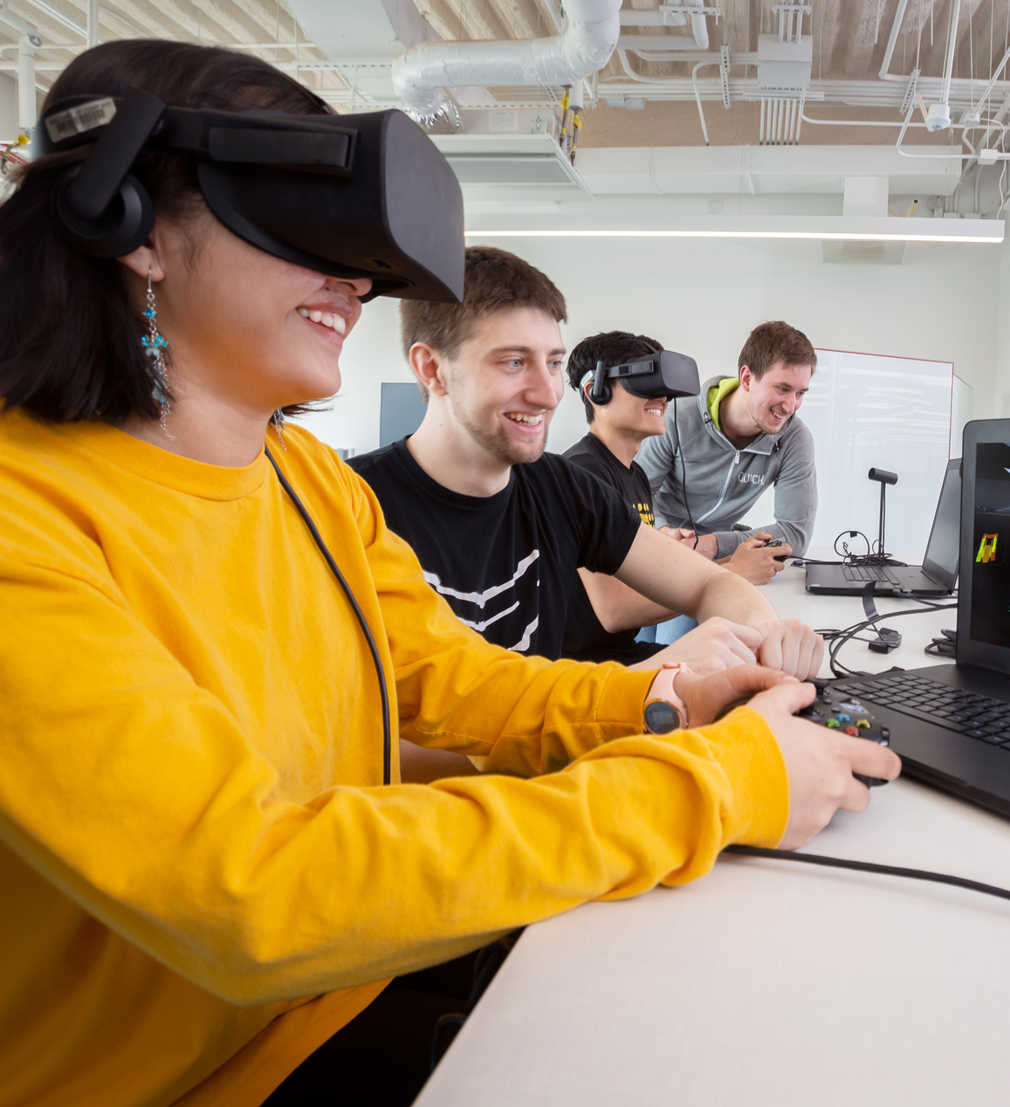
UNDERGRAD SPECIALIZATIONS
UMD's Department of Computer Science has consistently modernized its undergraduate offerings, introducing Cybersecurity in 2013, Data Science in 2016, Machine Learning in 2020, and Quantum Information in 2022. These additions emphasize the department's commitment to equipping students for specialized roles in evolving tech fields.

Slide 16
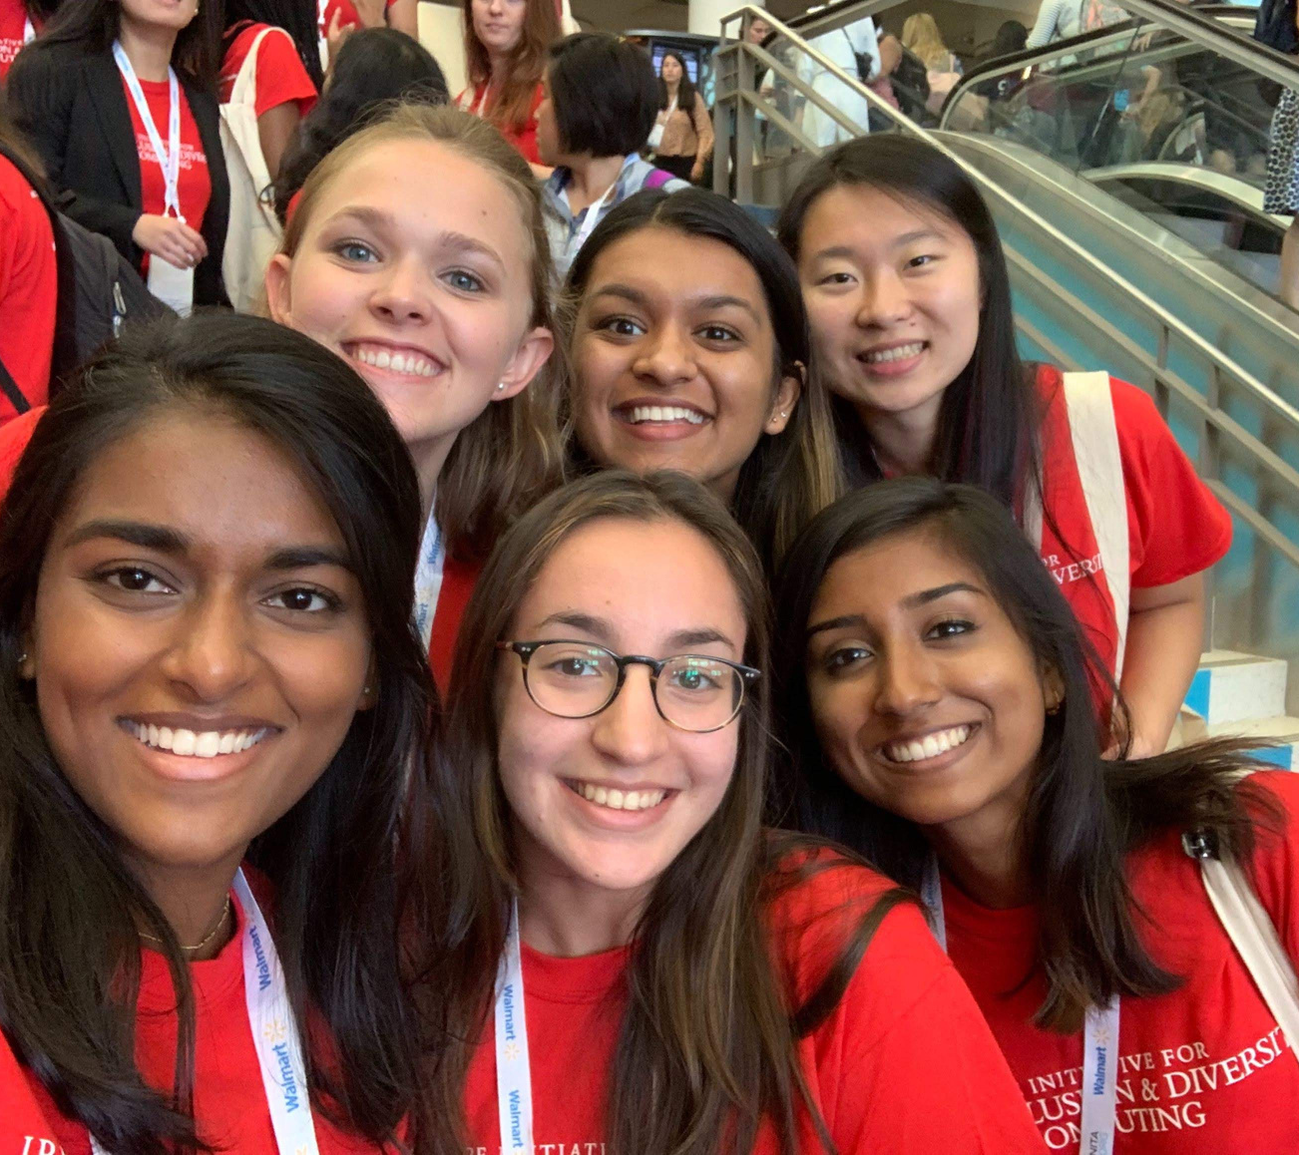
THE MARYLAND CENTER FOR WOMEN IN COMPUTING
In 2014, the Department initiated the Maryland Center for Women in Computing (MCWIC) to enhance diversity in computing, specifically for women. MCWIC combines research, education, outreach, and partnerships to bolster a community supporting women in computing.

Slide 17
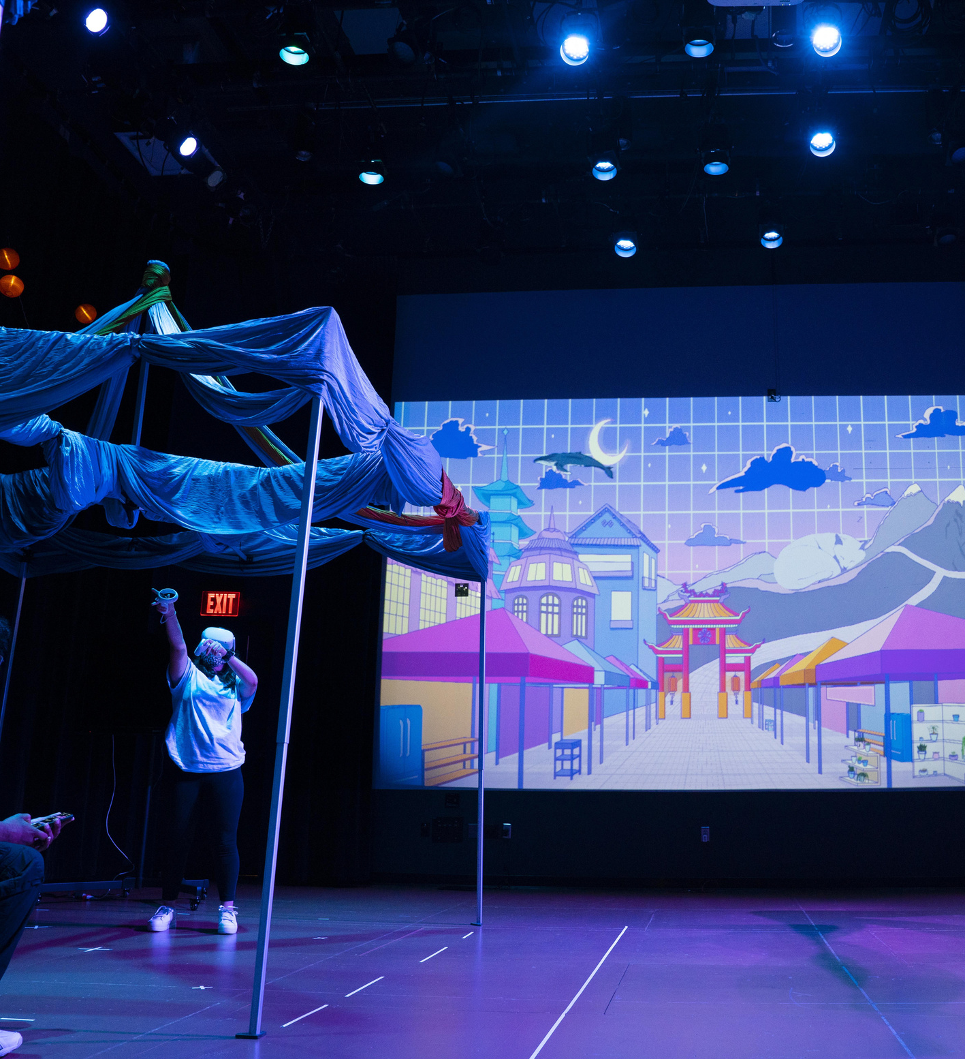
ESTABLISHMENT OF THE IMMERSIVE MEDIA DESIGN PROGRAM
Launched in 2020, the University of Maryland’s Immersive Media Design (IMD) Program combines art with computer science, led by experts in virtual reality and human-computer interaction. By Fall 2023, it’s graduating its first class, filled its faculty roles, has 110 majors, expanded its summer incubator program, and continues to refine its labs and curriculum.

Slide 18
INSTITUTE FOR ROBUST QUANTUM SIMULATION
In 2021, the NSF-backed Quantum Leap Challenge Institute for Robust Quantum Simulation was founded, concentrating on verified quantum simulations, environmental factor-focused quantum simulations, and scalable simulations for scientific and tech progress.

Slide 19
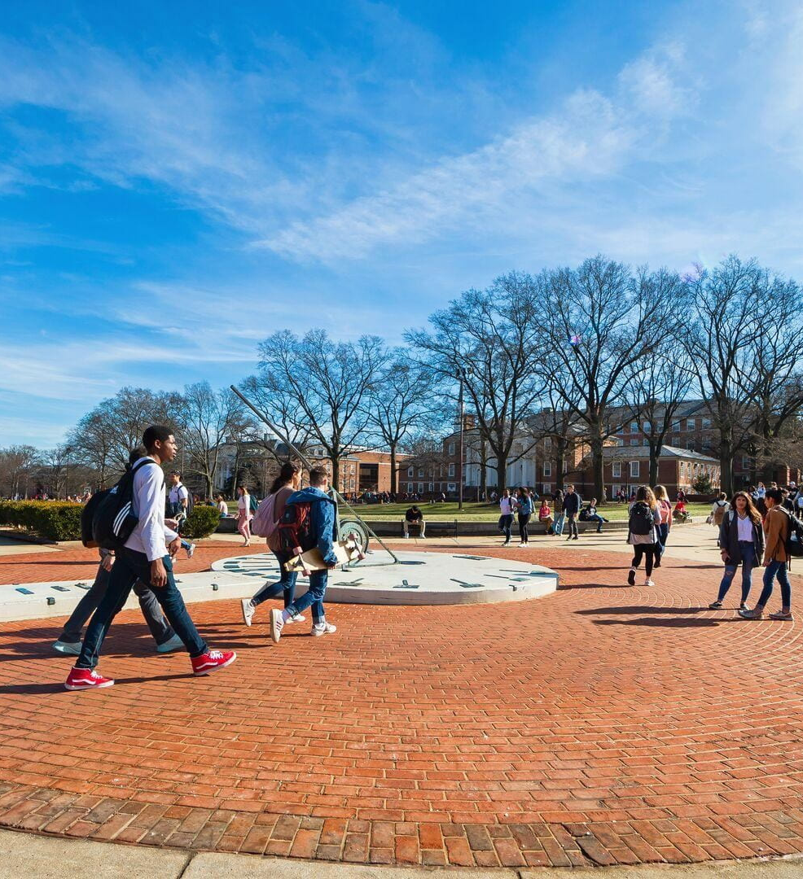
DATA SCIENCE MINOR PROGRAM
In May 2022, the Departments of Computer Science and Mathematics launched the Data Science Minor Program, providing in-depth training in scientific methods, algorithms, and data interpretation. Students undergo core DATA courses covering computer science, mathematics, statistics, ethics, and data science best practices.

Slide 20
TRUSTWORTHY AI WITH TRAILS
Established in 2023, TRAILS, is backed by a $20 million grant from the NSF and the National Institute of Standards and Technology. It is a partnership between the University of Maryland, George Washington University, and Morgan State University, and aims to steer AI towards ethics, human rights, and insights from marginalized communities beyond just technological innovation.

Slide 21
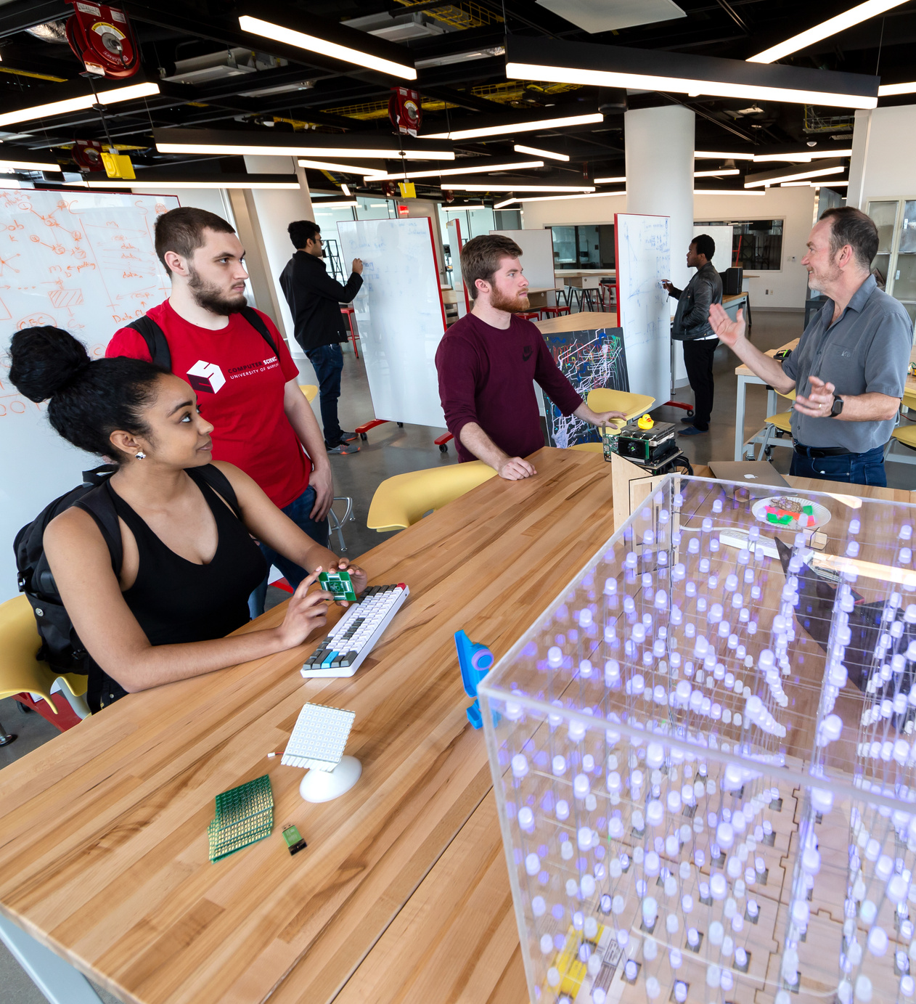
DEVOTED TO EXCELLENCE
As of 2023, the University of Maryland's Computer Science Department, with over 3,700 undergraduates, 437 graduate students, and 60+ faculty, boasts 10 top student programs, a 10,000-strong alumni network, and over $30 million in research funding. U.S. News & World Report ranks us 9th in the nation's best public undergraduate programs.

Slide 22
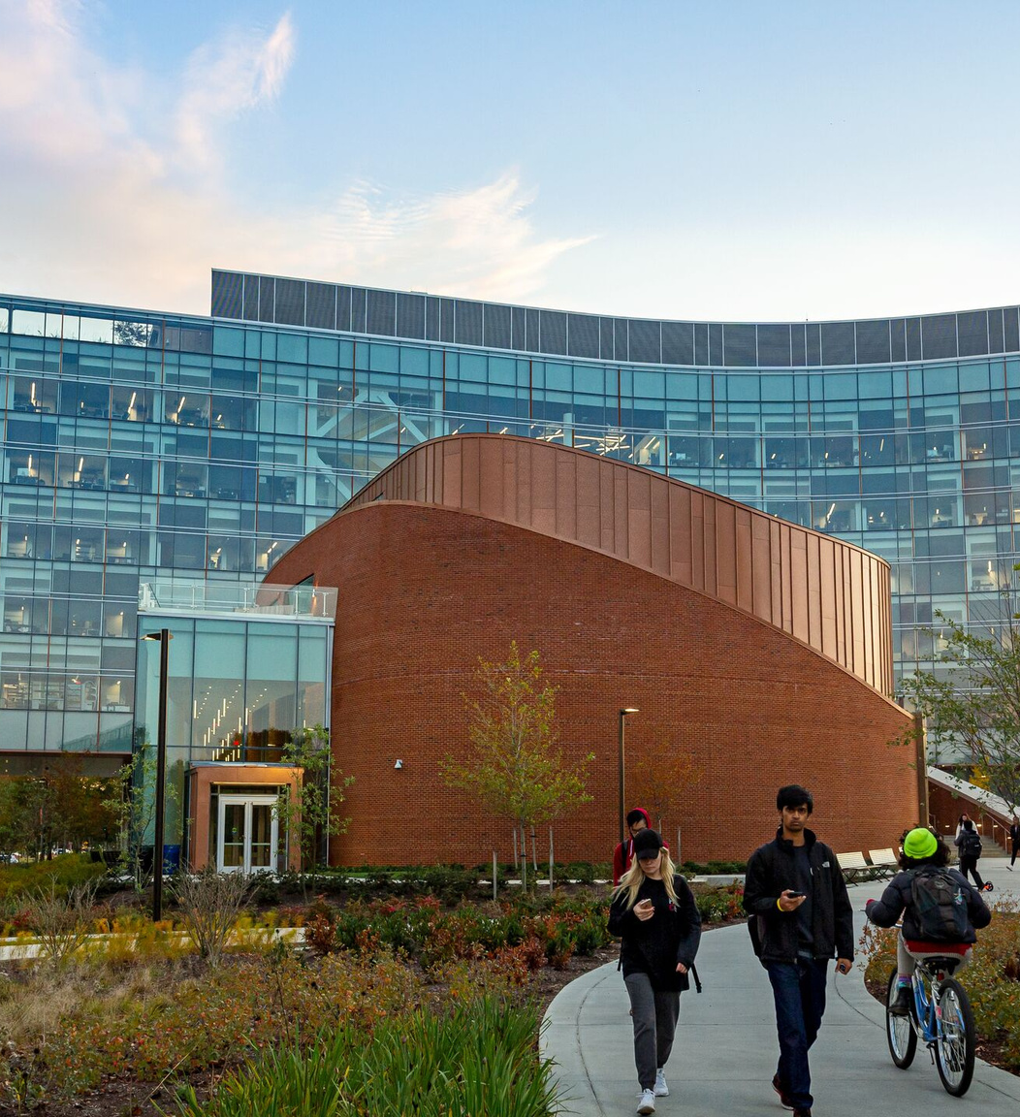
RESEARCH AREAS
The Department is at the forefront of technology and computational studies, researching areas such as:
• Internet-of-Things and Wearable Technology
• Machine Learning and Data Science
• Natural Language
Processing
• Programming Languages
and Software Engineering
• Quantum Computing
• Systems and Networking
• Human-Computer Interaction
• Information Retrieval and Geographic Information Systems
• Algorithms and Theory
• Artificial Intelligence and
Robotics
• Bioinformatics and Computational Biology
• Computer Vision and
Machine Perception
• Cybersecurity and
Cryptography
• Databases and Big Data
• Graphics, Visualization, and Virtual/Augmented Reality
• High-Performance and
Scientific Computing

Slide 23
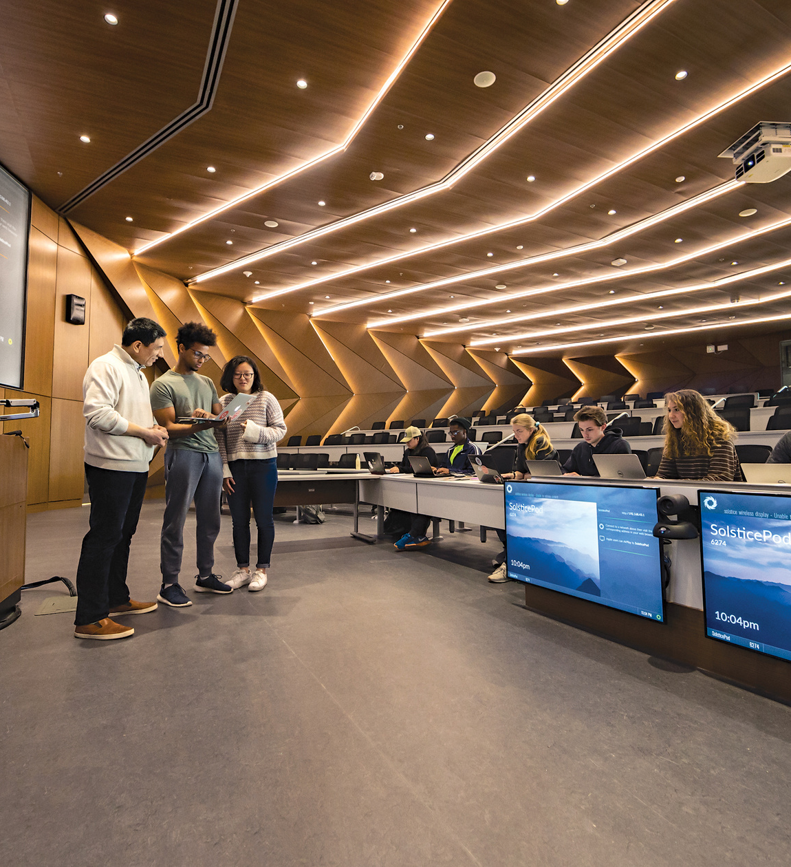
Research Centers
The Department is distinguished by its diverse research domains and its prominent Research Centers, each pioneering advancements in their fields.
• Institute for Systems Research
• Institute for Trustworthy AI in Law & Society
• Joint Center for Quantum Information and Computer Science
• Maryland Cybersecurity Center
• University of Maryland Institute for Advanced Computer Studies
• Center for Bioinformatics and Computational Biology
• Center for Automation Research
• Center for Machine Learning
• Computational Linguistics and Information Processing at Maryland
• Human-Computer Interaction Laboratory

Slide 24
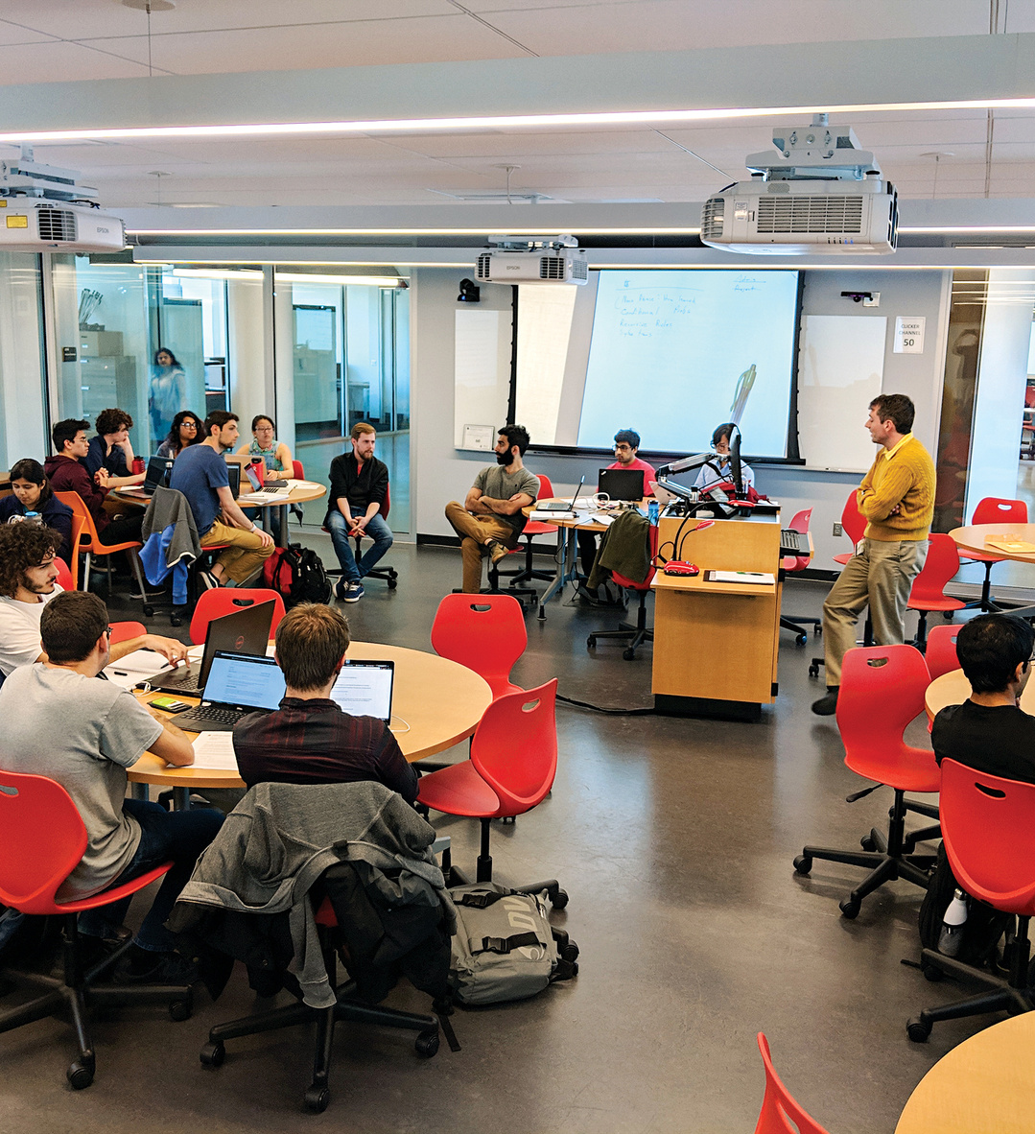
Faculty and Faculty Awards
The Department boasts a diverse faculty consisting of 63 tenured/tenure-track, 25 research/instructional, and 49 affiliate/adjunct faculty members. The faculty's distinction is evident through their fellowships as well:
21 in ACM,
18 in IEEE,
10 in AAAS,
7 in AAAI, and
3 in SIAM

Slide 25
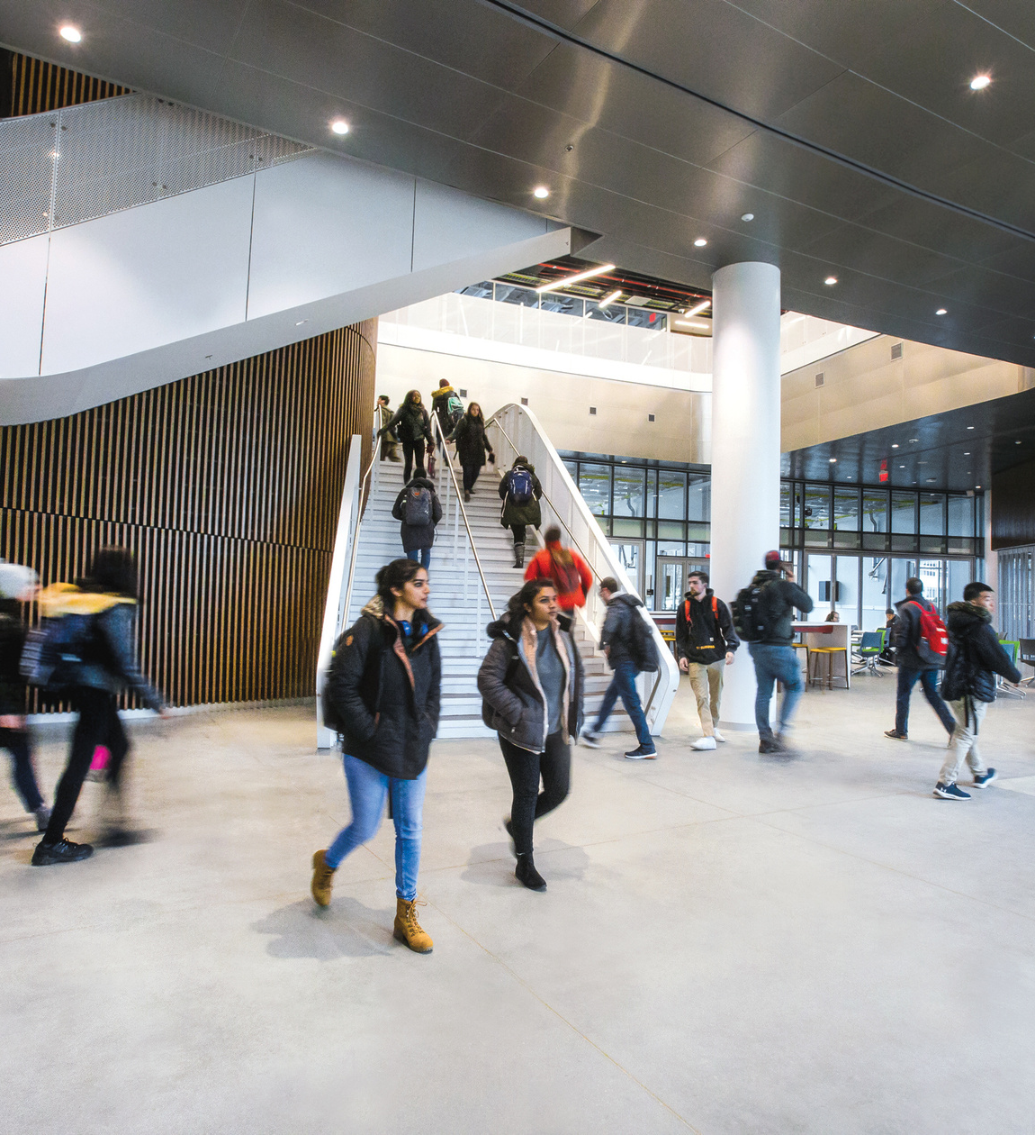
Student Programs
The Department also emphasizes student development through programs such as the Iribe Initiative for Inclusion and Diversity in Computing, the Mokhtarzada Hatchery for budding entrepreneurs, and their active participation in the ACM International Collegiate Programming Contest. Additionally, students are enriched by the Advanced Cybersecurity Experience for Students (ACES) and partake in Bitcamp and Technica Hackathons.

Slide 26
Enrollment Growth (Total)
Source: Campus Statistics

Slide 27
Faculty
Source: Campus Statistics

Slide 28
Contributions
From 2013 to 2023
Contributed
$ 2.5 Billion to GDP by undergraduates alone
$ 1.3 Billion to the economy of the area
Alumni
Over 10,000 BS
Over 1000 PhD
At Present
Largest Undergraduate Major
About 11% of UGs

