Slide 1

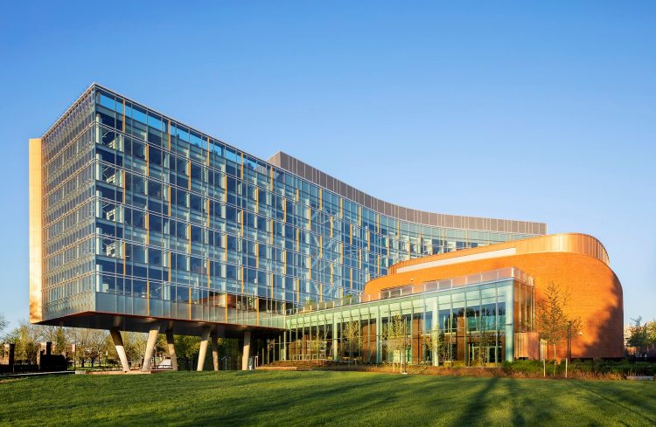
Computer Science at the University of Maryland
Part 1 - The latter part of the 20th Century

Slide 2
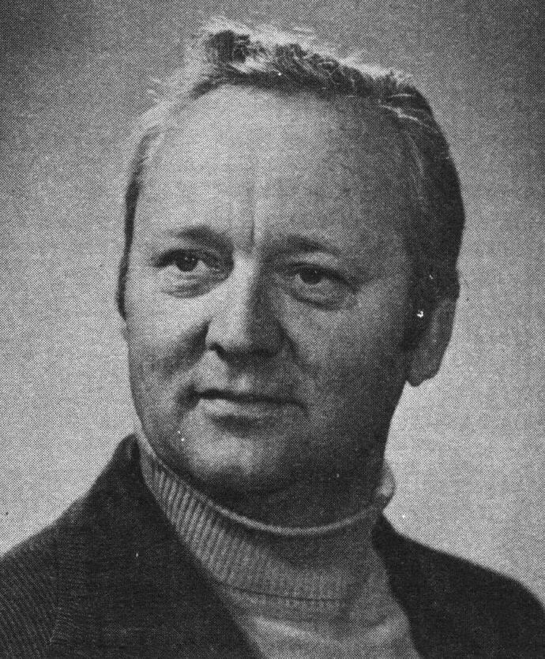
Dr. Werner Rheinboldt appointed director of the Computer Science Center in 1963
Six courses introduced in 1965. An MS degree was introduced in 1967 and a PhD program added in 1969

Slide 3
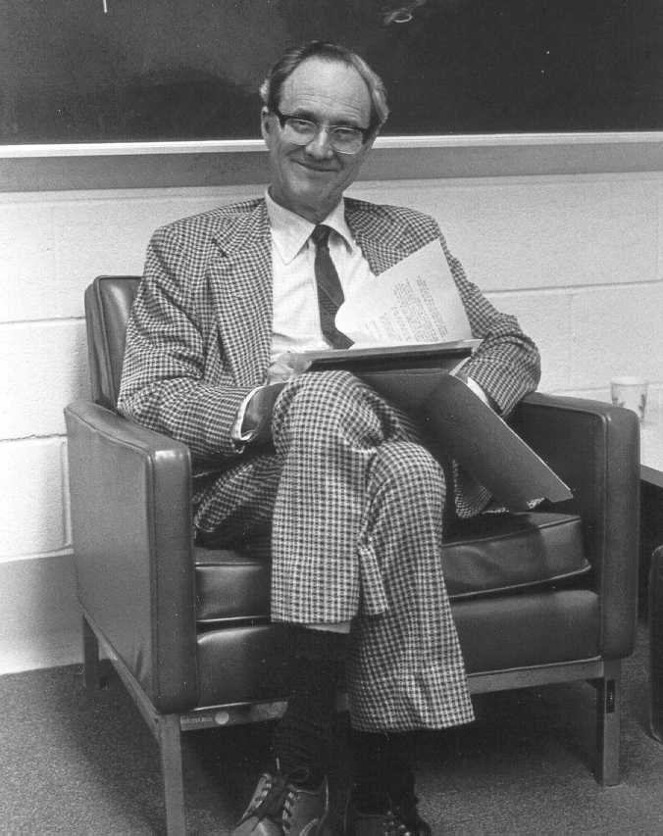
Rheinboldt resigned as director and Dr. William Atchison became director when PhD Program started.
In most universities a computer science program was often added as part of a mathematics or engineering department – depending upon the interests of the faculty.
Maryland was unique in that the computer science education component was added to the computer center – not an academic department

Slide 4
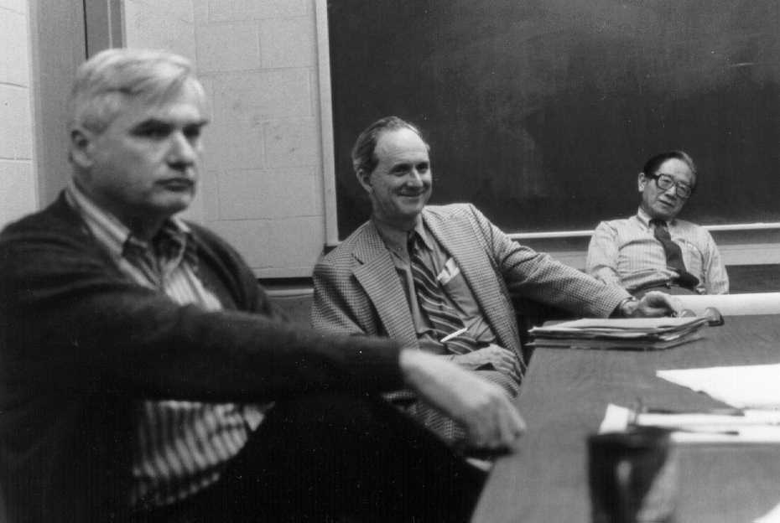
Professors Dick Austing, Bill Atchison and Yaohan Chu

Slide 5
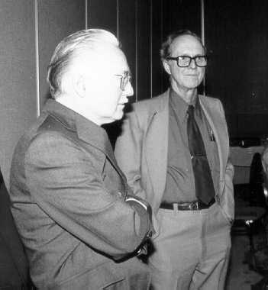
Professors Harold
Edmundson and
Bill Atchison

Slide 6
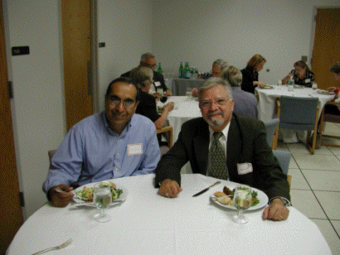
Professors Ashok Agrawala and Vic Basili

Slide 7
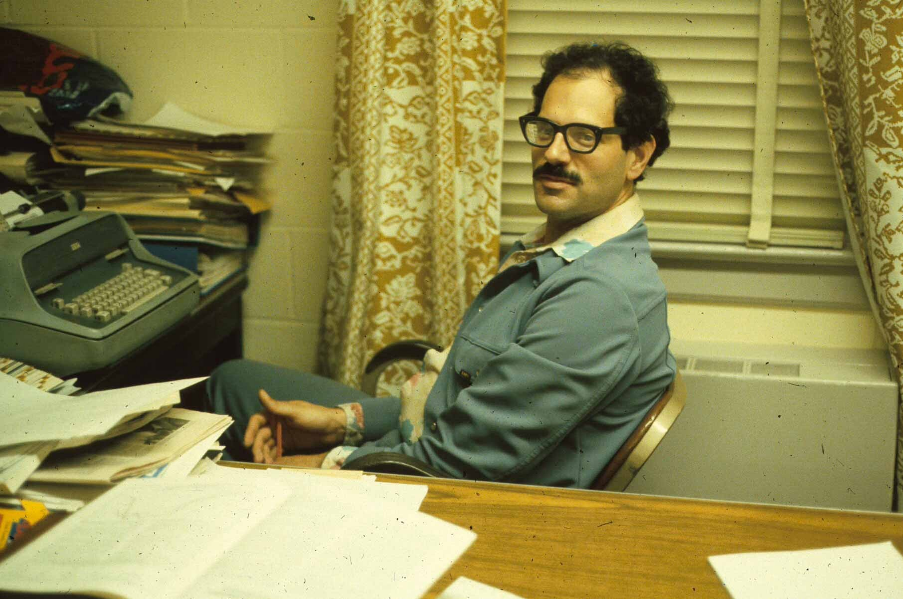
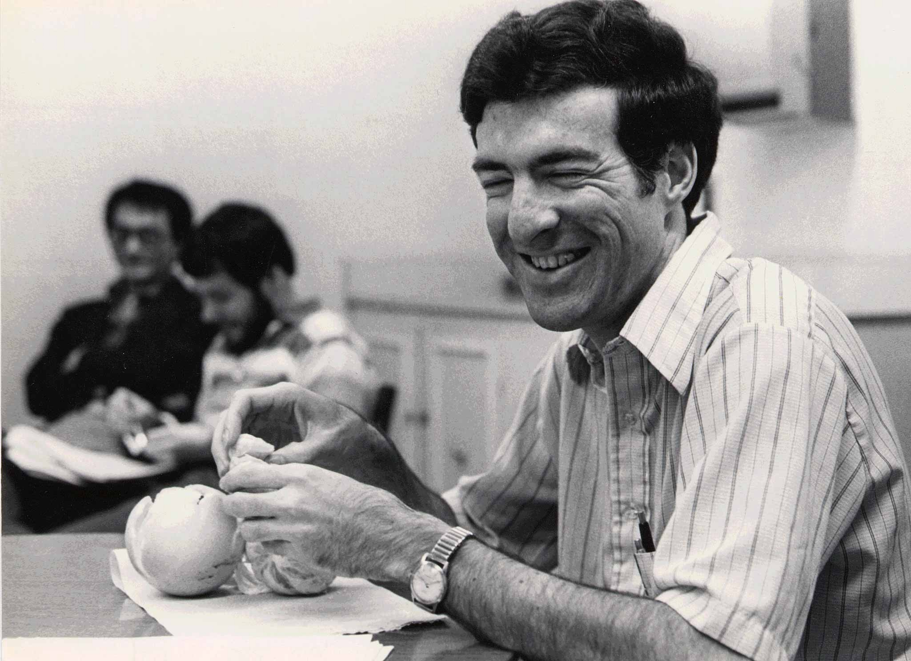
Professor Hanan Samet
Professor Marv
Zelkowitz

Slide 8
In the early 1970s demand for computer science courses increased and there was a demand for an undergraduate major in CS
A CS Undergraduate degree was added in 1973, with the educational component moving from the Computer Science Center to a department within the Math, Physics, and Engineering division (MPSE)
Engineering moved to their own division and “MPS” renamed CMPS (Computer, Math, and Physical Sciences) – giving CS some recognition as the largest major in the college

Slide 9
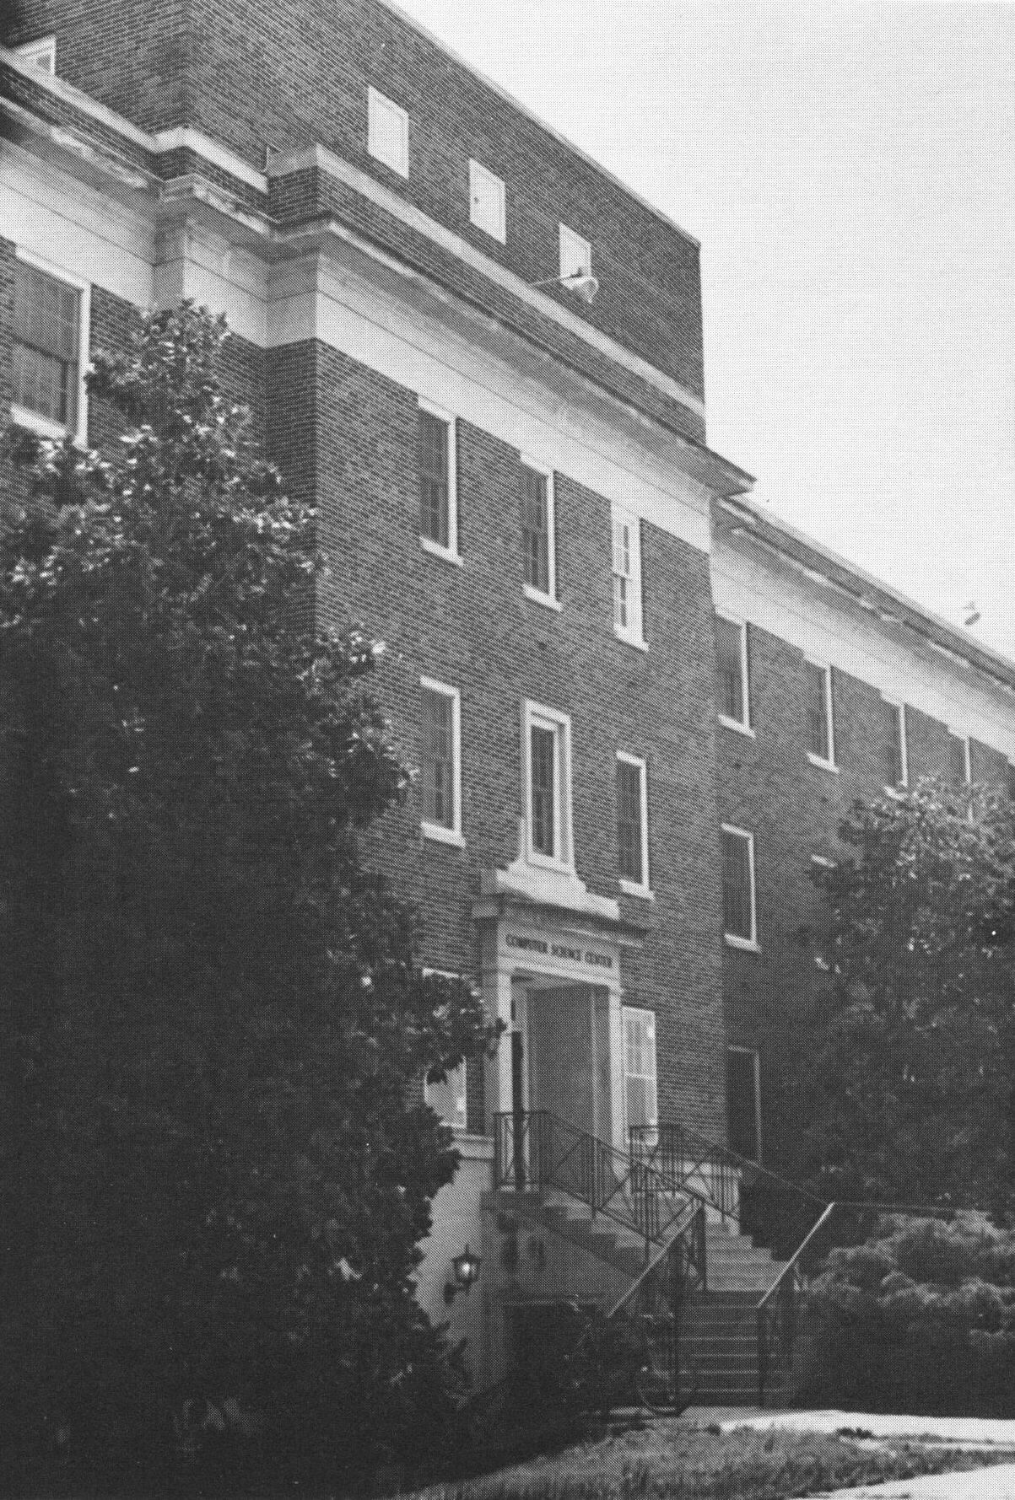
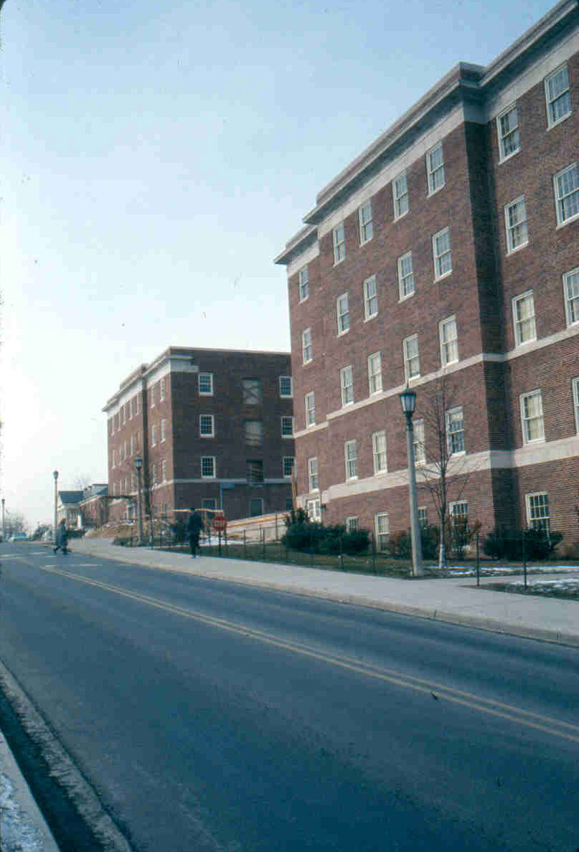
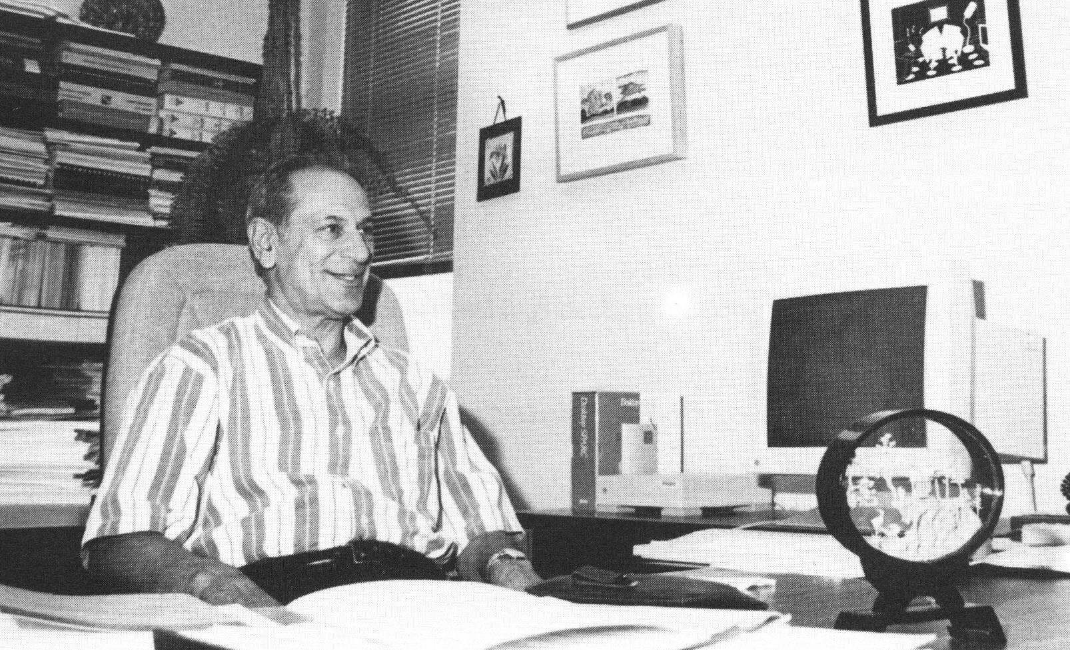
Home of the Computer Science Department from 1973 until 1987
Computer Science’s first permanent
chair – Jack Minker

Slide 10
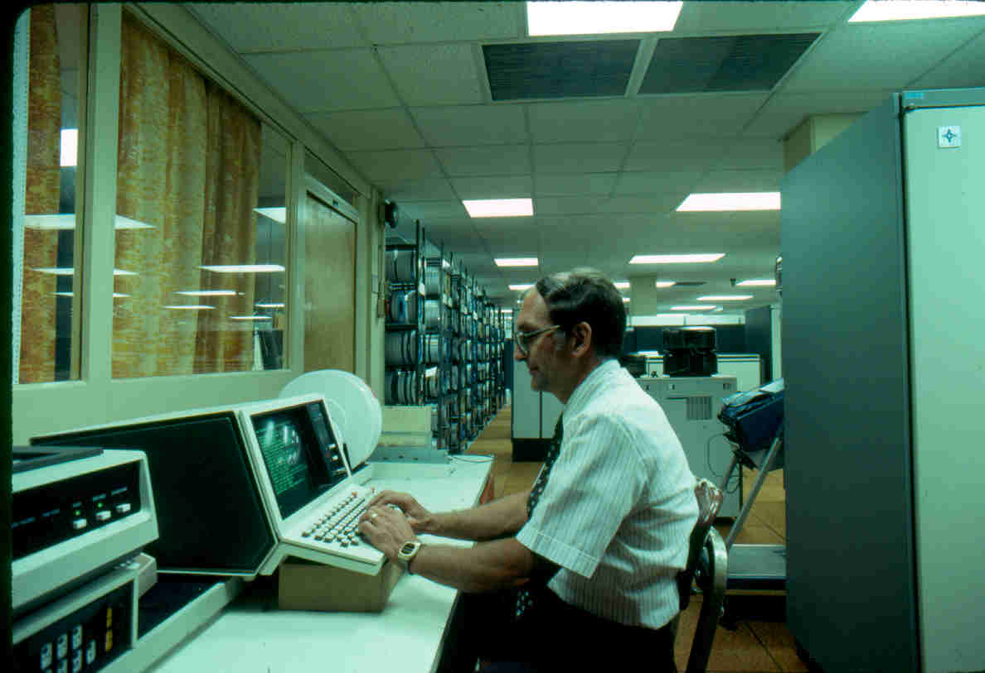
Univac 1108 mainframe in Computer Science Center was main computer for the campus. This was an early time-sharing system
Punched cards were used for program input with students handing in card decks with their program and getting output often hours or a day later.
Notice racks of ½” tapes. Each held about 50MB (at 1600bpi).
Today a $400 PC with a 500 GB disk can contain the storage for 10,000 such tapes.

Slide 11
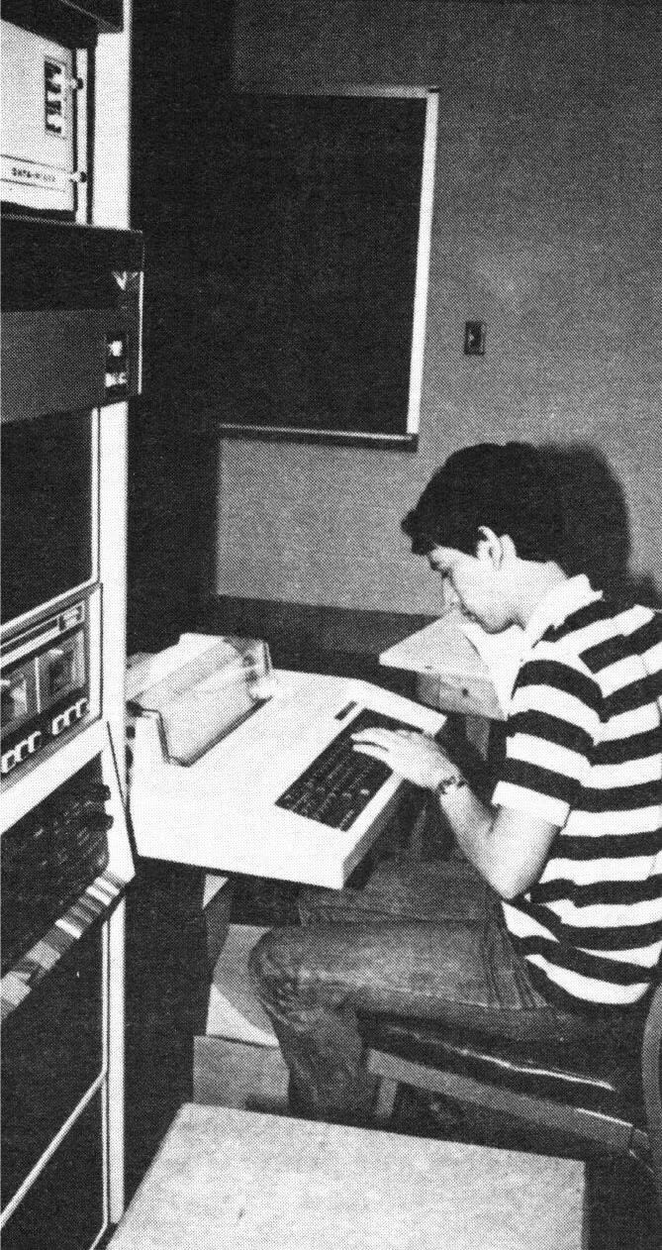
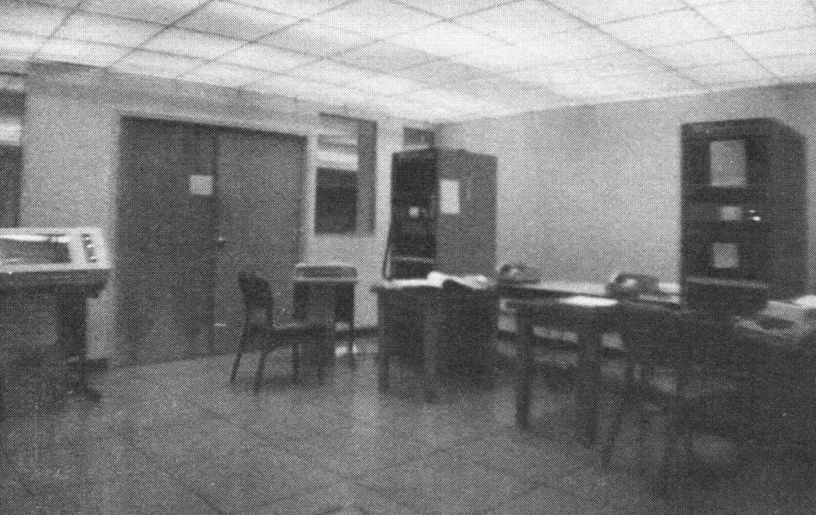
Dr. Laveen Kanal obtained the first minicomputer for Computer Science’s use- PDP 11/45
Department lab with
PDP 11/45 and PDP 11/40
in 1976

Slide 12
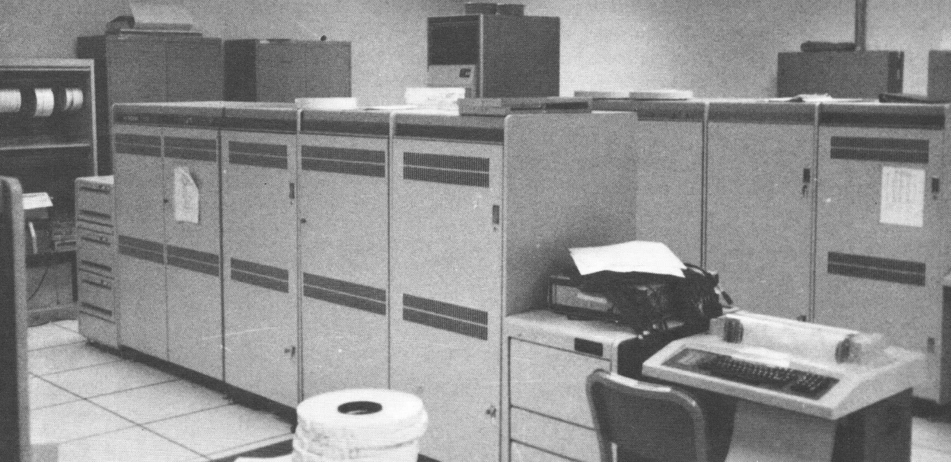
In 1980 Minker secured a $150,000 NSF grant for a VAX 11/780, which provided a powerful computer for department research
University provided computer support for student use.
Increasingly the department provided its own computers for research purposes

Slide 13
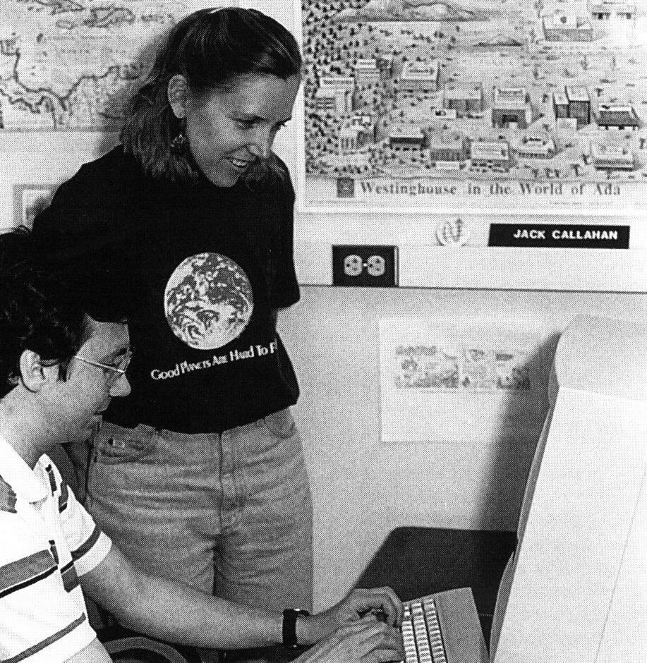
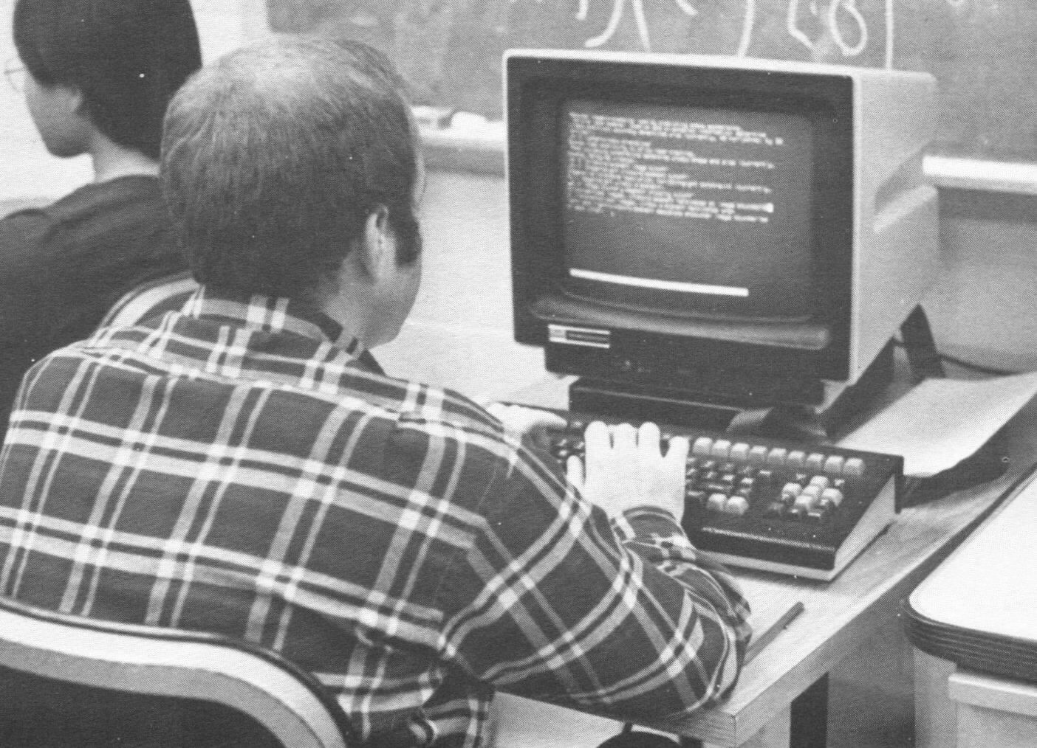
Green screen “Ann Arbor” text terminals were the main interface to the department mainframe Vax 780 in the early 1980s
PhD students JoAnn
Atlee and Jack Callahan
in 1991. Sun workstations
Replaced the Vaxes in
the late 1980s

Slide 14
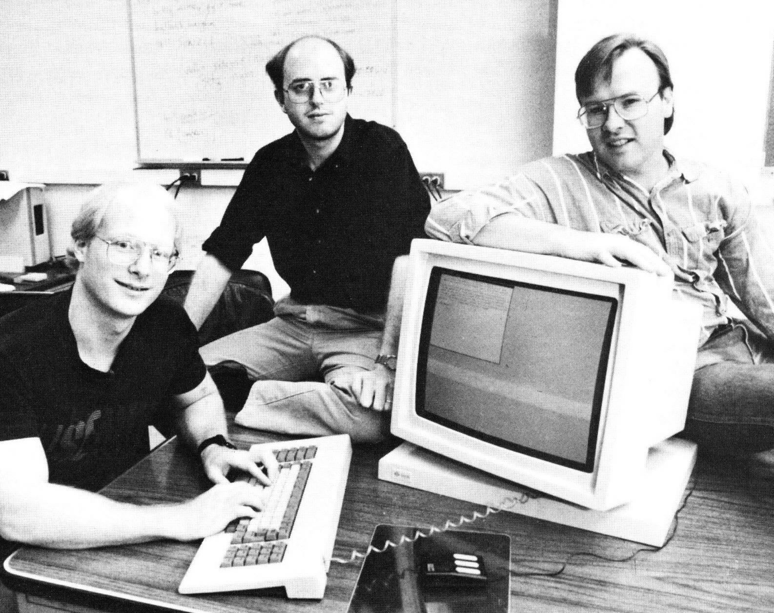
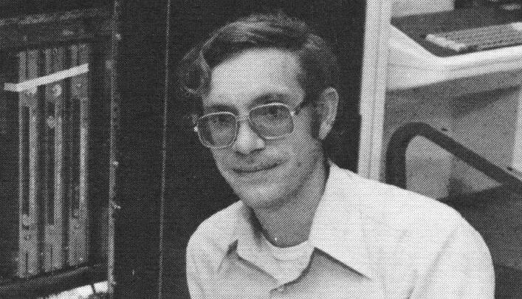
Late 1980s Lab
Staff –
Chris Torek,
Steve Miller,
Pete Cottrell
Steve Kogge, when he
wasn’t scuba diving, handled
hardware issues in the lab.

Slide 15
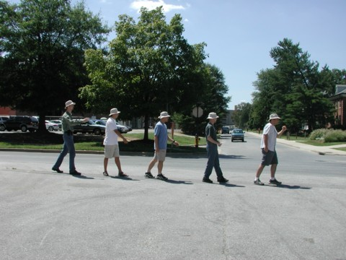
Department computer staff

Slide 16
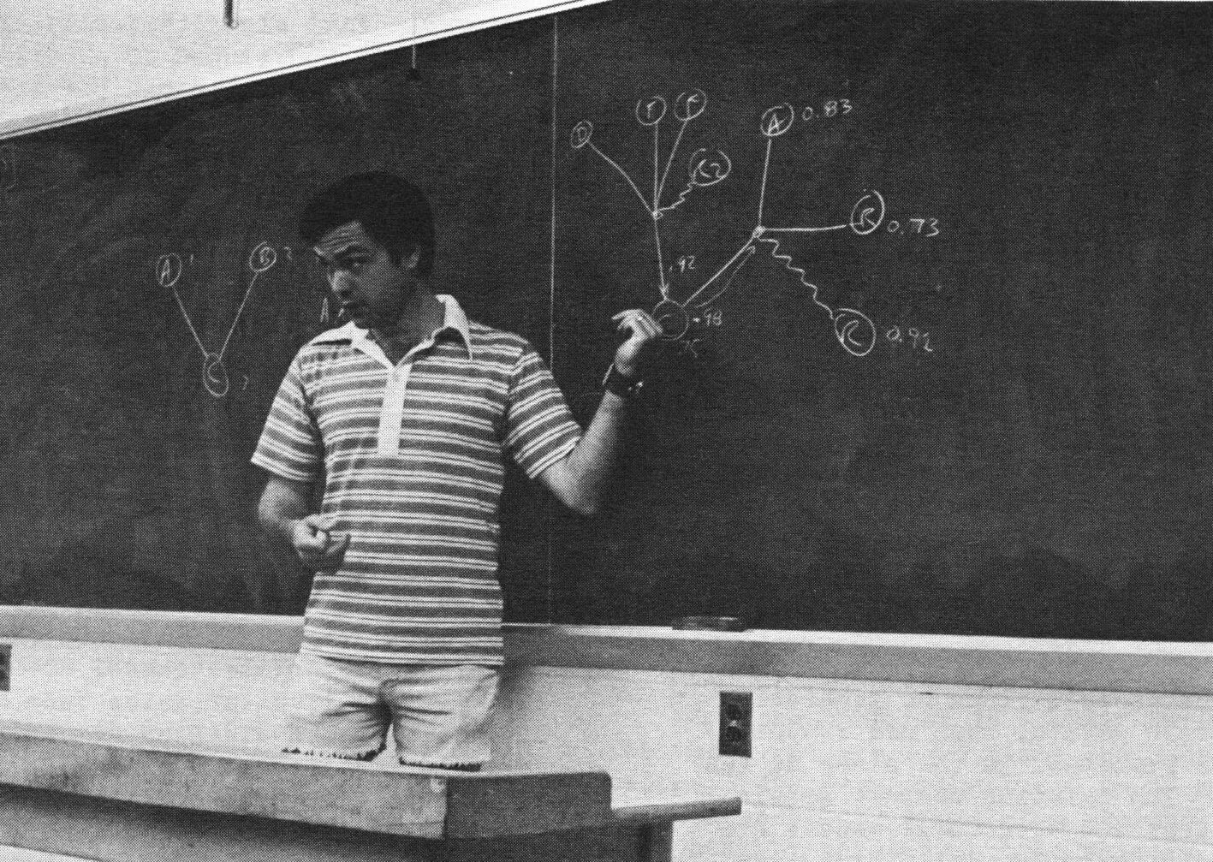
1980s were busy with networking research and new multiprocessor architectures.
Zmob: Professor Chuck Rieger designed a network of 256 Z80A processors. Each contained 64K memory and were linked together on a “conveyor belt” ring as packets of information were passed from one processor (or “moblet”) to another.

Slide 17
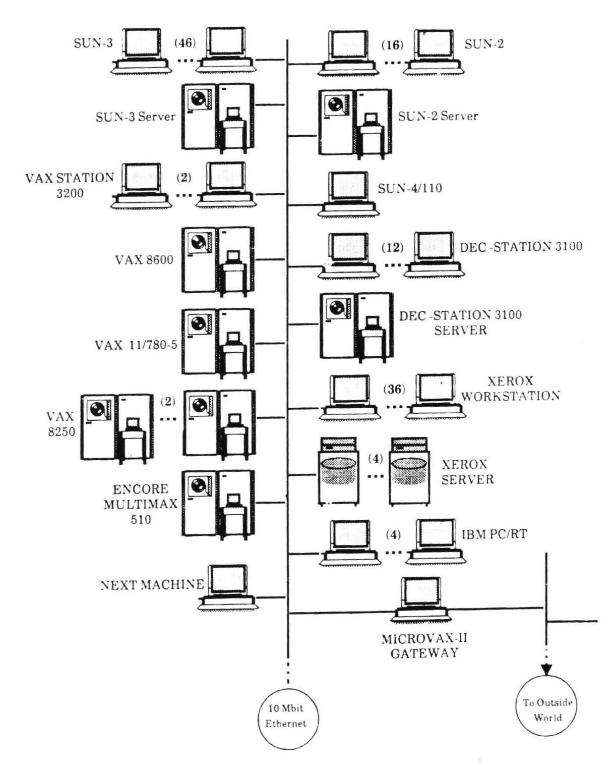
Department computer Network in 1989
Hybrid network of multiple vaxes, DEC workstations and Sun workstations, plus a few other machines
In late 1980s PCs running Linux or Windows started to replace the Suns.

Slide 18
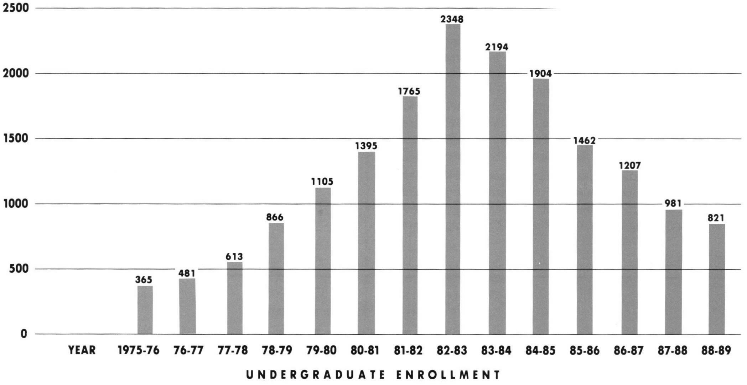
Department’s early growth with little increase in faculty size required computer science to be a restricted major in 1983
Freshmen admitted as premajors and after taking freshman courses with certain grade point averages, they were admitted to the major
Initially 3.0 needed, then it dropped to 2.8. After about 10 years, the restricted major was dropped

Slide 19
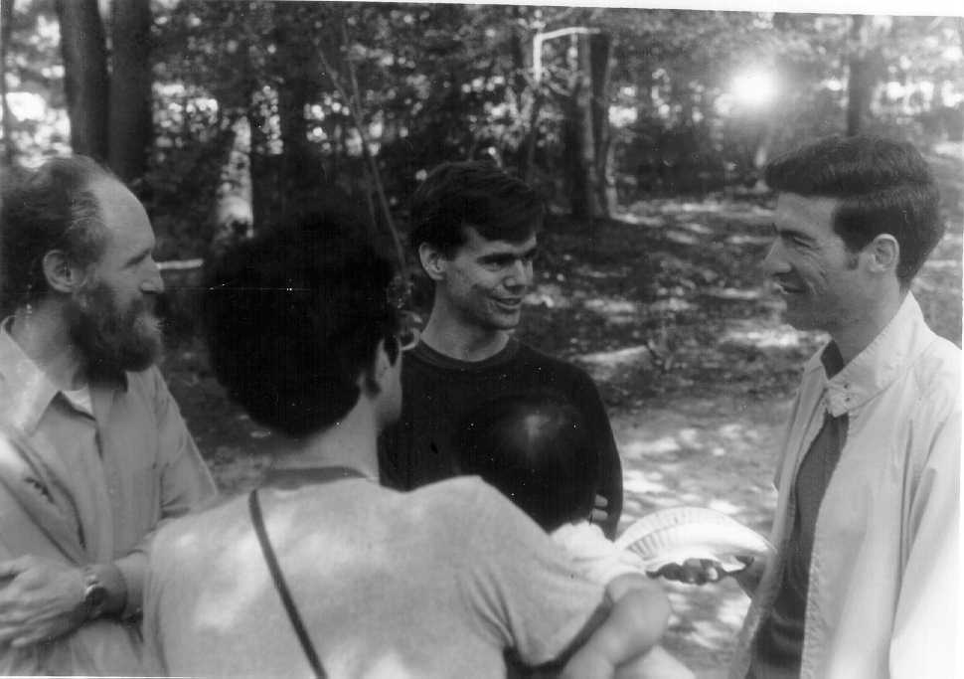
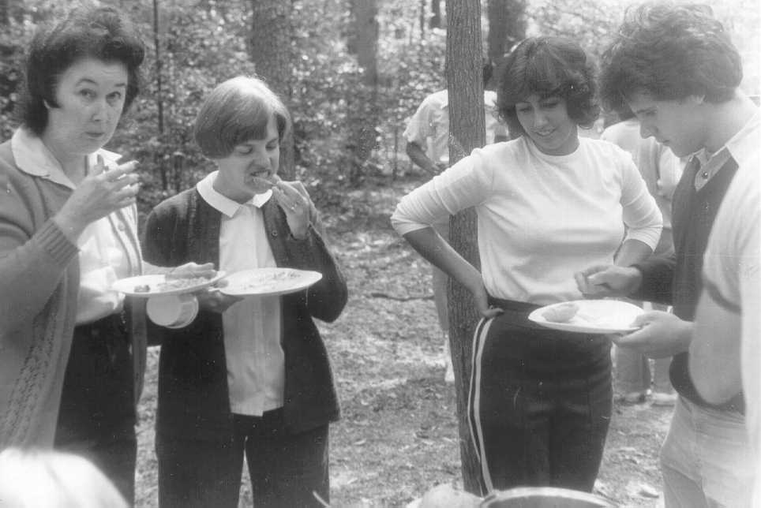
Department was not overly social, but did have a few events
Department Picnic - 1978
Department secretary
Barbara Ellis
Professors
Dick Hamlet,
Marv Zelkowitz
(daughter Elena),
John Gannon,
Hanan Samet

Slide 20
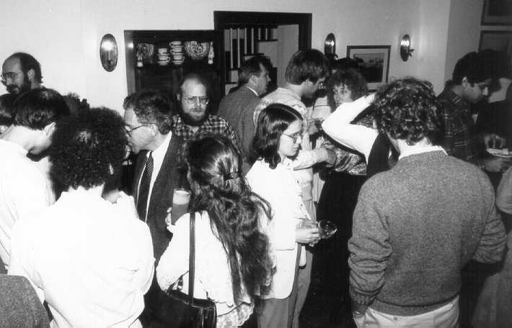
Department party (around 1986)

Slide 21
Department Chairs
  Computer Science Center
    Werner Rheinboldt: 1963-1965
    William Atchison: 1965-1973
  Computer Science Department
    William Atchison (Acting Chair): 1973
    Jack Minker: 1974-1979
    Ray Yeh: 1979-1981
    Dick Austing (Acting Chair): 1981-1982
    Vic Basili: 1982-1988
    Satish Tripathi: 1988-1995
    John Gannon: 1995-1999
    Larry Davis: 1999--

Slide 22
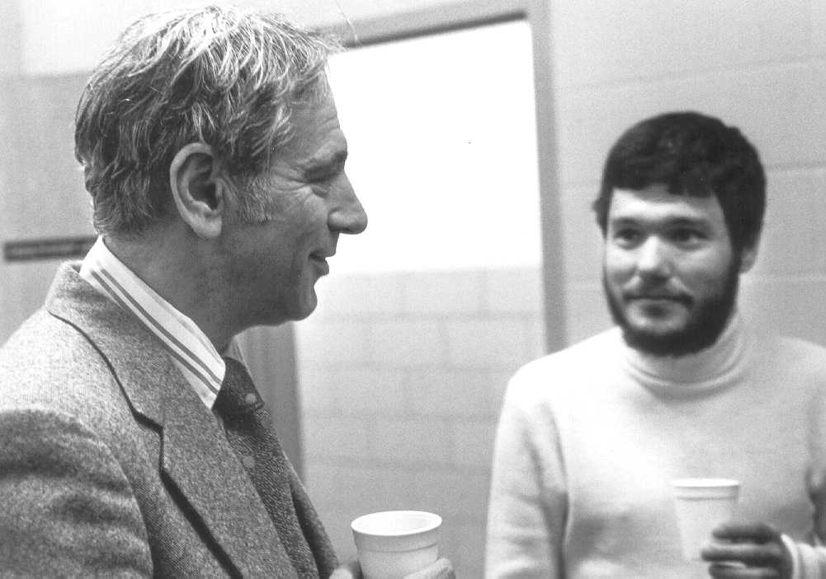
Professors Jack Minker and Dana Nau

Slide 23
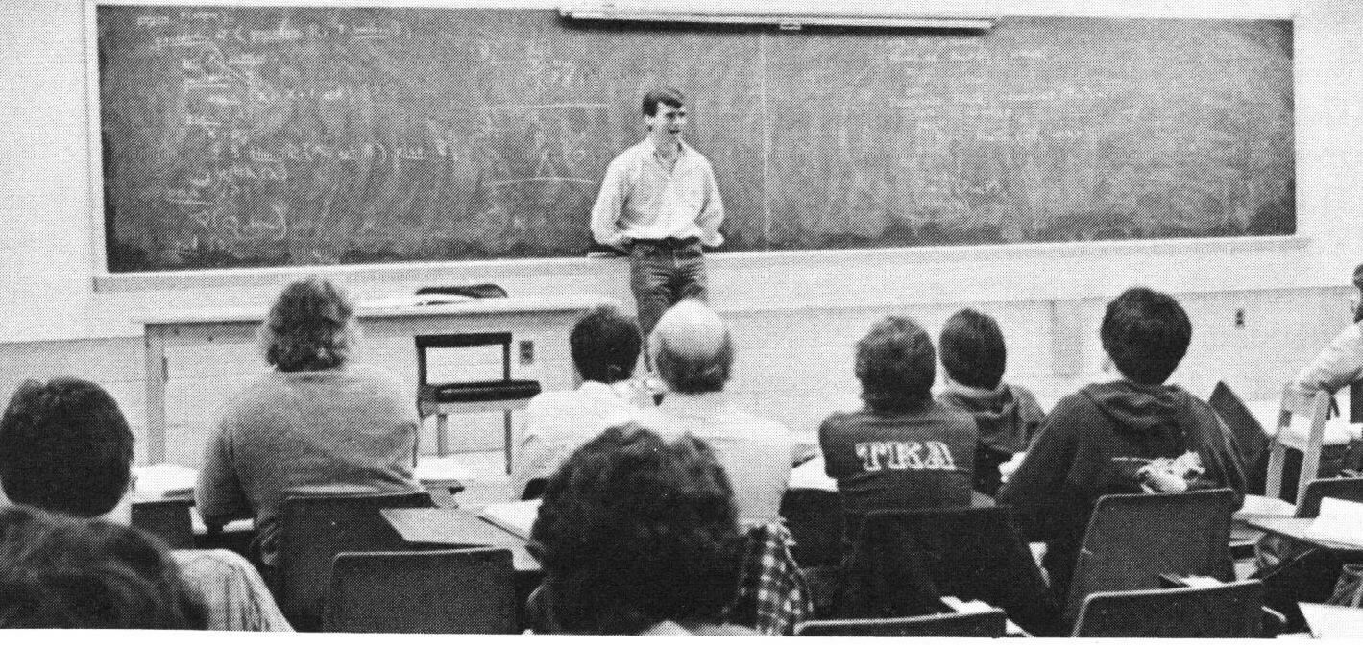
The days using overhead projectors and
transparencies, before PowerPoint and white boards
(Professor Gannon around 1976)

Slide 24
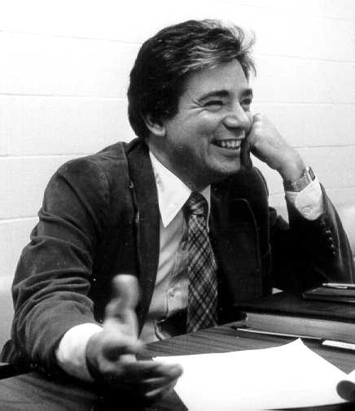
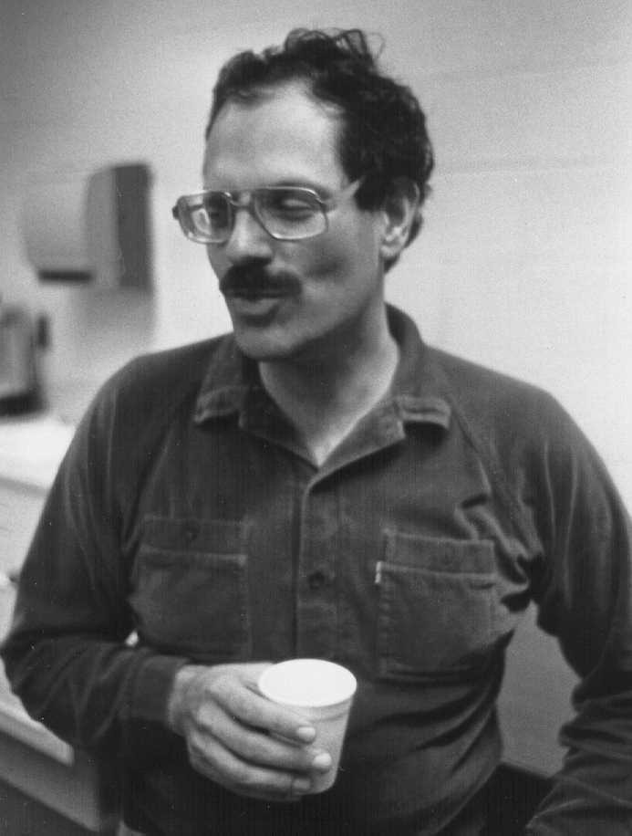
Early software engineering
collaboration between Professors
Vic Basili and Marv Zelkowitz
in 1970s.

Slide 25
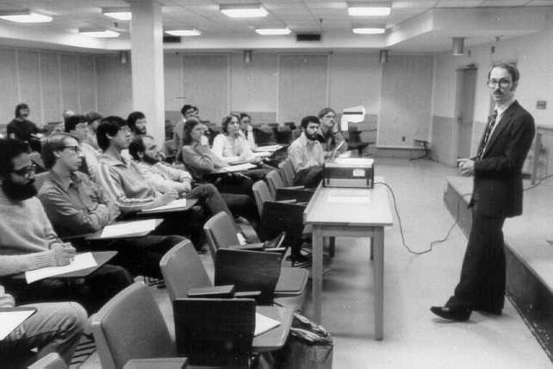
Did you ever sit behind the post in CSS 2324?

Slide 26
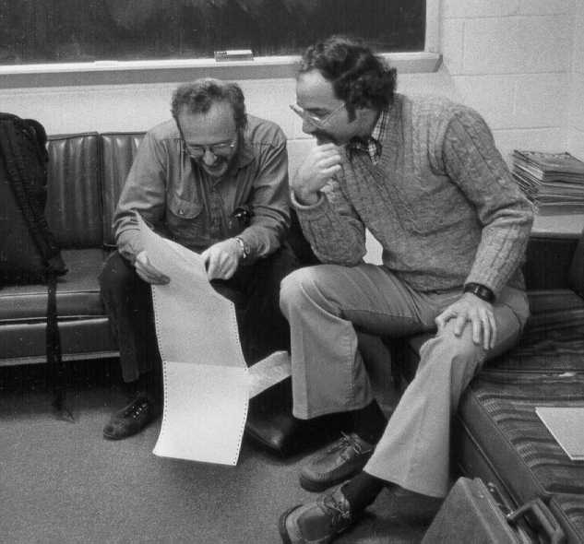
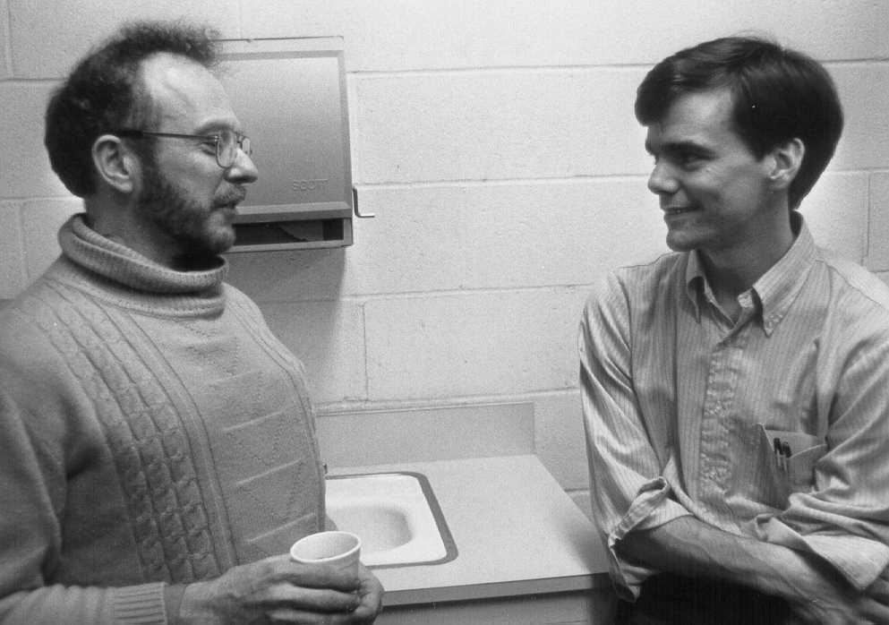
Dave Weiss (PhD) working
with Dave Parnas of the Naval Research Lab
Professor John Gannon
with Dave Parnas

Slide 27
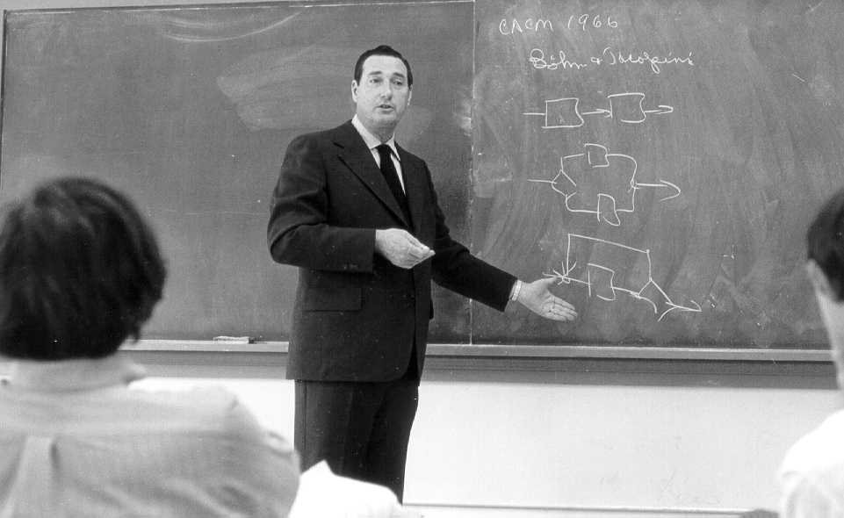
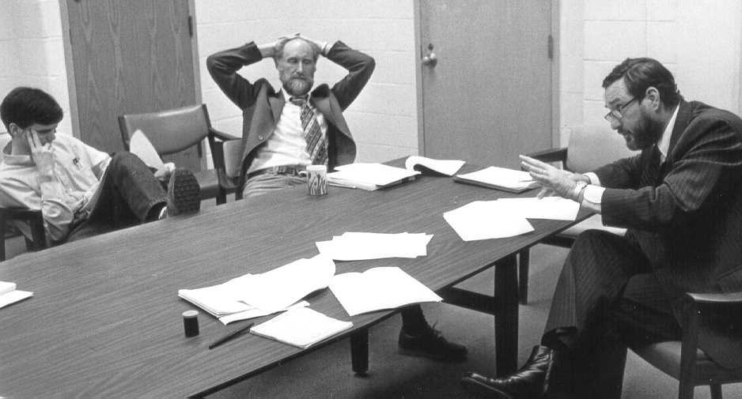
Harlan Mills (IBM and
UMD professor) redefines
freshman computer science
courses
Professors John
Gannon and Dick
Hamlet work with
Harlan on course

Slide 28
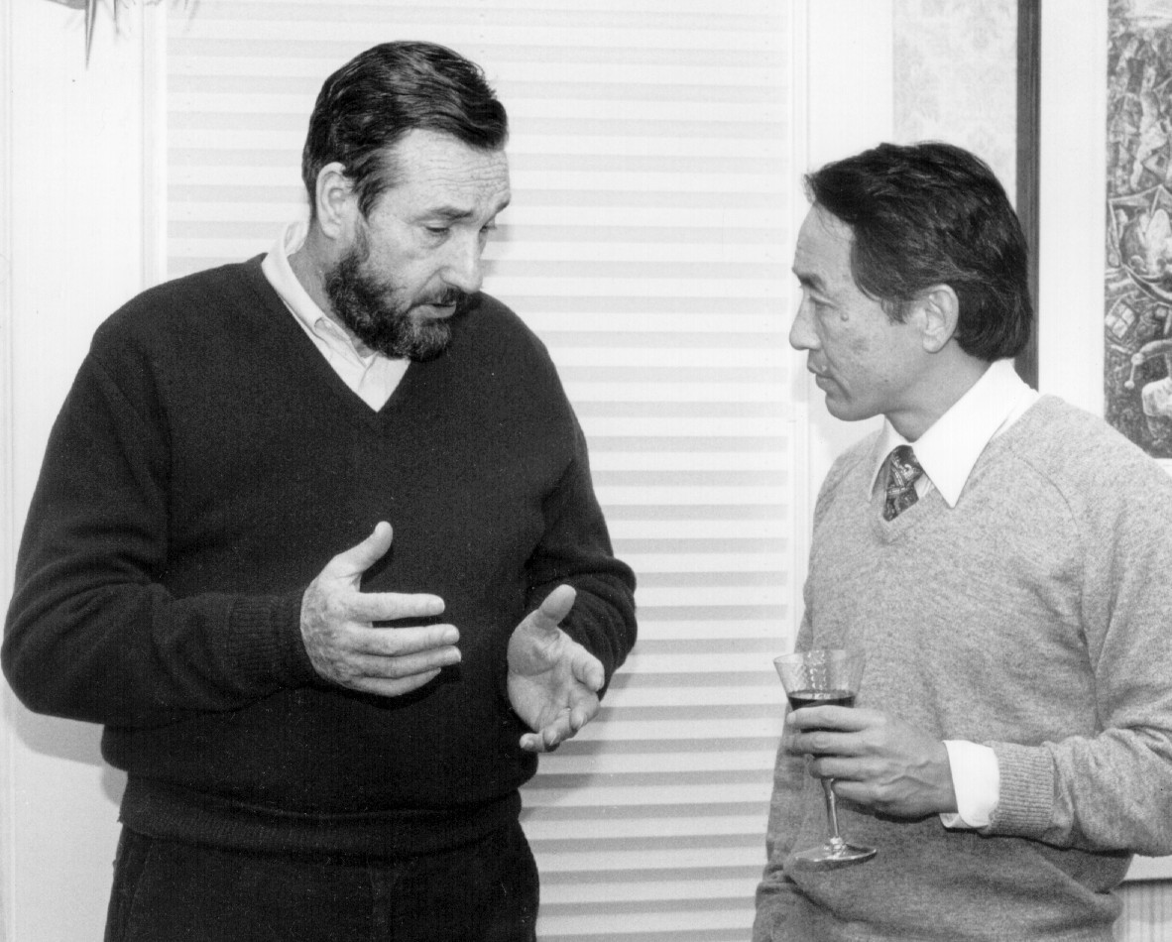
Professors Harlan
Mills and Ray Yeh

Slide 29
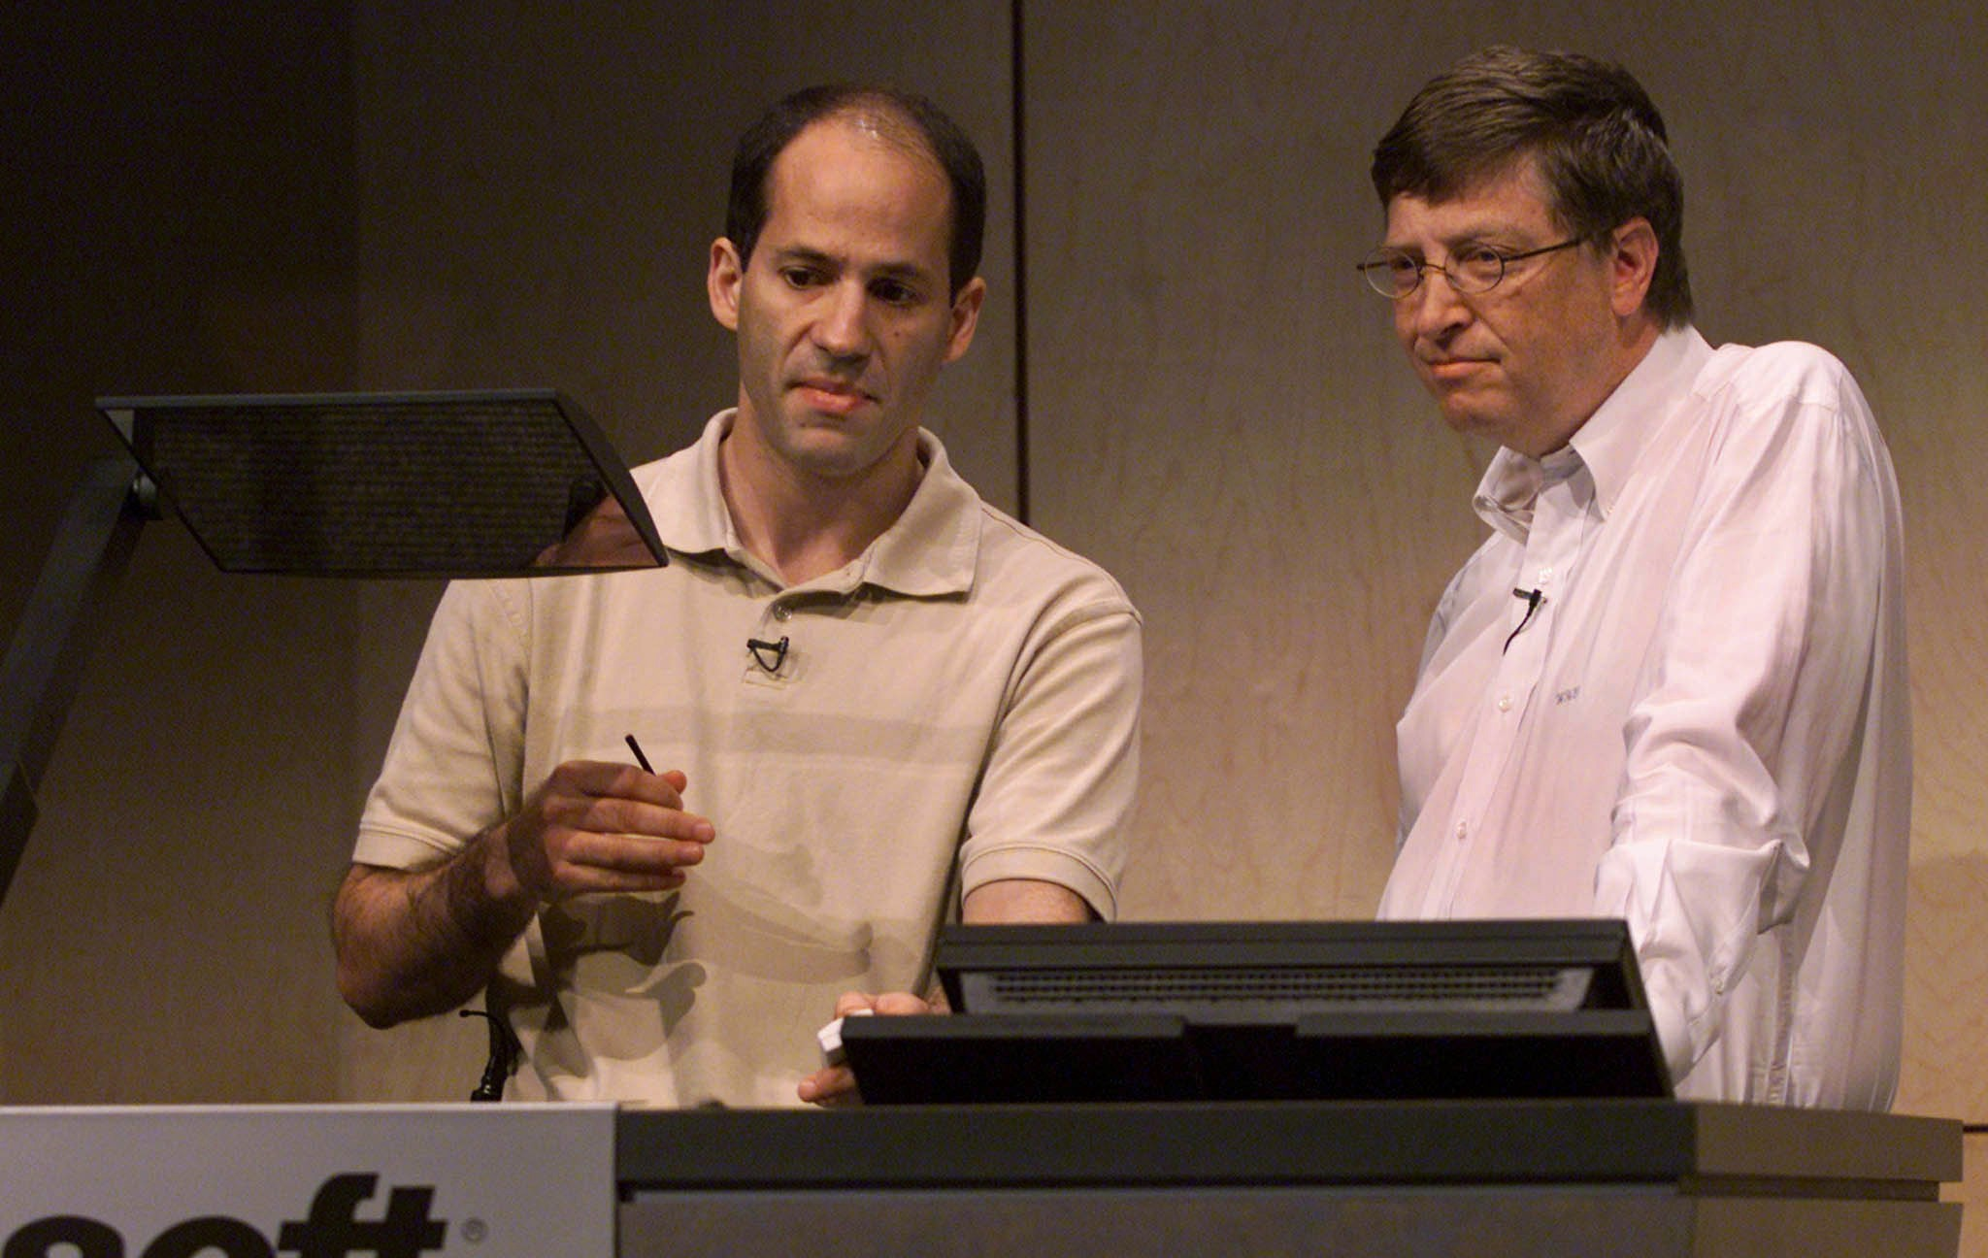
Professor Ben Bederson with some Microsoft guy

Slide 30
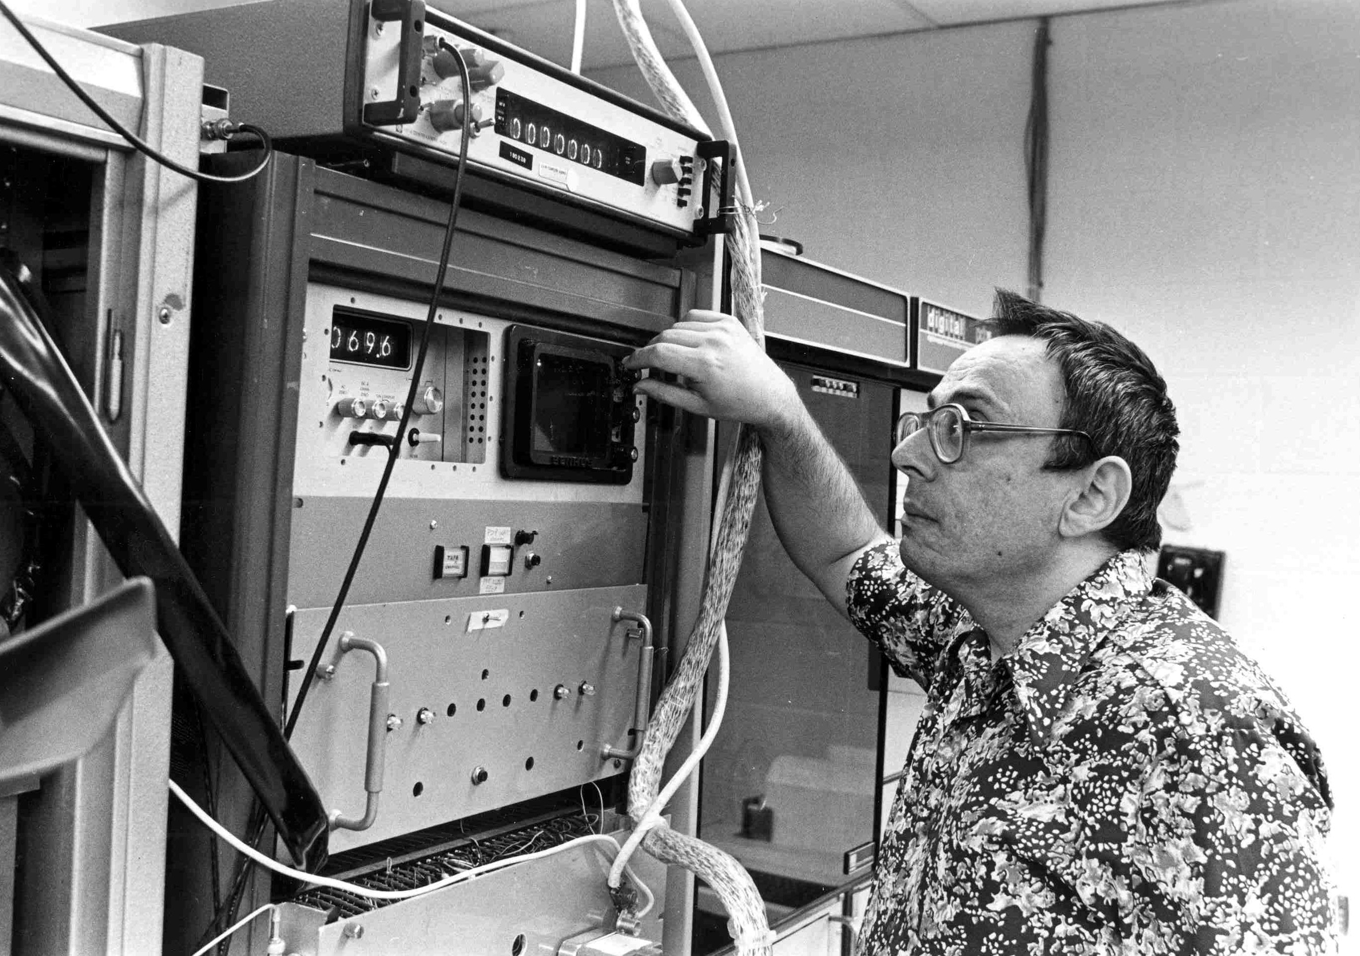
Professor Azriel
Rosenfeld in his
original vision lab
in the Computer
Science Center

Slide 31
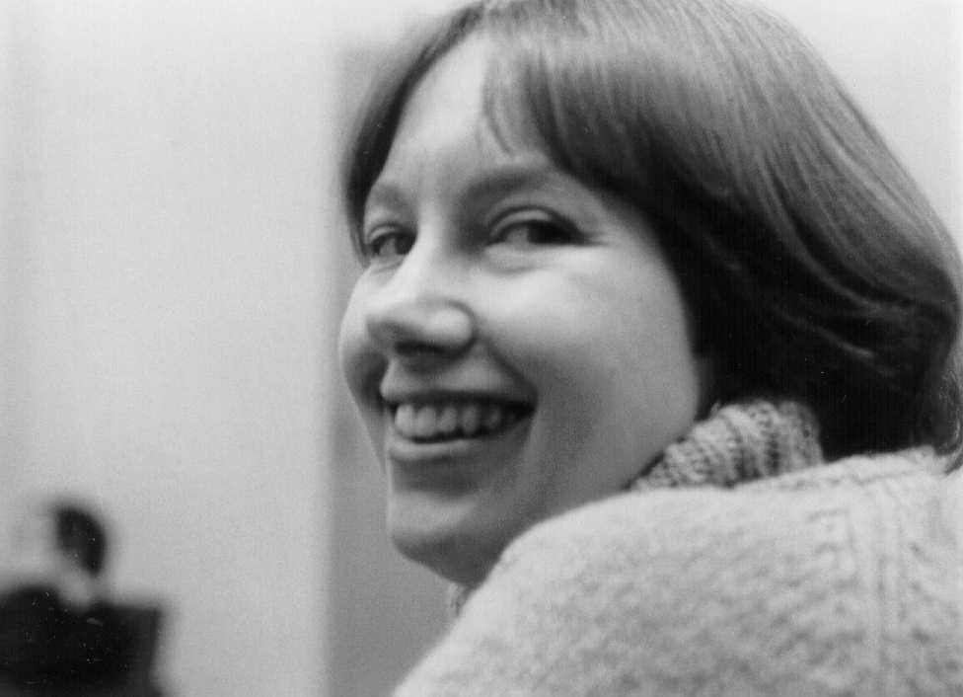
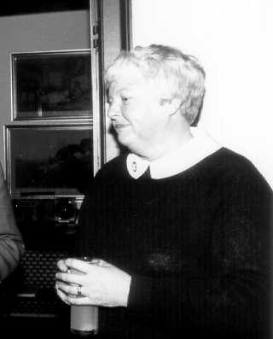
Sally Heikkinen ran the
Education Office in the
1980s.
Professor Pamela Zave

Slide 32
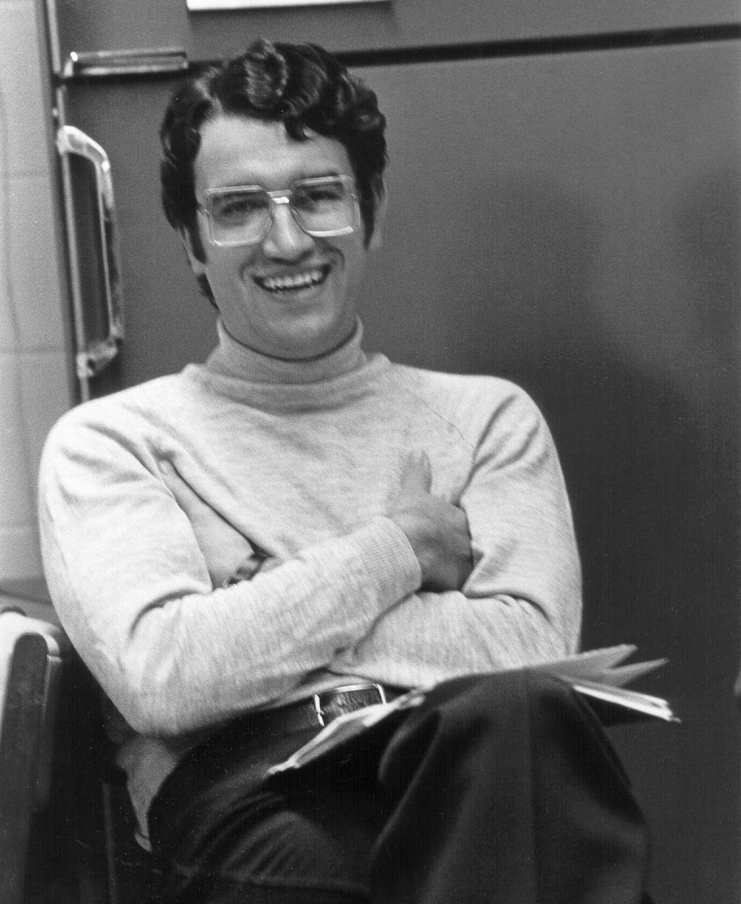
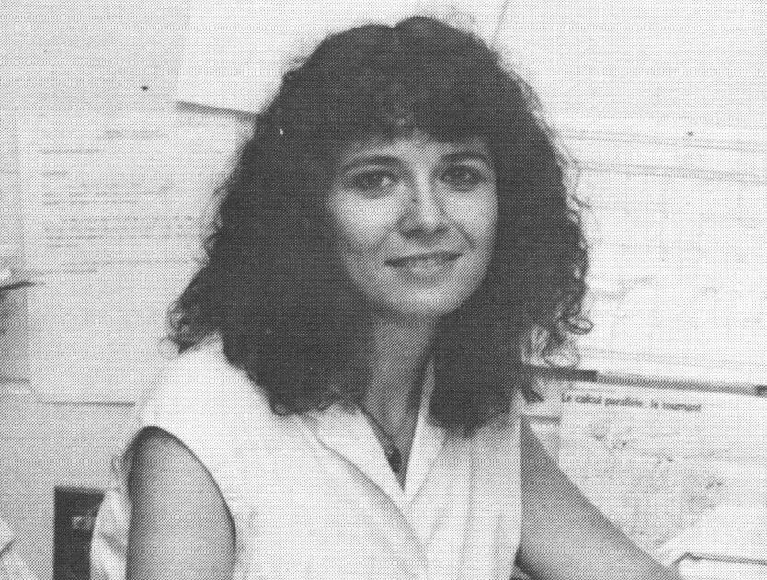
Professor Virgil
Gligor – Now with
ECE Department
Professor Brigitte
Plateau

Slide 33
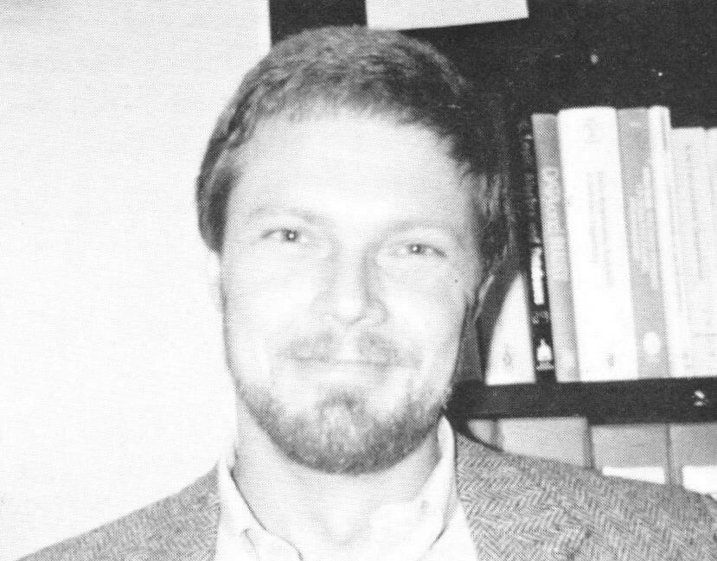
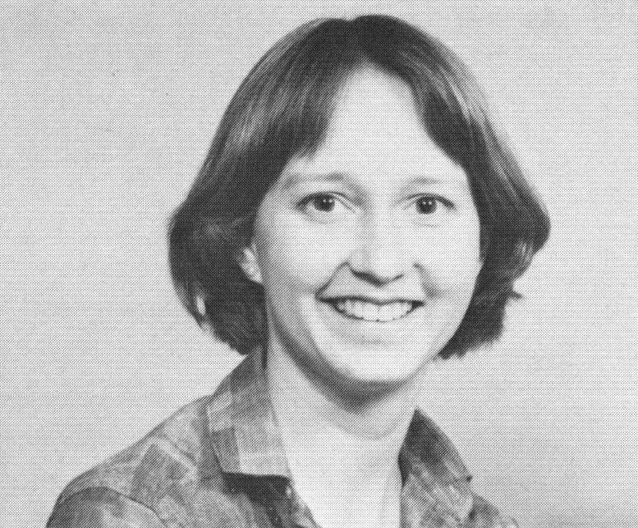
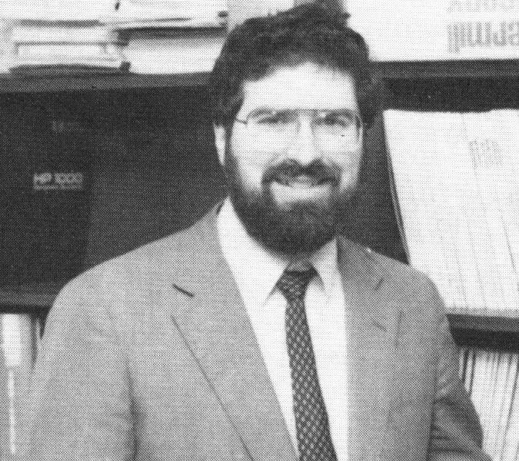
Professor Leo Mark
Professor Beverly
Sanders
Glenn Ricart. Was also Computer Science Center Director

Slide 34
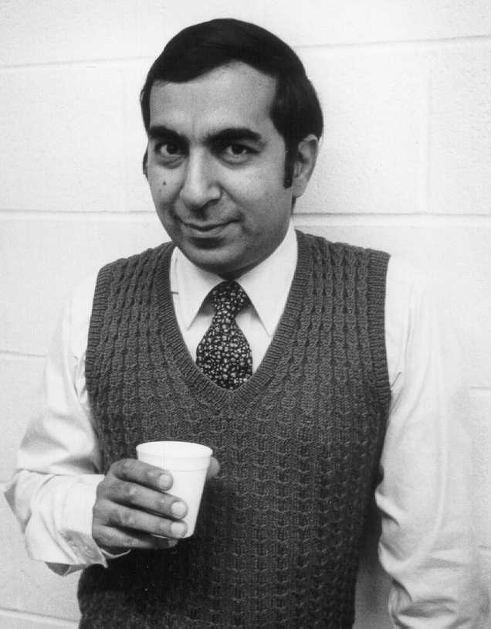
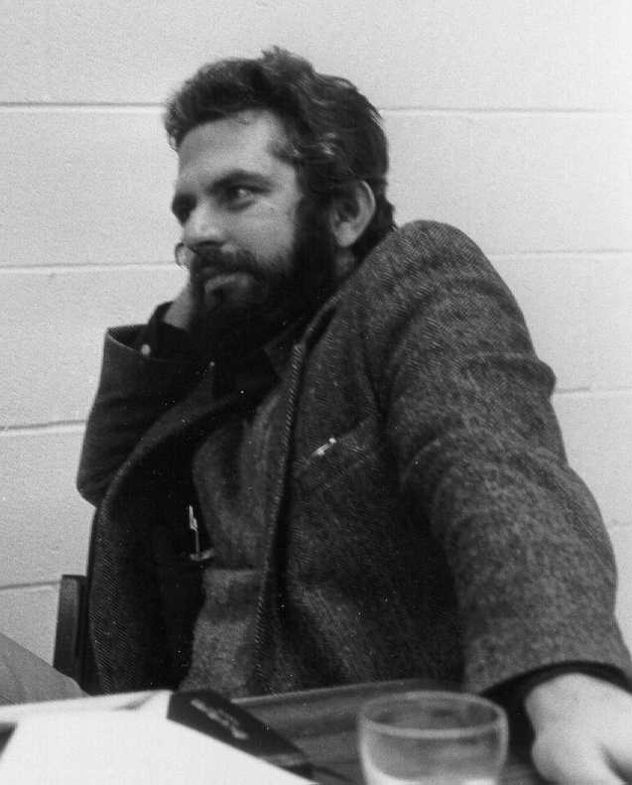
Professor Nick Roussopoulos
Professor Ashok Agrawala

Slide 35
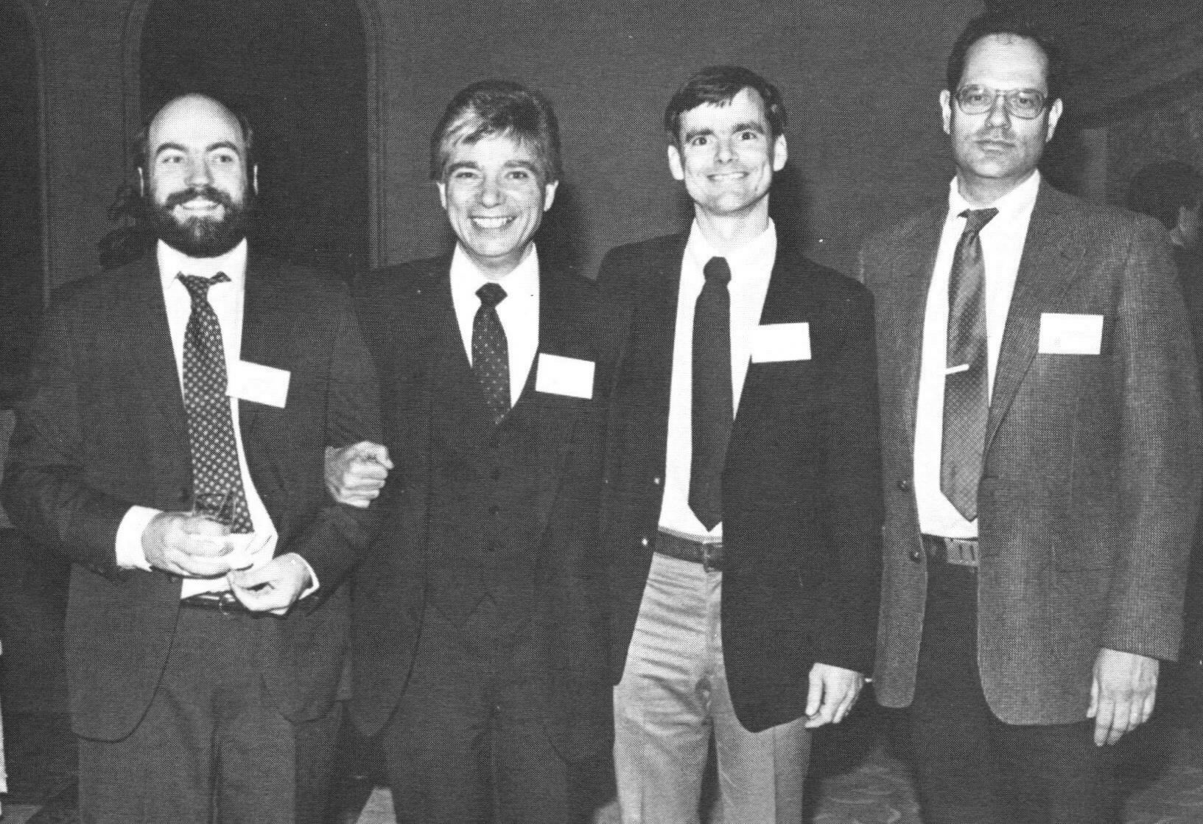
Software engineering
Faculty in 1987 open
house:
Professors Mark
Weiser, Vic Basili,
John Gannon, Marv
Zelkowitz.
1987 was 20th
anniversary of computer
science education at
College Park.
(PhD program began in 1967)

Slide 36
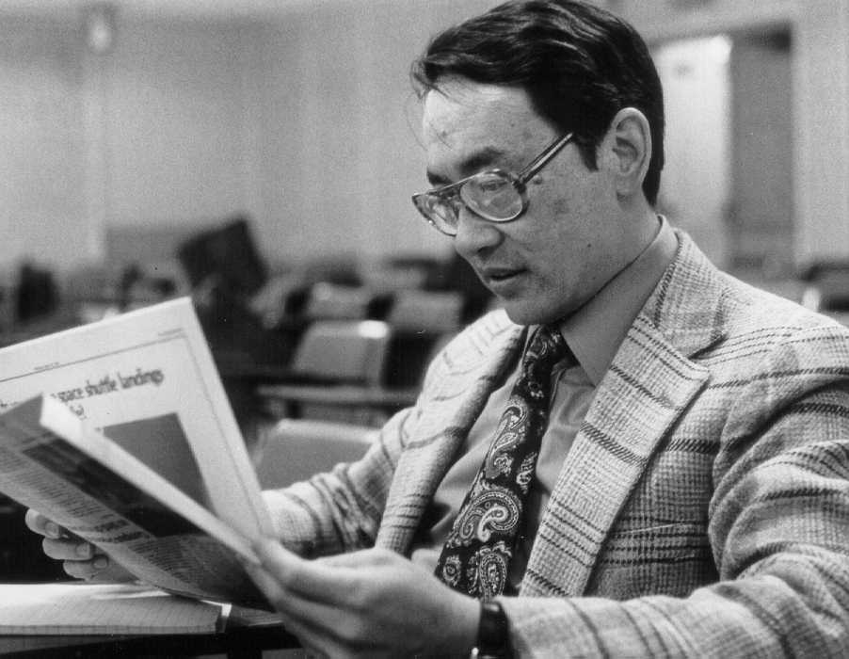
Professor Ray Yeh was department chair beginning 1979

Slide 37
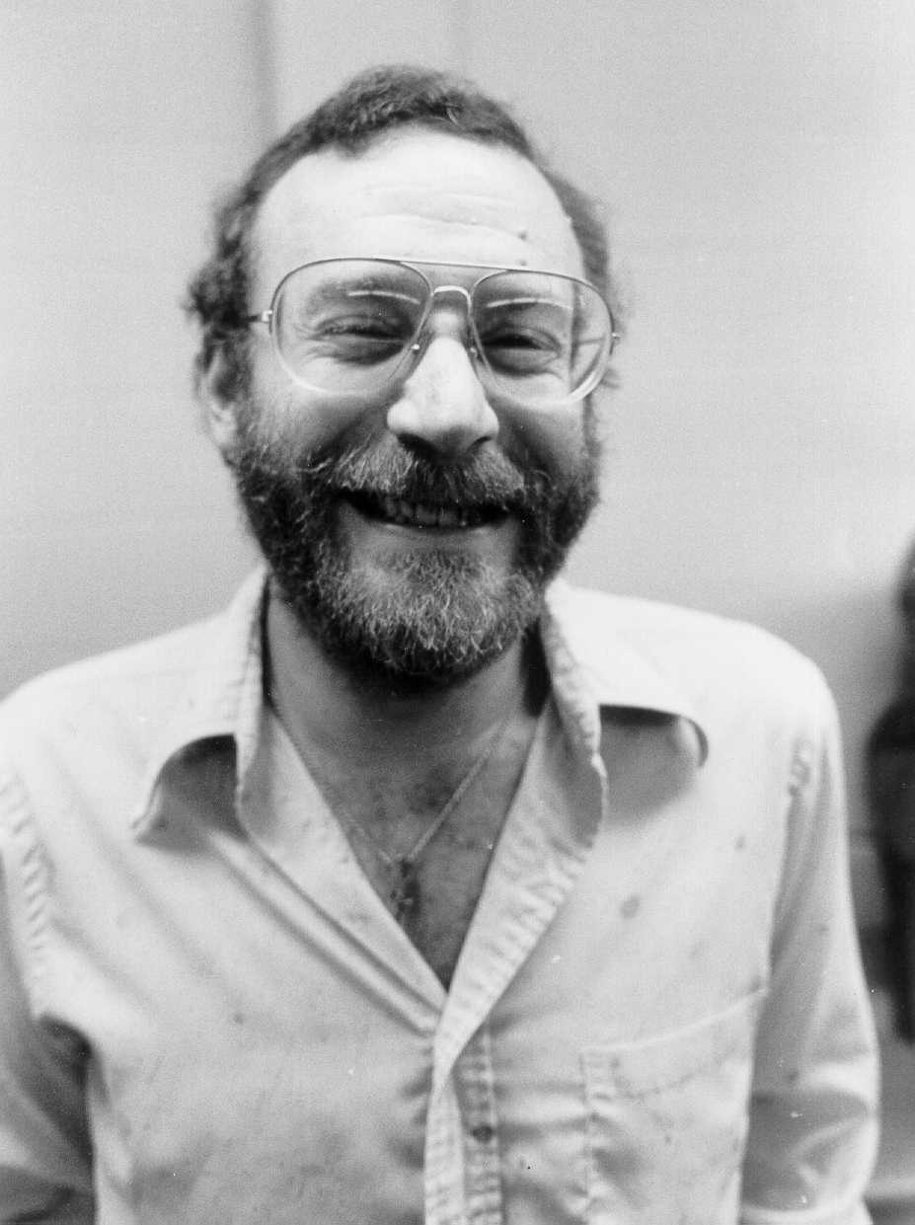

Professors Carl Smith and Howard Elman

Slide 38



Professor Scott
Carson
Professor I. V.
Ramakrishnan
Professor Timos Sellis

Slide 39

Professors John Gannon, Nick Roussopoulos, Rick Furuta,
Larry Davis, Mark Weiser

Slide 40


Professors Christos
Faloutsos and Jim
Purtilo
Professors Dana Nau
And Mark Weiser

Slide 41

Professors Jim Hendler and Don Perlis

Slide 42


Professor Joel Saltz
Professor Rodrigo Fontecilla

Slide 43

Professors Clyde Kruskal and Carl Smith

Slide 44


Professor Ray Miller
Professor Vic Basili

Slide 45

Cindi Hale was first department
Director of Administration - 1982

Slide 46

Professor Larry Davis and Cindi Hale

Slide 47
How many professors, instructors, and
affiliated faculty (faculty from another
Department) have had appointments in computer
science in the 40 years between 1962 and 2002?
140!

Slide 48
Computer Science Center
1962
Werner C. Rheinboldt
John P. Menard
Charles J. Mesztenyi
Abraham Sinkov
Earl J. Schweppe
James D. Chappell
1963
Richard H. Austing
George E. Lindamood
Azriel Rosenfeld
1964
James M. Ortega
Chan-Mo Park
Edmund M. Glaser
1965
James F. Williams
James C. Owings
David Lorge Parnas
Abraham Tal
James S. Vandergraft
1966
William F. Atchison
Yaohan Chu
1967
Harold P. Edmundson
Laurence Heilprin
Jack Minker
Victor B. Schneider
1969
Edward S. Deutsch
Eliott D. Feldman
Patrick E. Hagerty
Michael Hanani
Chan M. Park
Robert G. Voigt
1970
Victor R. Basili
Laveen Kanal
W. Michael Lay
Michael McClellan
Martin Milgram
1971
Ashok Agrawala
Ronald M. Baecker
Richard G. Hamlet
Robert Noonan
Marvin V. Zelkowitz
1972
George J. Fix
David Milgram
David L. Mills
Roger Nagel
Gordon VanderBrug
Computer Science Department
1973
Matthew Hecht
1974
Charles J. Rieger, III
Gilbert W. Stewart
1975
John D. Gannon
Virgil D. Gligor
Chul Kim
Harlan D. Mills
Hanan Samet
1976
C. Dianne Martin
Pamela Zave
1977
John Privitera
1978
Lawrence Dowdy
Rachelle S. Heller
Barry Jacobs
Dianne O'Leary
Satish K. Tripathi
1979
Michael Brodie
John Grant
Dana Nau
Ben A. Shneiderman
Mark Weiser
Raymond T. Yeh
1981
Larry S. Davis
Mohamed Y. Elsanadidi
Nicholas Roussopoulos
1982
Donald Perlis
James A. Reggia
Glenn Ricart
Carl Smith
1983
Rodrigo J. Fontecilla
I.V. Ramakrishnan
A. Udaya Shankar
1984
David M. Mount
1985
Amihood Amir
Howard Elman
Christos Faloutsos
Richard K. Furuta
William Gasarch
James Hendler
Joseph JaJa
Pankaj Jalote
Clyde Kruskal
Leo Mark
Beverly Sanders
P. David Stotts, Jr
1986
Yiannis Aloimonos
Scott Carson
Gregory F. Johnson
Bonnie Kowalchack
Brigitte Plateau
James Purtilo
Dieter Rombach
Timoleon K. Sellis
1987
Louiqa Raschid
Gwen Kaye
1988
Sarit Kraus
Raymond E. Miller
William Pugh
Kenneth Salem
Uzi Vishkin
Amy Weinberg
1989
VS Subrahmanian
1990
John F. Horty
Jan Plane
1991
Ramalingam Chellappa
Richard Gerber
Adam Porter
1992
Bonnie J. Dorr
Samir Khuller
Joel Saltz
Alan Sussman
1993
Michael J. Franklin
1994
Jeffrey Hollingsworth
Peter J. Keleher
1995
Evan Golub
Chau-Wen Tseng
1996
Larry Herman
1997
Benjamin B. BedersonJames Glenn
Leana Golubchik
1998
Sudarshan S. Chawathe
Donald Yeung
1999
Samrat Bhattacharjee
James J. Maybury
2000
William Arbaugh
Steve Scolnik
Amitabh Varshney
2001
Michael Hicks
Atif M. Memon
Aravind Srinivasan
2002
Lise C. Getoor
Francois Guimbretiere
Liviu Iftode
David Jacobs
Jonathan Katz
Jeffrey Foster

Slide 49

Vic Basili was Chairman
during the 1980s
(1982-88) when the
Department underwent
a rapid growth in
students, faculty,
and research funding.
UMIACS was created
during this period.

Slide 50


Professor Dana Nau
Professor G. W. (Pete)
Stewart

Slide 51

Professors
Gregory Johnson,
Amihood Amir
and Marv Zelkowitz

Slide 52



The Vision Lab became a separate center in 1983
The Center for Automation Research
University President
John Slaughter
University Chancellor
John Toll
CFAR director
Professor Azriel
Rosenfeld

Slide 53
In 1983 the DoD issued an RFP for a Software Engineering Institute
Department submitted a proposal, which we heard was the best technically, but was awarded to Carnegie Mellon University
Losing the proposal, but an early National Academy of Science ranking of the department as 13th nationally caused various state groups to lobby for increased state support to the University
The state responded by authorizing UMIACS
This had a profound effect on the department’s growth

Slide 54
UMIACS:
In 1985 the University created the University of Maryland Institute for Advanced Computer Studies
30 faculty lines were added with many CS faculty getting part-time research appointments to reduce their teaching load.
Several faculty given permanent part-time research appointments (Stewart, Basili, Minker and Joseph JaJa from EE)
$3M annually in state support
Larry Davis appointed first director
Initial problem: Where to put these people?

Slide 55
It was clear that by the mid-1980s space was becoming critical. The department desperately needed more space.
Proposal to split the department:
  Software engineering and department computer lab in 2000 sq ft of space in the North Gym
  CFAR moved to their own building freeing 3500 sq ft of space
  Temporary classroom building with 4 classrooms built
  Rest of department remaining in Computer Science Center
  What to do with UMIACS?
  Classroom space distributed all over campus

Slide 56

University finally came up with a sensible solution: MRB – Modular Research Building.
MRB built as temporary space which units temporarily move into while their space is refurbished.
Computer Science given this space. Building renamed A V Williams after donor gave money to build it.
AVW opens in 1987.
Computer Science was to be a temporary resident for only a few years. (Turned out to be over 25 years until current building built.)

Slide 57

Department research groups:
Artificial Intelligence meeting in Caracas, Venezuela
in 1977. Can you find Professors Azriel Rosenfeld,
Jack Minker and Chuck Rieger?

Slide 58


Professor Ben Shneiderman
was the original director of
the HCI Lab
Typical Shneiderman display of visual information

Slide 59

Can you recognize UMD participants?
Vic Basili (Professor)
Giovanni Cantone (Visiting Professor, Italy)
Ross Jeffrey (Visiting Professor, Australia)
Chris Lott (PhD)
Markku Oivo (Visiting Professor, Finland)
Adam Porter (Professor, Not shown)
Dieter Rombach (Professor)
Rick Selby (PhD)
Marv Zelkowitz (Professor)
Software Engineering meeting – Dagstuhl, Germany, 1992.

Slide 60

Opening the Fraunhofer Center, February 1998.
Professors Dieter Rombach and Vic Basili (2nd and 3rd from left)

Slide 61

Department retreat with professors Amihood Amir,
Harold Edmundson, Marv Zelkowitz, Vic Basili,
Bill Atchison, and Pankaj Jalote.

Slide 62




Professors Adam
Porter, Howard
Elman, Jim Reggia,
And Bonnie Dorr

Slide 63

Professors
Dieter Rombach
Vic Basaili and
A. U. Shankar

Slide 64

Professors David Stotts and Don Perlis

Slide 65


Professor Michael Franklin
Professor Richard Gerber

Slide 66

Professor Laveen Kanal and Professor
“Leonardo”
Shneiderman

Slide 67

Professors Larry Davis, Harold Edmundson
And Laveen Kanal

Slide 68


Jan Jastrzebski in
the department
business office
Gwen Kaye in the
Education Office

Slide 69

Former chairman
Satish Tripathi from
1988-1995.
Left to be dean of Computer Science and Engineering at the University of California – Riverside.
Now president of University of Buffalo

Slide 70

John Gannon was Chairman
from 1995 until his untimely
death in 1999

