Slide 1

Isophilly
Isochrone Based Real Estate Pricing
Benjamin Knight
Jack Doggart
Om Duggineni
  BUFN FInal Presentation 2025

Slide 2


Agenda
Real Estate Pricing Overview
Isochrones and our methods
Datasets, Codebase, and Live Site Demo
Results and Next Steps
  02

Slide 3

Goal
  Real Estate Pricing aims to predict the prices of real estate property by analysing external features of the communities surrounding them. [1]
Current Approach
Real Estate Pricing Prediction
  Current Approaches in real Estate Pricing primarily use demographics, income, businesses, and features of the property to assign value. These are used by investors and Real Estate Investment Trusts.
Room for Improvement
  Real Estate Pricing’s focus on demographic factors relies on static Census Block regions. These regions are semi-arbitrary and may not reflect the actual geography of communities.
Our Approach
  Isochrones - the area around a point that can be accessed in a specific time.
  By analyzing features using isochrones, we can increase accuracy and better represent community.
  03
[1] https://ieeexplore.ieee.org/abstract/document/8631423

Slide 4

Our Task
Create an interactive dashboard to explain and examine changes in Real Estate features at different isochrone levels.
Run a simple Linear Regression to determine the importance of features and the effectiveness of the regression at each isochrone level
  04

Slide 5
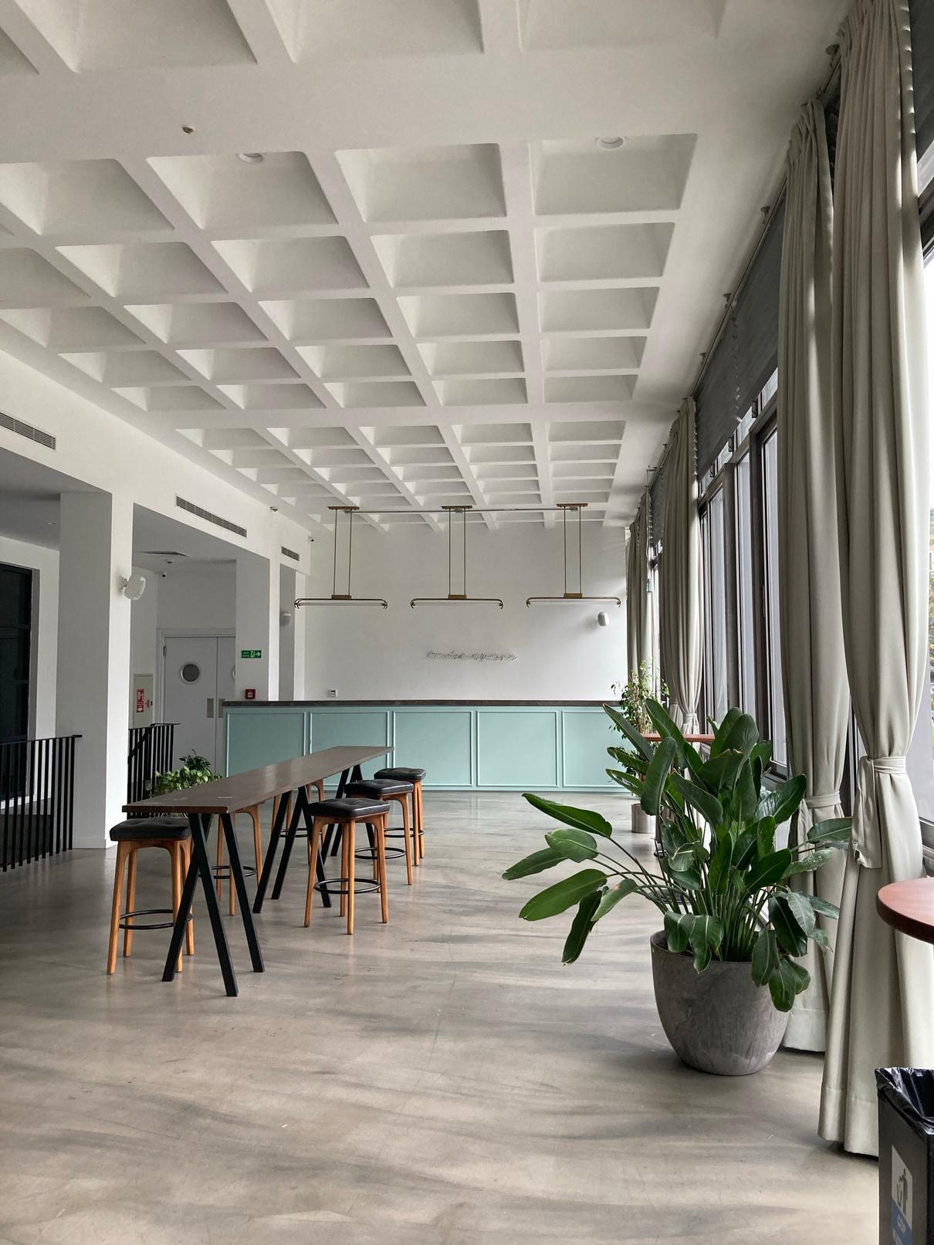
Project Steps
Calculate Isochrones
  Use GraphHopper to calculate isochrones for each census block group
Collect Relevant Features
  Collect a wide variety of known Real Estate price predictors from different datasets.
Aggregate data by region
  Take data points from our datasets and aggregate them using Geopandas by Census Block and Isochrone Groups.
Regression
  Using Real Estate pricing by census block as the dependent variable, run regressions to evaluate the effectiveness of isochrone regions.
Display Online
  Host a live site using React with fully interactive visualizations allowing the exploration of our data and findings.
  05

Slide 6
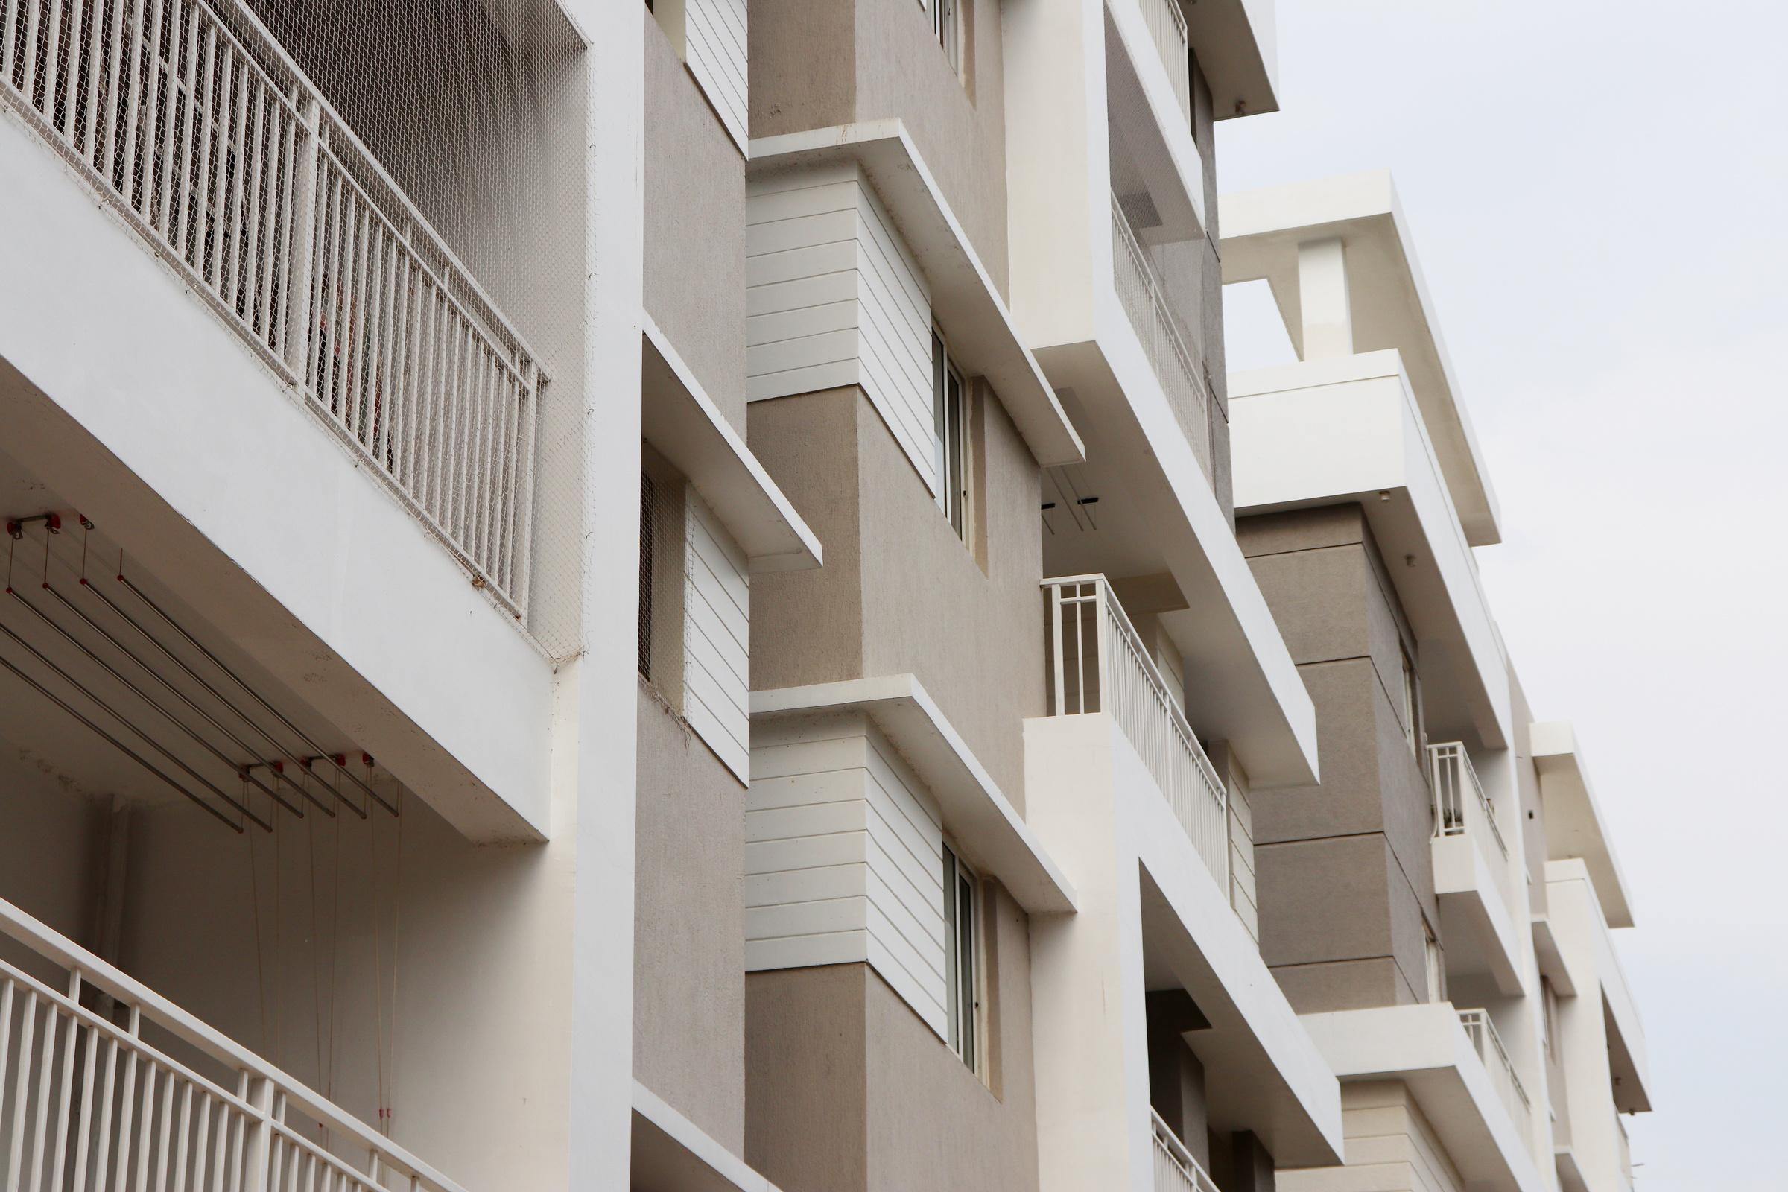
Calculating Isochrones
Batch calculation of isochrones
GraphHopper Server
Area and POI calculation
  GraphHopper is a tool which processes mapping data and calculates the fastest route between two points. Using data from OpenStreetMap, we can use it to calculate the area of all locations reachable from a start point using a particular method of transportation given a certain amount of time.
  For each of the 9 isochrone types, the area was average over the center point, for each census block group using a python script, outputting a csv. Using a python script, every Yelp poi of interest contained in each isochrone was calculated, the average number and average rating of POIs per isochrone was calculated.
  5 center points (centroid, north, east, south, west) were calculated for each census block group. Using a python script, API calls were made to a locally running graphhopper server to calculate 9 isochrones for every point (walking, public transit, and car, at 10, 20, and 30 minutes travel time). 45 total isochrones were calculated per census block group. The calculation was run in parallel on 4 separate servers, with output combined into a single geojson.
  06

Slide 7

Feature
Datasets
Census Block Groups
Yelp Business Dataset
RTT Dataset
  Smallest Geographical area for the US Census Data filtered for Philadelphia County.
  Base area to calculate isochrones and aggregate other parameters.
  [1336 Census Block Groups]
  7 Million Reviews from 150 thousand businesses in 11 cities.
  Filtered to only Philadelphia based businesses and extracted to give ratings.
  [14569 Businesses]
  All Real Estate Transfers since 2010 in the City of Philadelphia categorized by transfer type.
  DEED - Transfers between owner
  DEED SHERIFF - Usually Foreclosures
  [296448 Deeds]
Choice Neighborhoods
No Thru Trucks
PPR Swimming Pools
  Neighborhoods marked for urban renewal.
  Likely to signify neglected neighborhoods.
  [4 Choice Neighborhoods]
  Streets not allowing trucks in Philadelphia
  [2728 Roads]
  All public and private swimming pools in Philadelphia.
  [72 Pools]
  07

Slide 8
Tech Stack
OpenDataPhilly
Graphhopper
Isochrone
Calculations
Census Block Groups Dataset
Other Features
[1]
isochrones.
geojson
[1] census_blocks.geojson
[1] iso_features.csv
[2] census_features.csv
React Site
[3]
regression.csv
https://3benknight.github.io/Isophilly_site/
Notebooks
[1] Isochrone Features Dataset Creation.ipynb
[2] CensusBlockData.ipynb
[3] Regression.ipynb
  08

Slide 9
Tech Demo
https://3benknight.github.io/Isophilly_site/
  09

Slide 10

01
  Isochrones do offer an alternative to Census Block Groups in getting strong regressions for predicting property values.
02
  1200-pt, 1800-ft, and especially 1800-pt have emerged as promising alternatives for future analytical tools.
03
Results
  More work must be done to balance the smoother gradients of isochrone areas and not losing the chaotic features of the urban makeup of a city.
  10

Slide 11

Thank you
Any Questions?
  11

