Slide 1
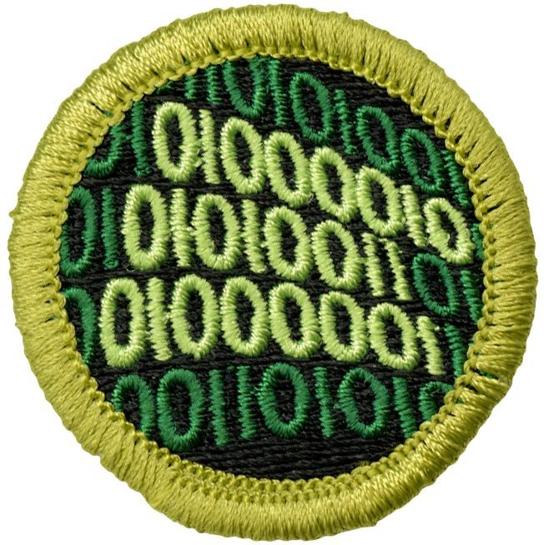
Programming Merit Badge
Troop 440 Merit Badge Day
Jack Doggett

Slide 2
About me
Computer Science major at the University of Maryland
Studying Systems Programming, Machine Learning, Comp Finance.
Previous Software Development Internships at Leidos
From Troop 440, Eagle Scout

Slide 3
Programming Merit Badge Requirements and Class Overview
Safety during programming
History of programming
Early stage program design, conceptualization to pseudocode
Overview of parts of program languages
Intellectual property, software licensing
Careers in programming
Hands on demo with Javascript
Review your projects

Slide 4
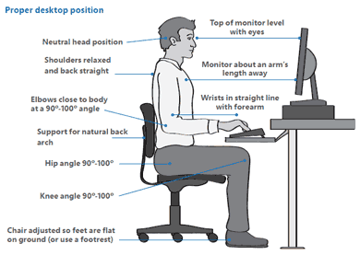
Safety

Slide 5
Safety

Slide 6
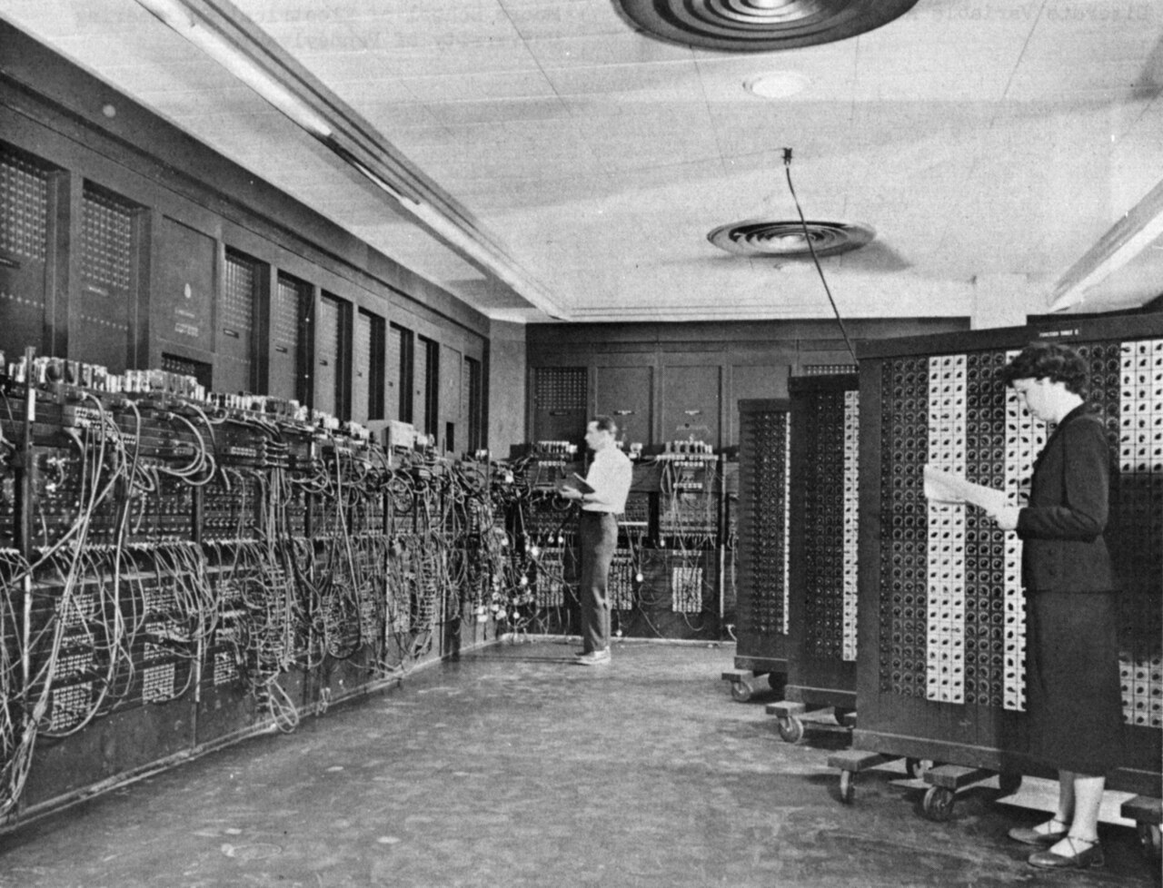
History of programming and computers - ENIAC
Electronic Numerical Integrator and Computer - “the first programmable, electronic, general-purpose digital computer, completed in 1945…By the end of its operation in 1956, ENIAC contained 18,000 vacuum tubes, 7,200 crystal diodes, 1,500 relays, 70,000 resistors, 10,000 capacitors, and approximately 5,000,000 hand-soldered joints..and consumed 150 kW of electricity.” (Wikipedia)
Programming involving physically switching together components.

Slide 7
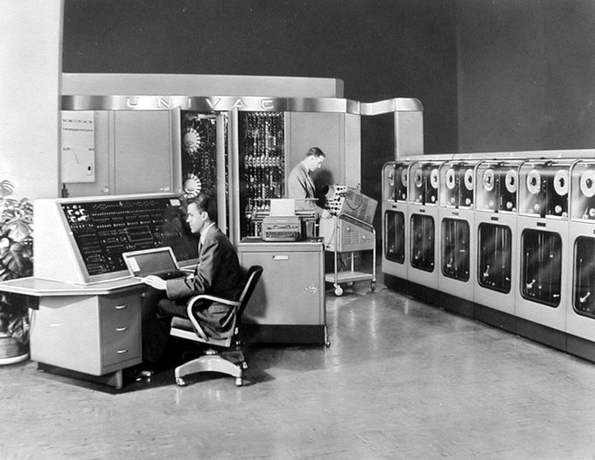
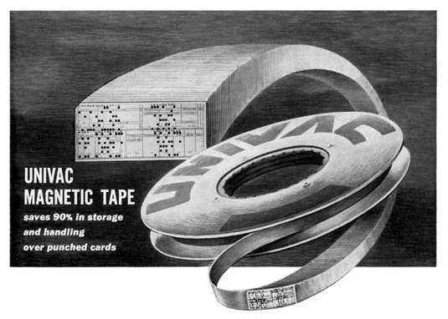
History of programming and computers - UNIVAC
Universal Automatic Computer - Introduced 1951
Digitally Stored Programs on Punch Card, Paper Tape and magnetic drum/tape storage.

Slide 8
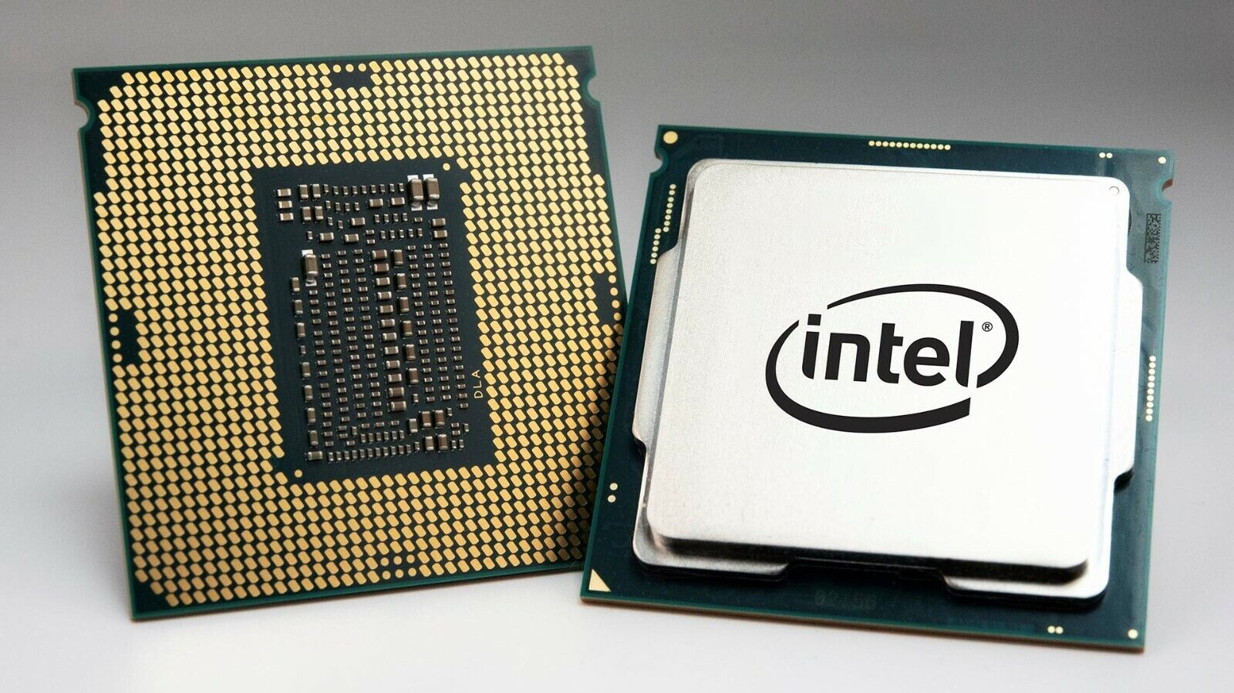
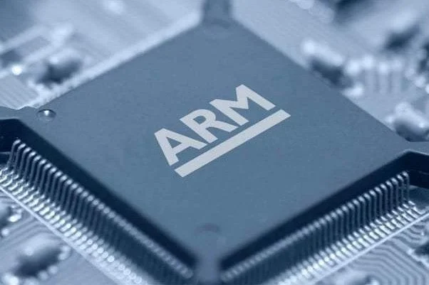
Machine Language and Assembly Instructions
Earliest form of digital programming
Individual physical instructions on processors and computer were used, like add 2 numbers together.
Machine Language is in Binary. Assembly is human readable. A program called an assembler converts the assembly text into a machine language program.
Programs were architecture specific, could only be run on same type of computer, had to be reprogrammed for a different computer architecture
Today we have X86 and Arm.

Slide 9
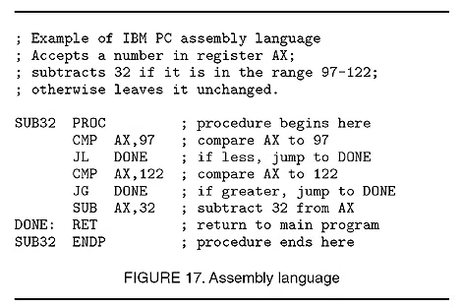
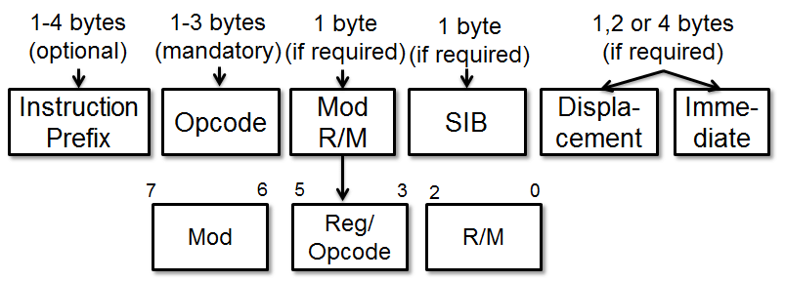
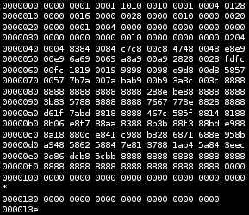
Machine Language and Assembly Instructions
Modern intel/amd cpus have 1000s of unique instructions!

Slide 10
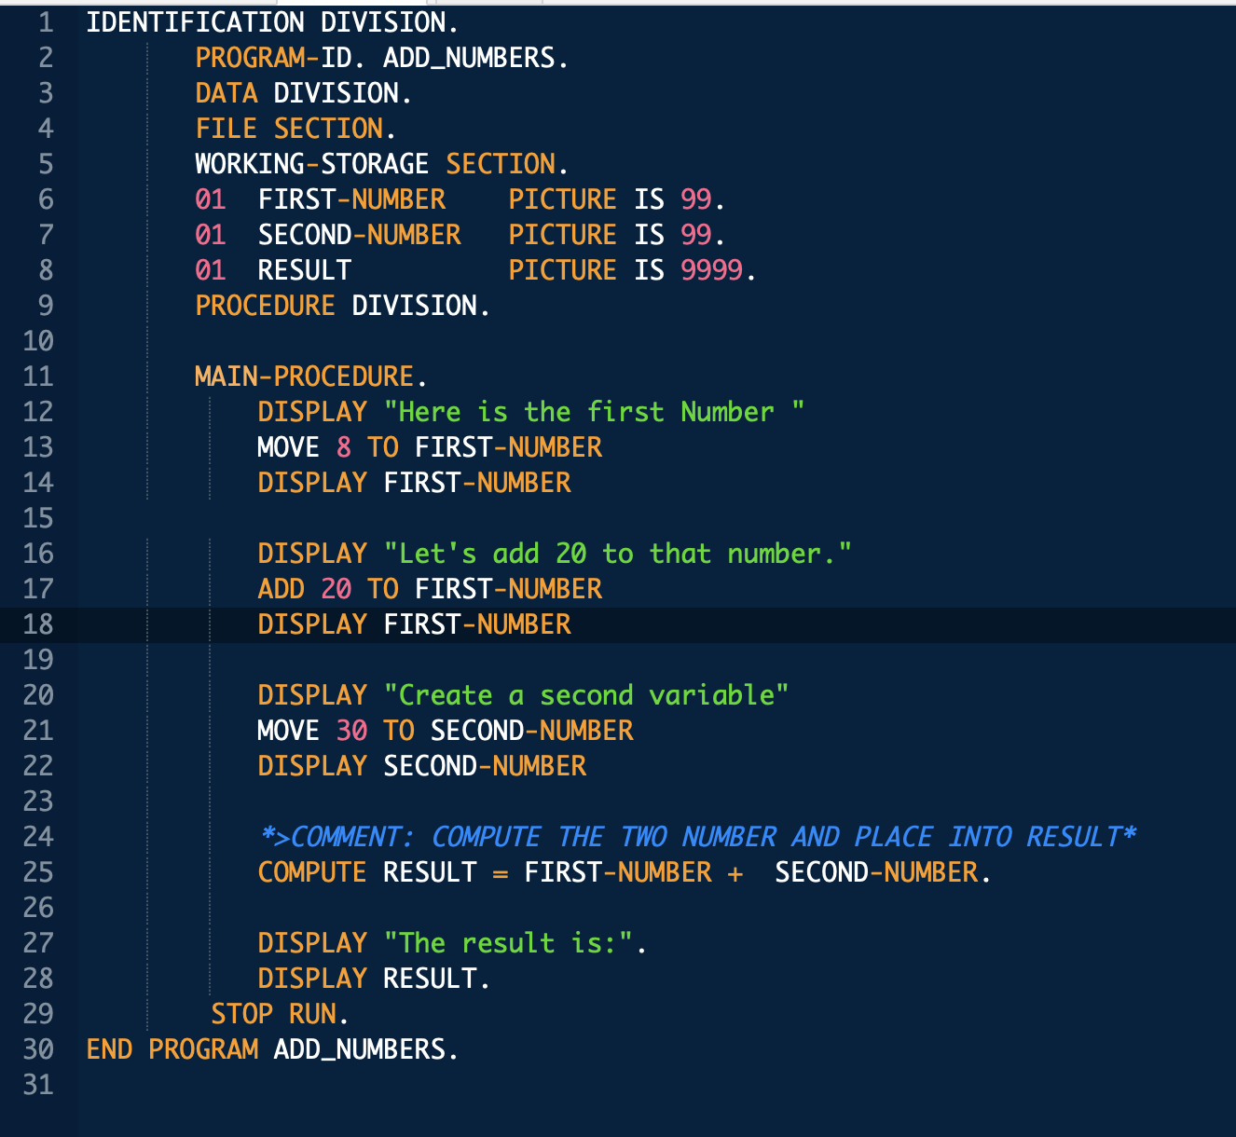
Early Portable Compiled Languages
Fortran, IBM, 1950s, scientific computing
COBOL, Department of Defense, late 1950s, business and industrial applications
Extremely verbose, modern languages don’t look like this (COBOL) example. Imperative and procedural.
Compiler converts program file into assembly code. Assembler converts to machine language. With light modification, programs can be easily compiled to run on different machines likes an IBM mainframe or a DEC minicomputer.

Slide 11
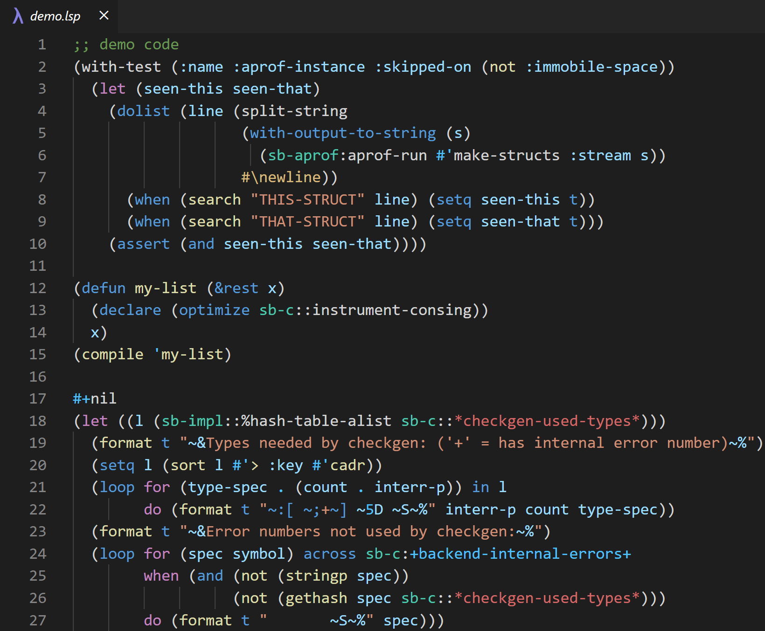
Functional Programming
Lisp (1960) and its derivatives with functional programming have added many features we have today in modern languages.
Data is immutable, doesn’t change.
Invented many features like recursion

Slide 12
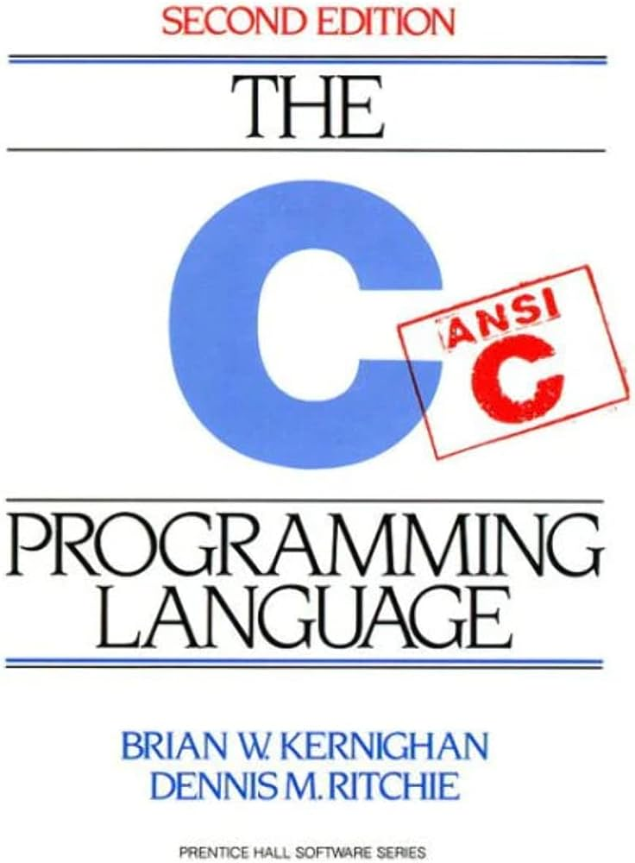
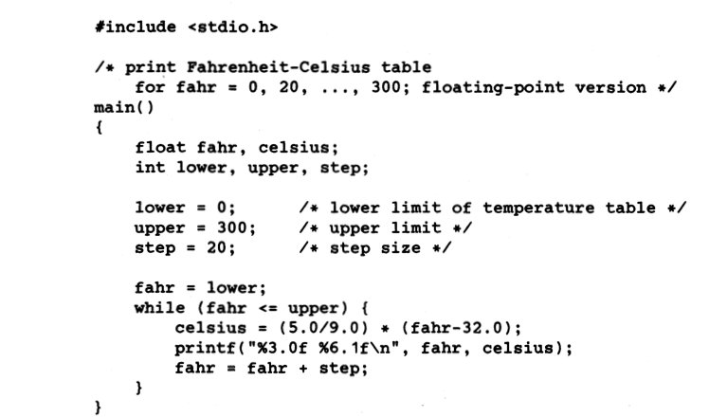
Modern Procedural Languages
Pascal, Professor Niklaus Wirth, 1969, teach structured programming and better data structured
C, AT&T, 1972, general purpose language. Again better structuring and data structure, easy access to computer memory. Today used as basis for many other languages and programs. Operating Systems are built on C.
Much cleaner simplified syntax.

Slide 13
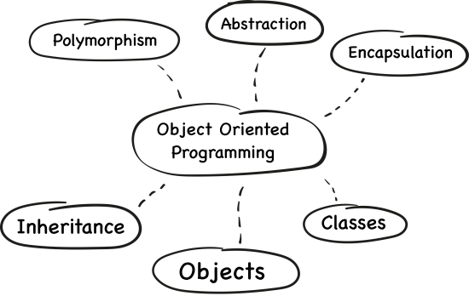
Object Oriented Programming
C++, AT&T, 1979, Added object orientation to C, classes and methods, more built in libraries.
Java, Sun Microsystems, 1995, Compile once run every architecture. Code is run by fast Java Virtual Machine (which is dependent on architecture), but is only compiled once to bytecode.

Slide 14
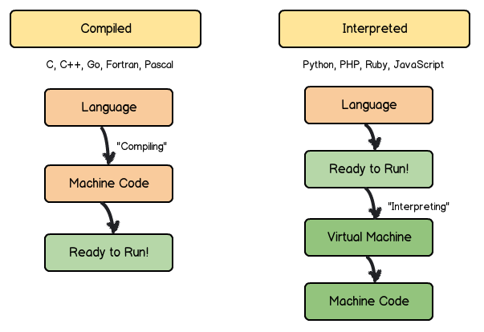
Scripting Languages
BASIC, Dartmouth College, 1964, Interpreted language, simpler to use but less powerful than compiled languages
Python, Guido van Rossum, 1991, Modern scripting language used today in general programming. Especially prevalent in data science and machine learning.
Ruby, Yukihiro Matsumoto, 1993

Slide 15
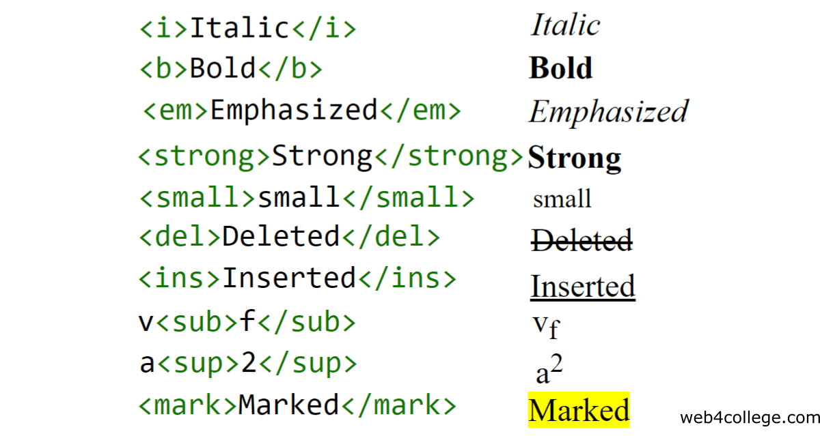
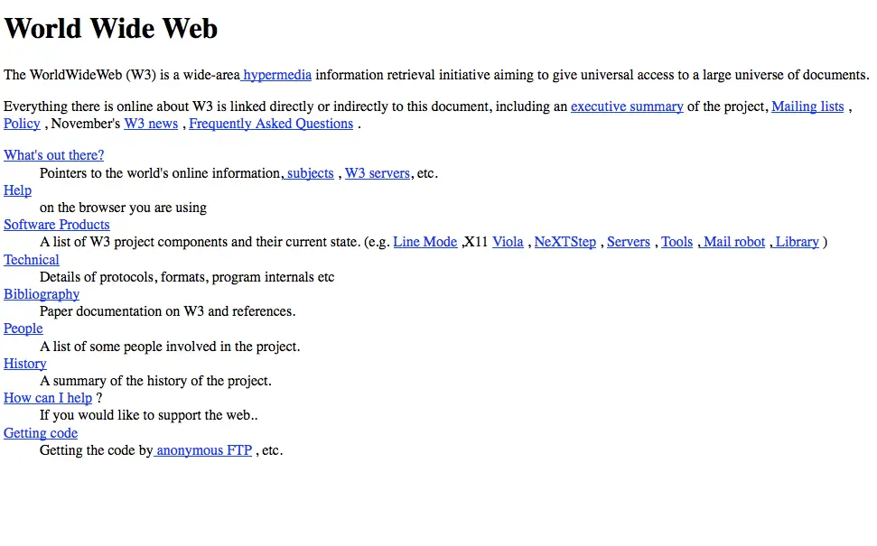
Web Languages
Hypertext Markup Language, Tim Berners-Lee, 1990, language to store formatting of web pages.
Javascript, Netscape, 1995, run scripts on client side and service side for websites, interpreted by browser.
PHP, Rasmus Lerdorf, 1995

Slide 16
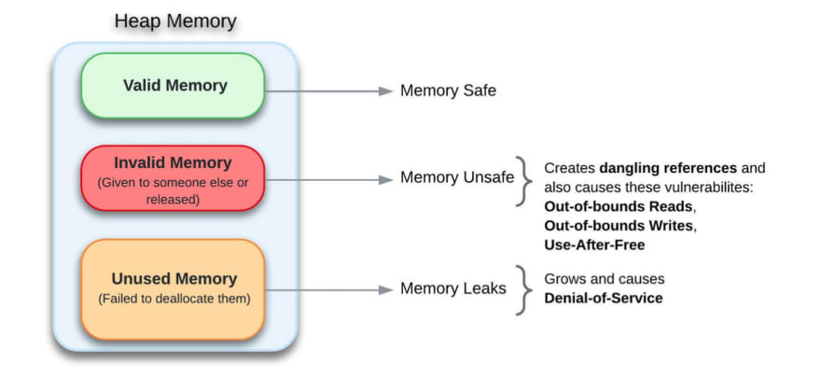
New languages today
Rust, Tim Berners-Lee, Graydon Hoare, 2006, memory safety, general purpose like C++.
Go, Google, 2007
Kotlin, JetBrains, 2010, compiles to run on Java Virtual Machine

Slide 17
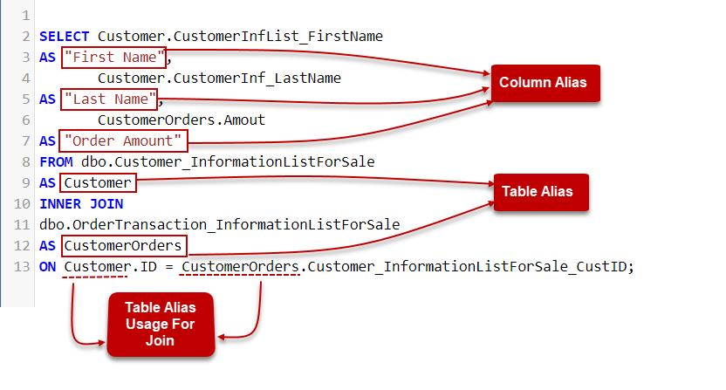
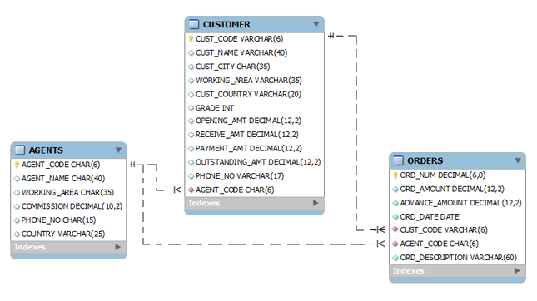
Databases
Structured Query Language, IBM, 1970s, used in database management

Slide 18
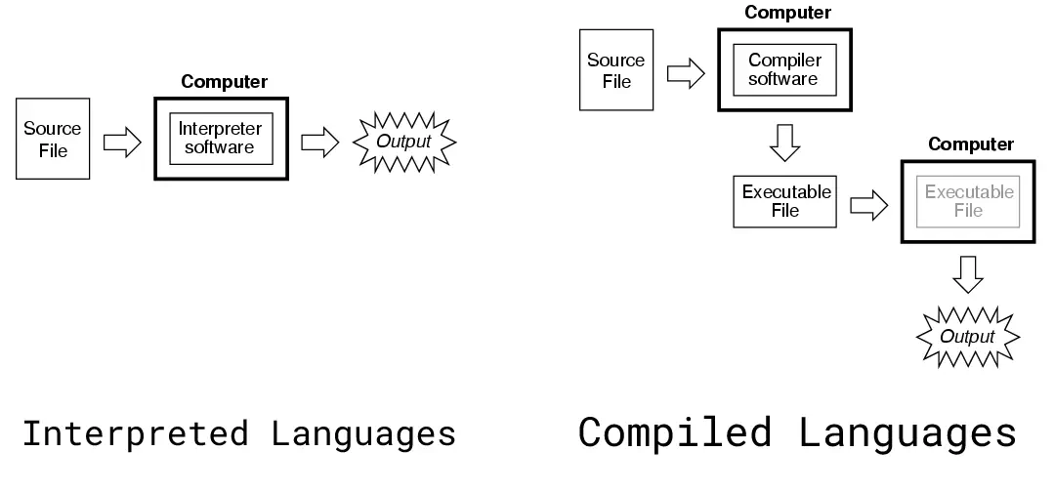
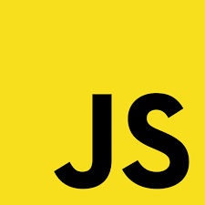
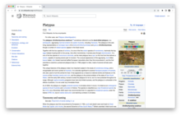
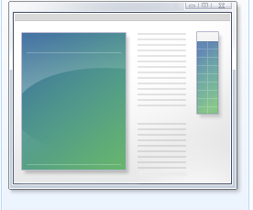
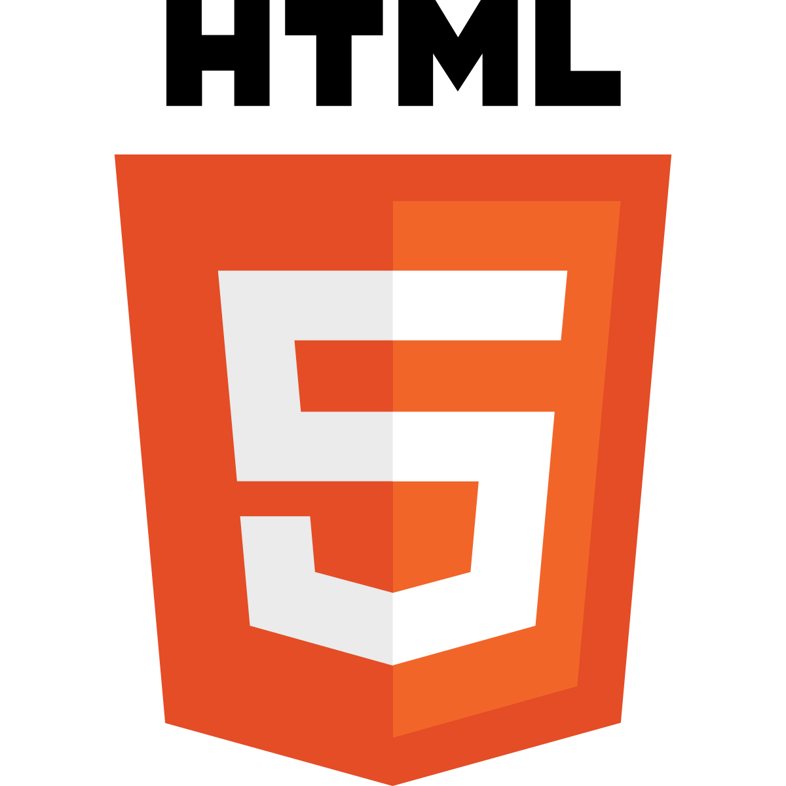
Compiled vs Interpreted Language

Slide 19
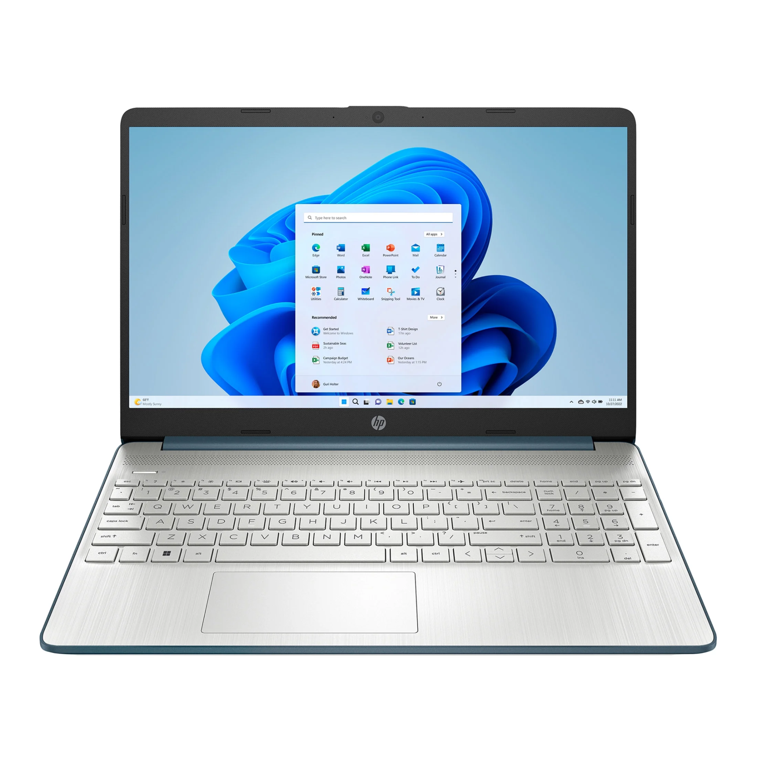
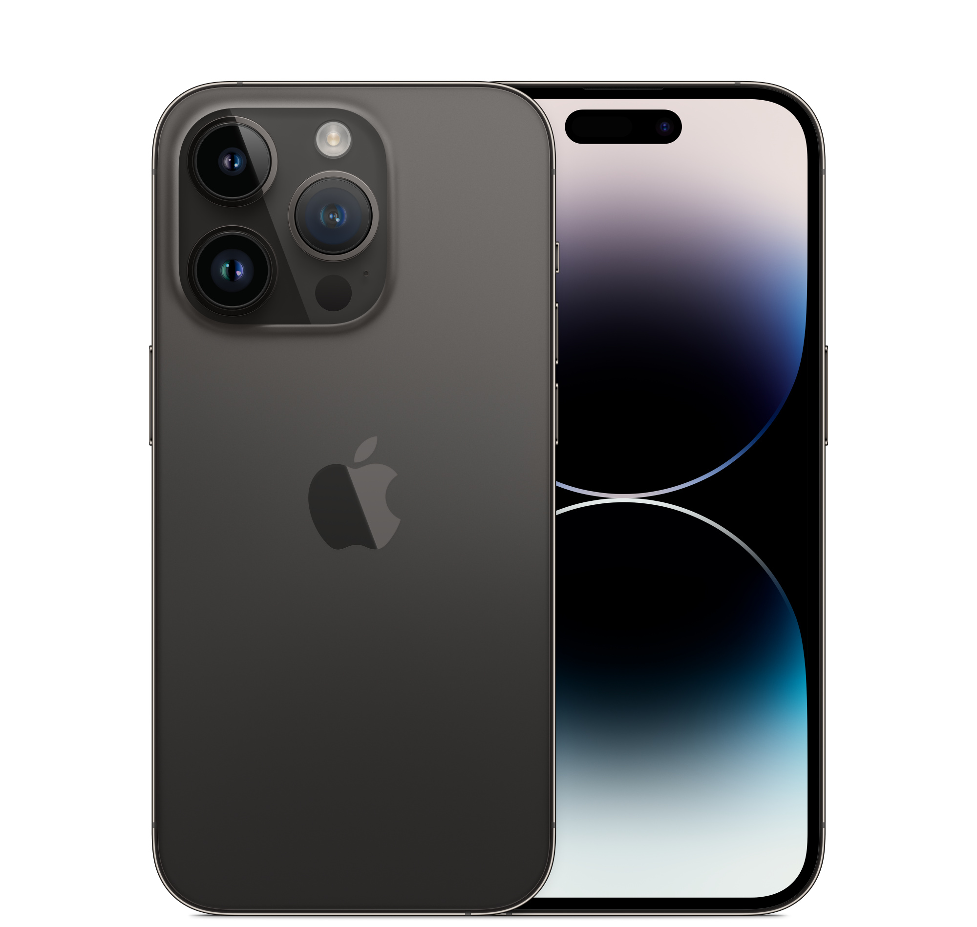
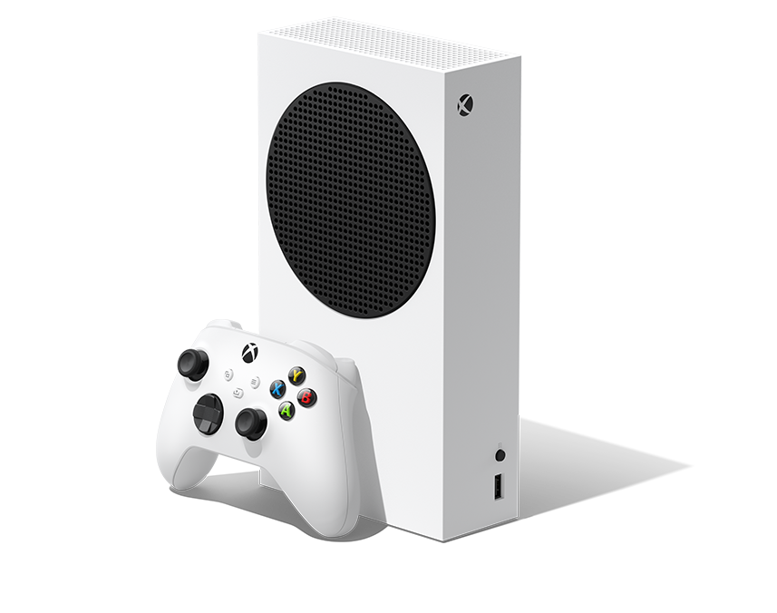
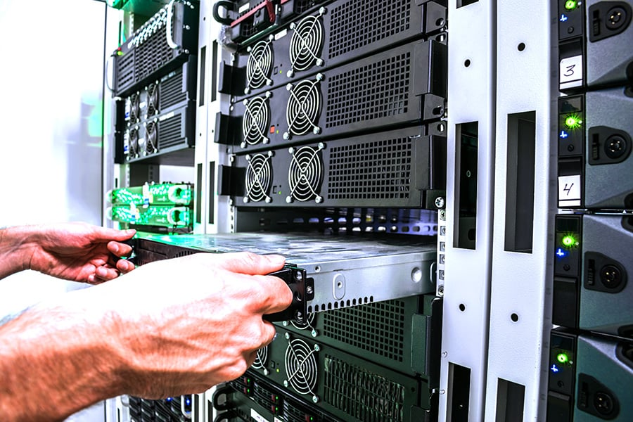
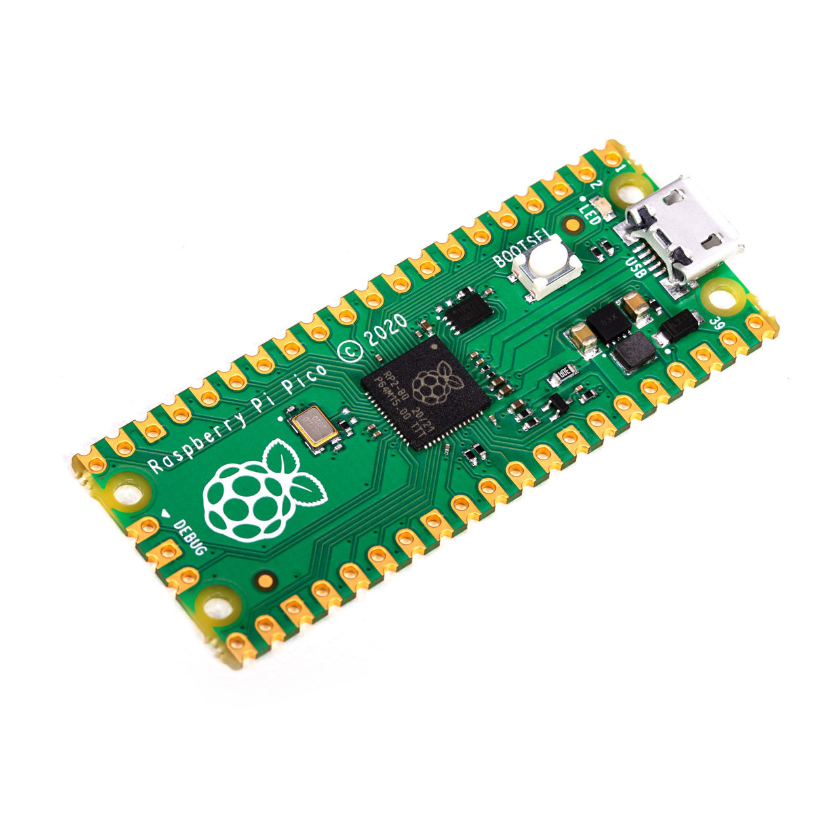
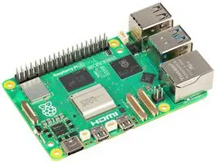
Computing Devices

Slide 20
Parts of a program
Create problem and idealized solution before hand: (like I need to create a tax software to calculate how much taxes to pay)
Think of specific tasks and algorithms
Write down what the program will do
Pseudocode
Diagrams

Slide 21
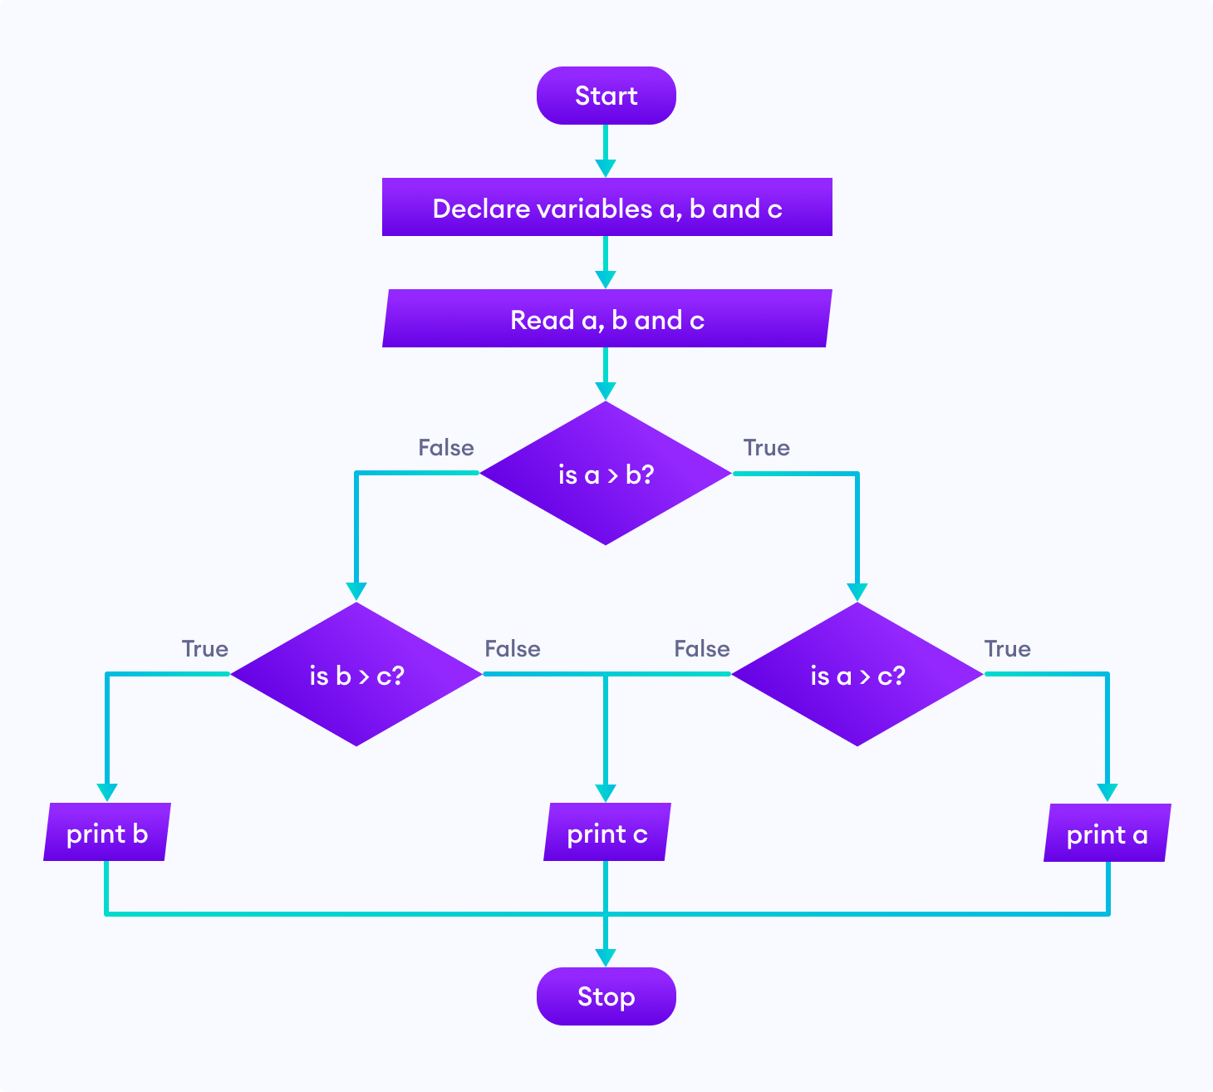

Slide 22
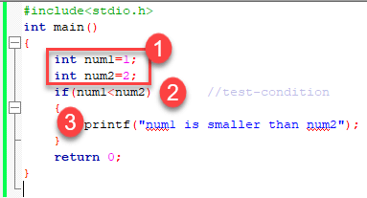
Parts of a program: program statement
Essential Elements of a Program - In Easy Steps

Slide 23
Parts of a program: variables

Slide 24
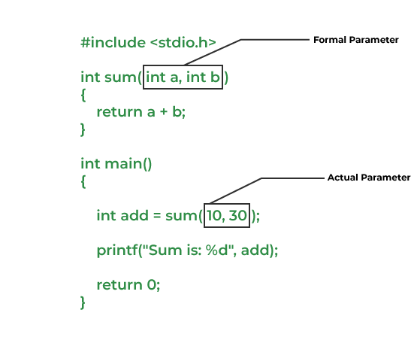
Parts of a program: functions

Slide 25
Parts of a program: operators

Slide 26
Parts of a program: conditionals

Slide 27
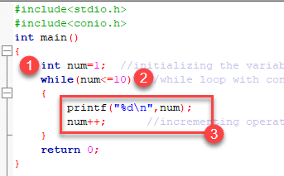
Parts of a program: loops

Slide 28
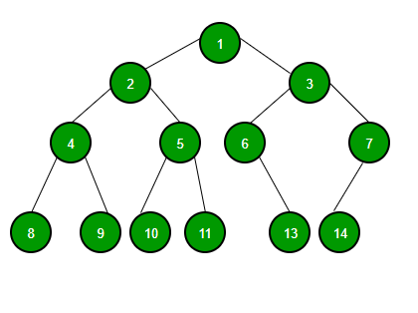
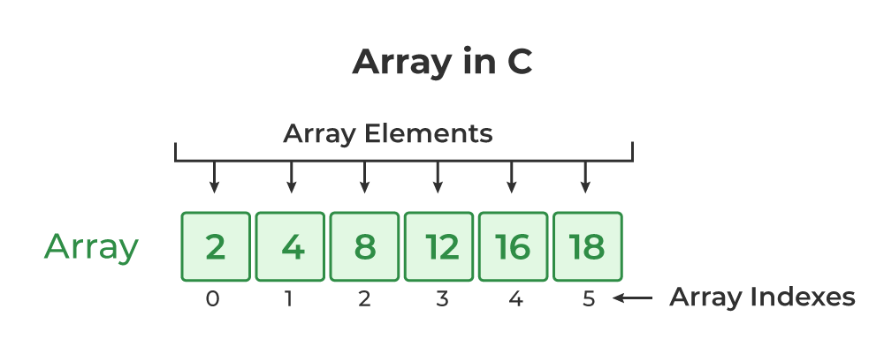
Parts of a program: Data Structures

Slide 31
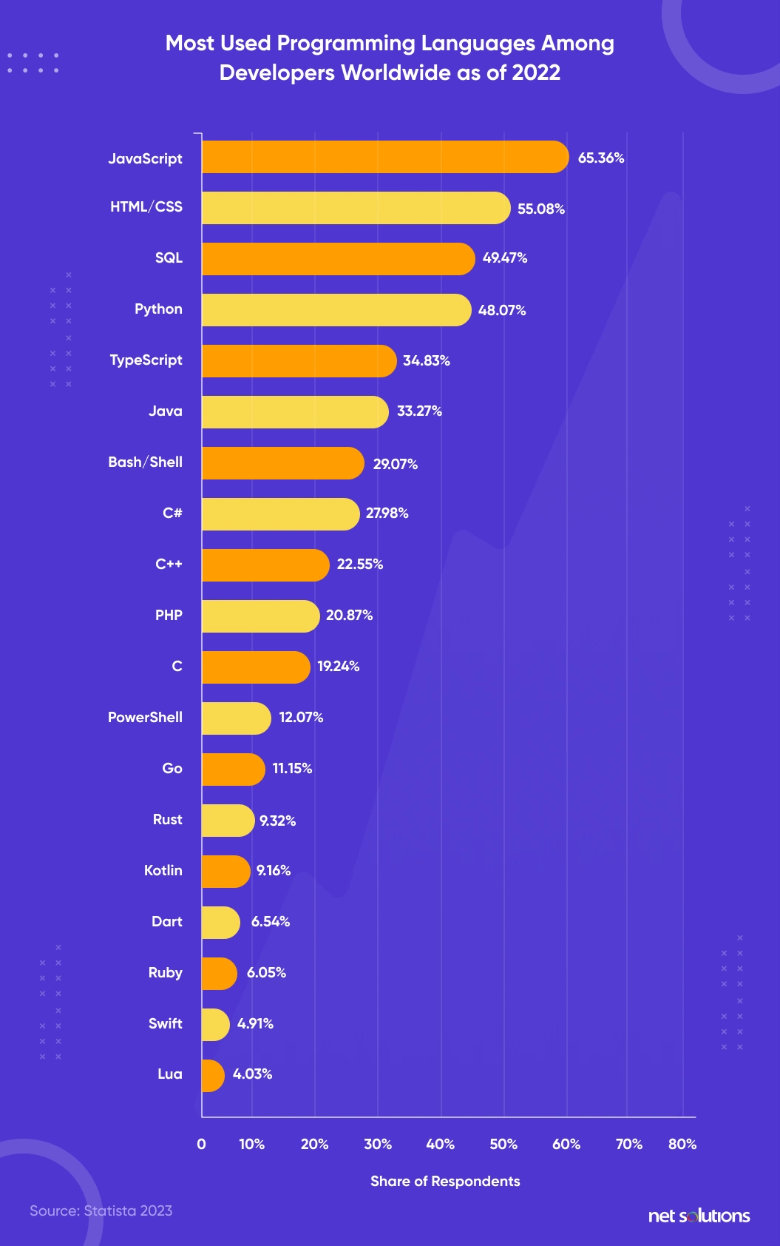
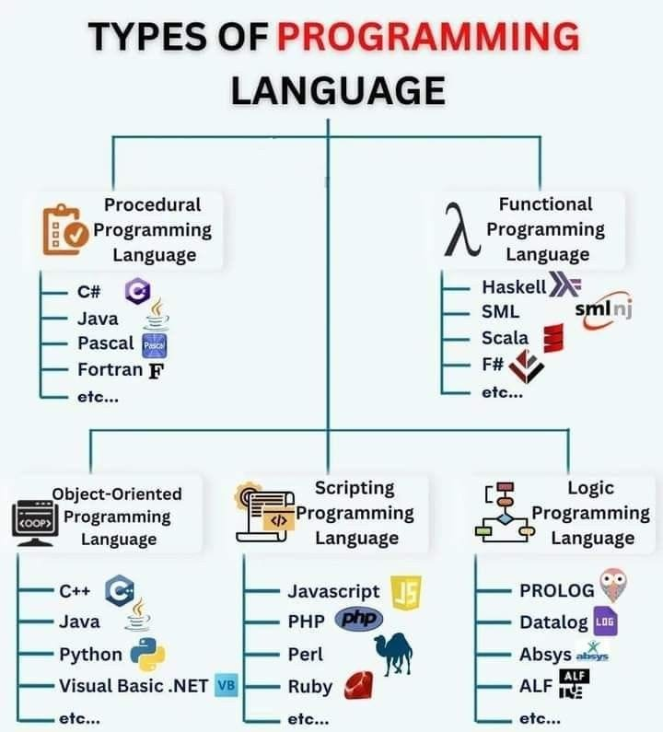
Programming Industry

Slide 32
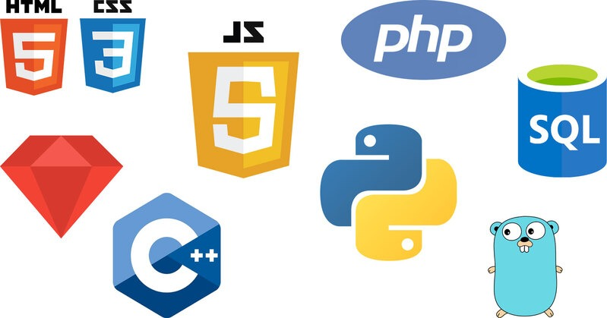
Web Development

Slide 33
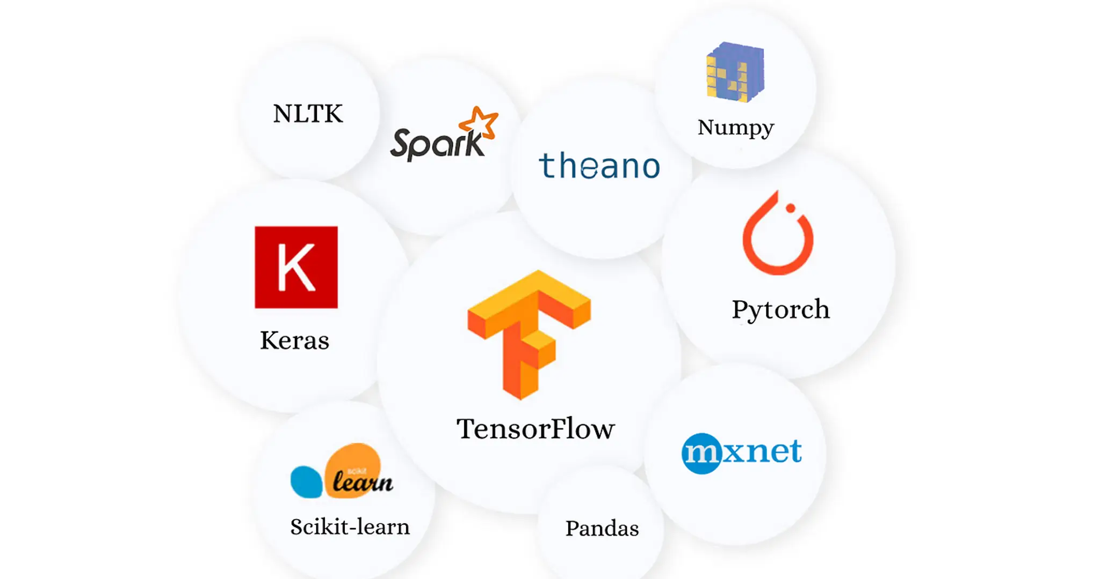
Machine Learning and Data Science

Slide 34
Systems Engineering

Slide 35
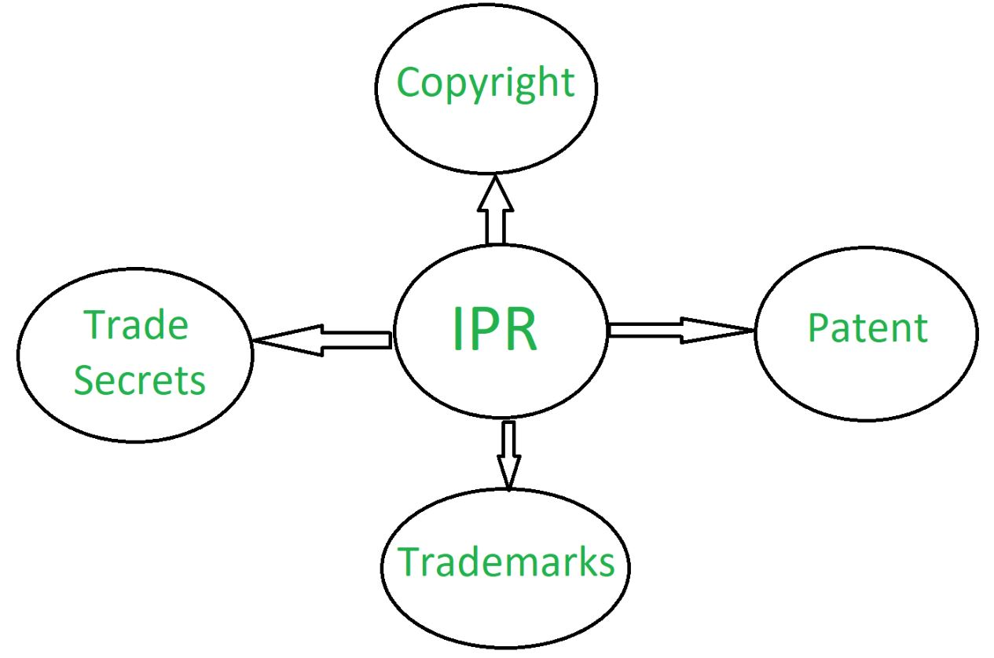
Intellectual Property

Slide 36
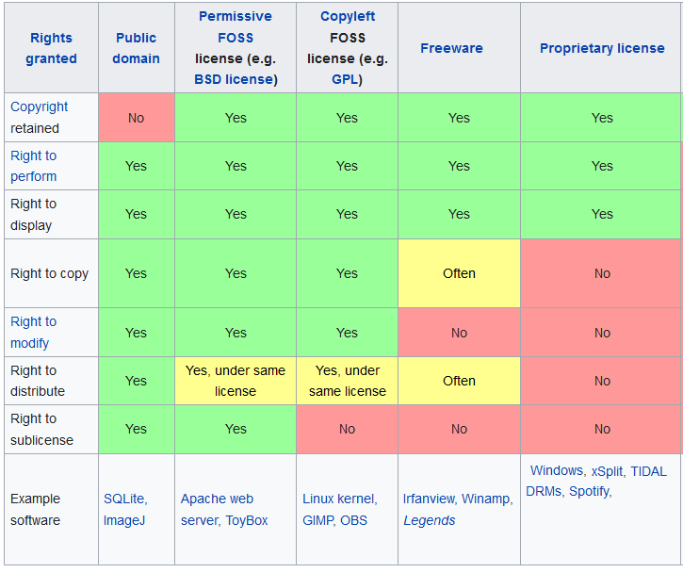
Licensing

Slide 37
Software Licensing

Slide 38
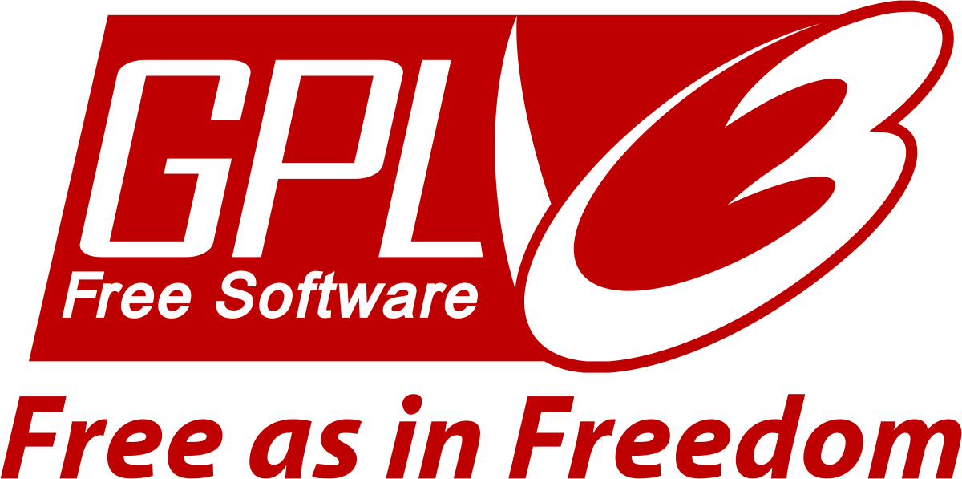
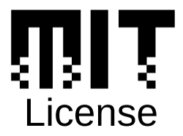
Opensource

Slide 39
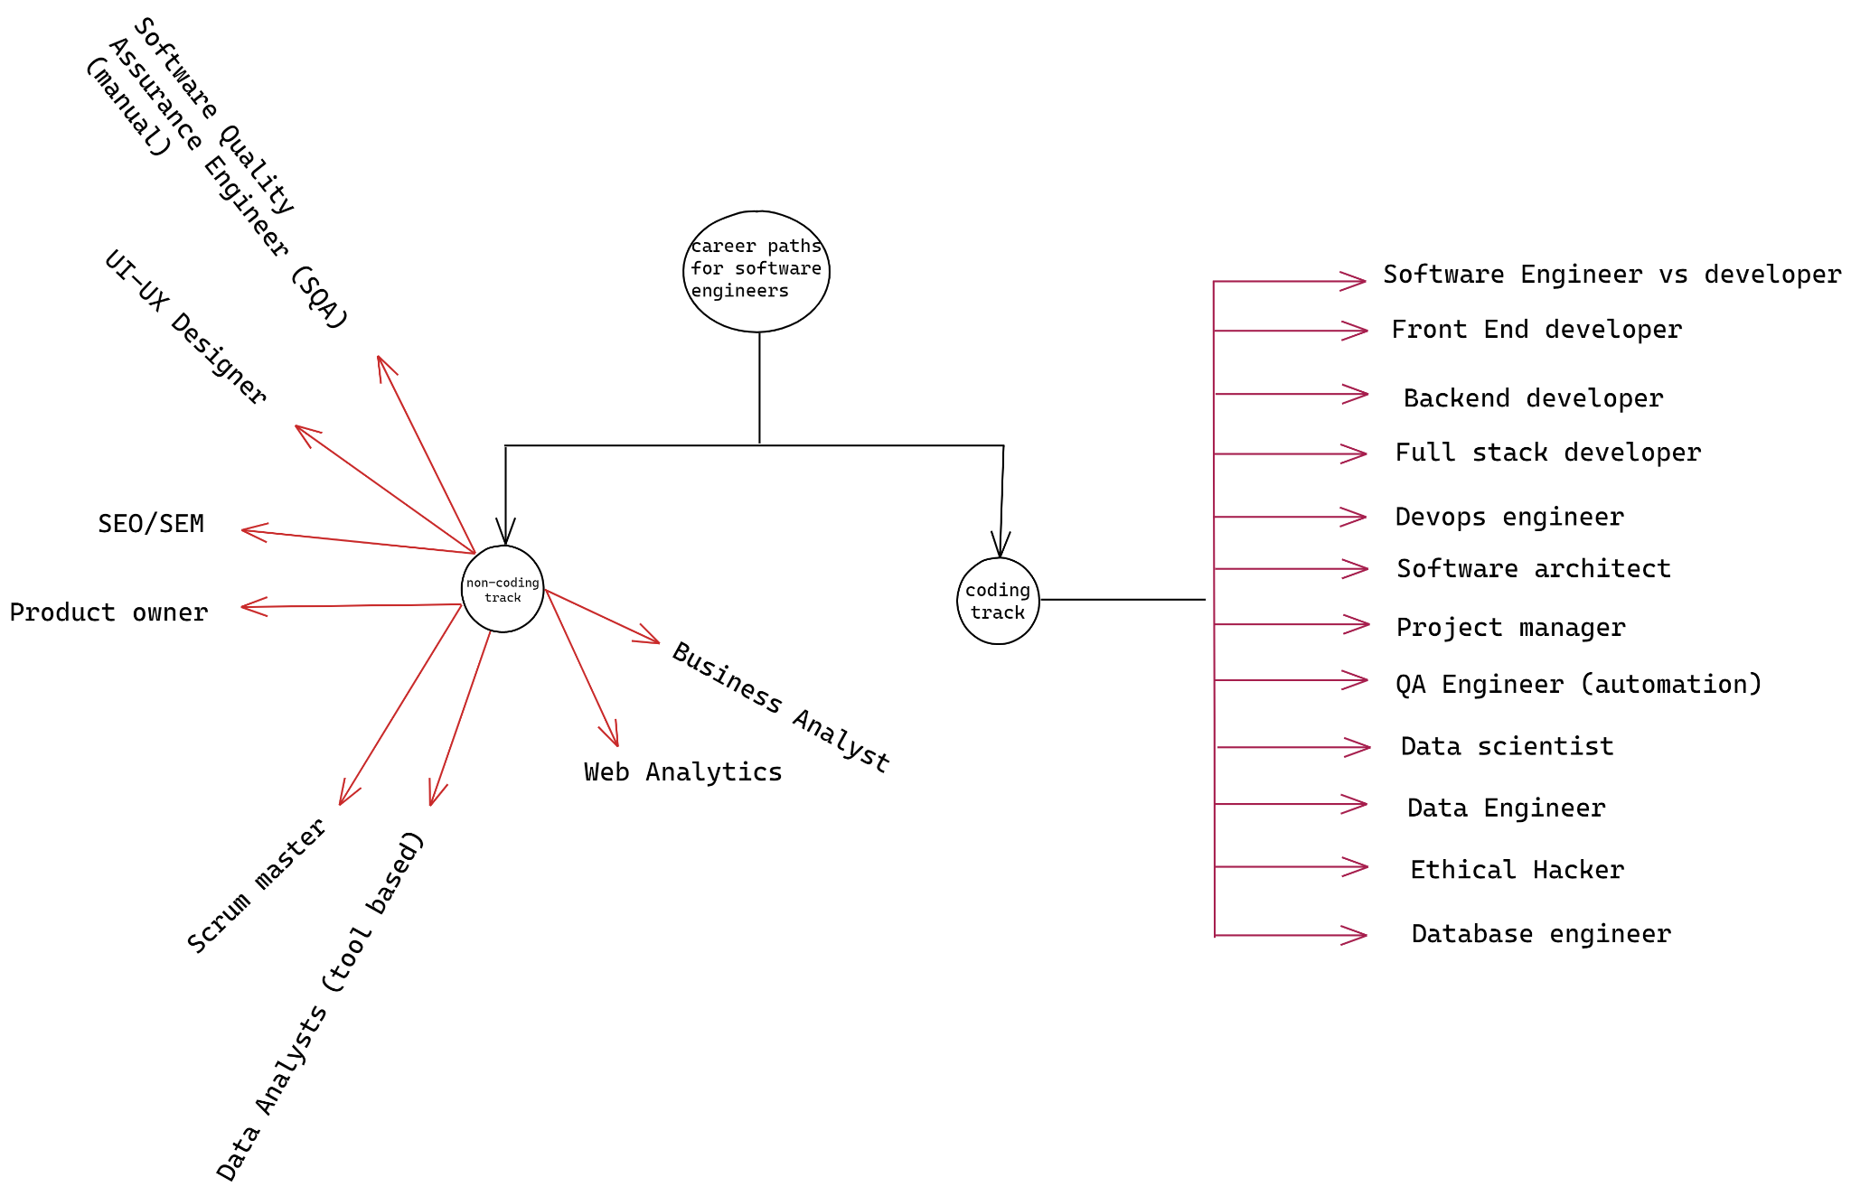
Careers

Slide 40
Weight Converter 5A example:
https://files.doggett.tech/Programming%20Merit%20Badge/Weight-Converter.html

